Slide 1
SSUSH17 Analyze the causes and consequences of the Great Depression. a. Describe the causes, including overproduction, underconsumption, and stock market speculation that led to the stock market crash of 1929 and the Great Depression. b. Explain factors (include over-farming and climate) that led to the Dust Bowl and the resulting movement and migration west. c. Explain the social and political impact of widespread unemployment that resulted in developments such as Hoovervilles.

Slide 2
Journal:
Imagine if everything you own was taken away from you over night and the same is true for your friends and everyone you know. What would you do?

Slide 3
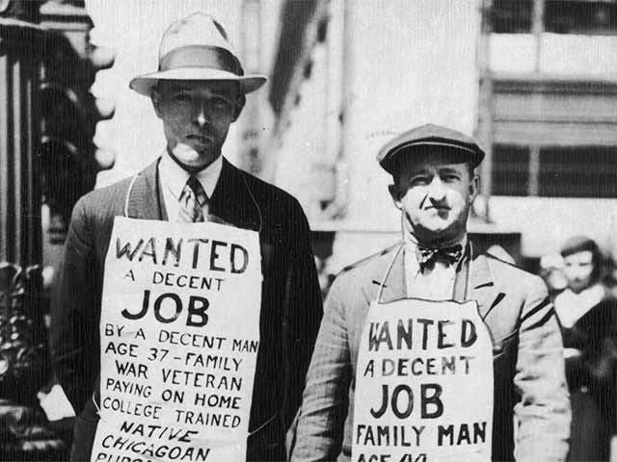
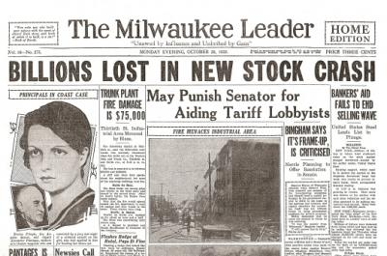
The Great Depression
During the 1920s, the wealthy grew wealthier due in large measure to government fiscal policies that both reduced business regulations and allowed the wealthy to keep more of their money.
These reduced regulations and low corporate taxes increased the profits of corporations and made their stocks more valuable.

Slide 4
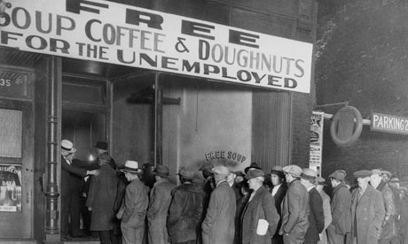
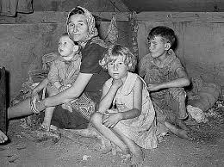
At the same time, the poor and working classes lost the ability to buy products because their wages stayed the same while prices rose.
This reduction in consumer consumption resulted in business overproduction and eventually caused business profits to decline.
These factors were an important cause of the Great Depression.

Slide 5
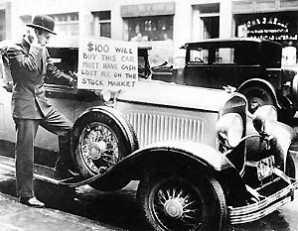
The Interactions of Business Overproduction and Consumer Underconsumption
New methods of buying products, including the installment plan and buying on credit, became popular during the 1920s. These methods encouraged consumers to buy more than they could afford and to go into debt.
Worst of all, banks loaned people money to buy stock with very little money down. The stocks themselves became the collateral for the loan. This was called buying on margin.

Slide 6
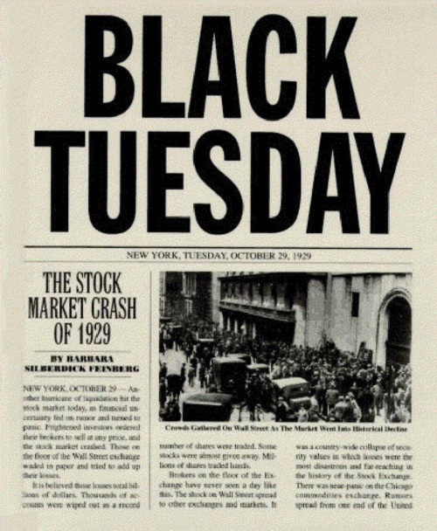
Stock market crash
Rising stock prices and the ability of ordinary people to buy stock on credit increased investment in the stock market and inflated the price of stocks above their actual value. Then, by October 1929, the U.S. economy was beginning to show signs of slowing down. Stockholders feared the economy was ending a period of prosperity and entering a period of recession.
This caused some investors to panic and sell their stocks. As more people sold their stock, other people panicked and sold their stock as well, driving down their prices and causing a stock market crash.

Slide 7
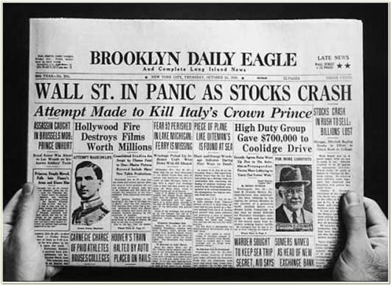
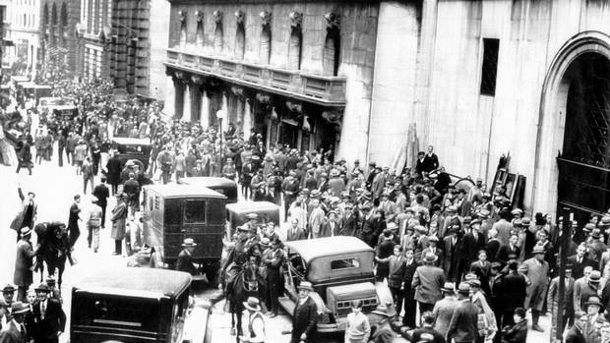
In turn, the stock market crash triggered other economic weaknesses and plunged the United States into the Great Depression––a severe economic recession in the 1930s that affected all the world’s industrialized nations and the countries that exported raw materials to them.
Industry, trade, construction, mining, logging, and farming decreased sharply. Business profits, tax revenues, and personal incomes did, too.

Slide 9
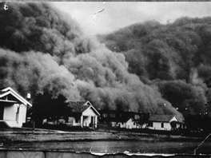
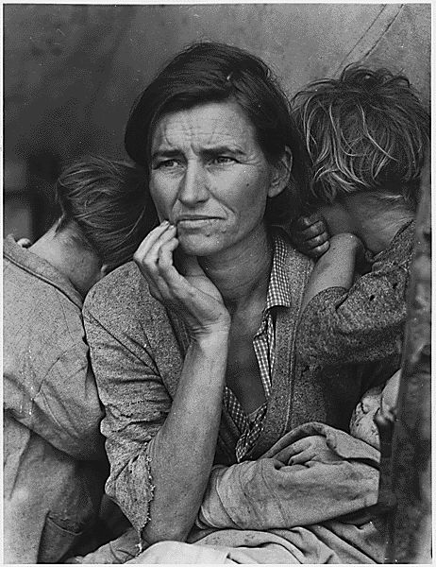
Dust Bowl
New machinery and improved farming techniques made American farmers very productive. By producing more food each year, farmers thought they could earn more money. Instead, this overproduction helped drive down the prices of their products and made it harder for them to make a profit.
In response, farmers tried producing even more food by taking out more loans to buy more land and farm equipment. As a result, most farmers were very vulnerable to economic and environmental disasters when banks started foreclosing on farms owned by farmers unable to repay their loans.
To make matters worse, the Great Plains states were experiencing a severe drought.

Slide 10
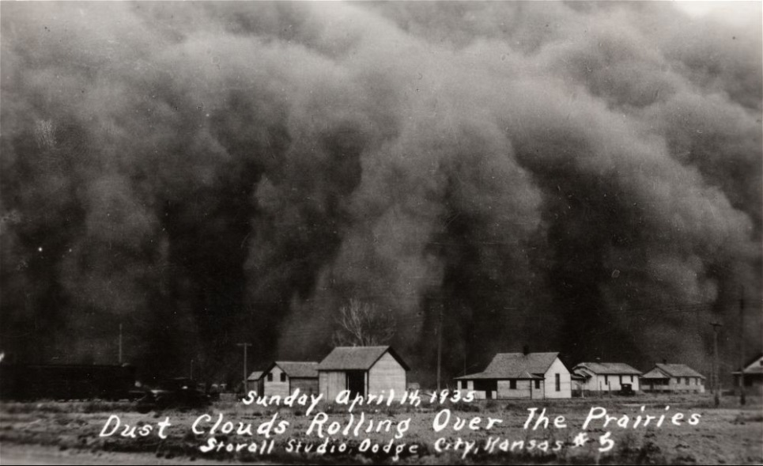
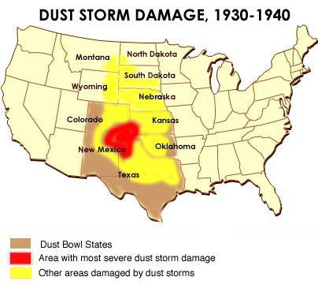
When a series of severe dust storms hit the prairies, they picked up the dirt loosened by the drought and the poor farming practices that had eroded the soil. This ecological disaster was called the Dust Bowl.
Dry conditions and high winds made farming impossible. Tenant farmers and sharecroppers were among the hardest hit as their landlords evicted them and sold the land. Over 500,000 Americans were left homeless. Many farmers from Oklahoma, Texas, and the surrounding Dust Bowl states migrated to California in search of work.

Slide 11
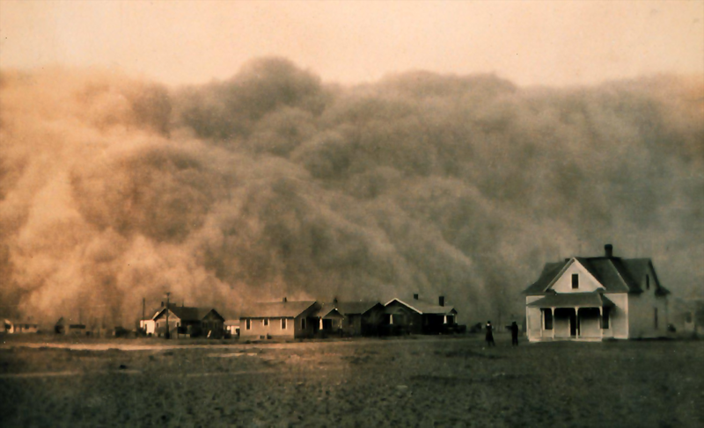

Slide 12
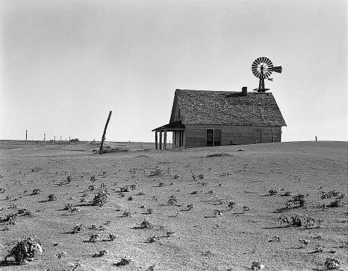
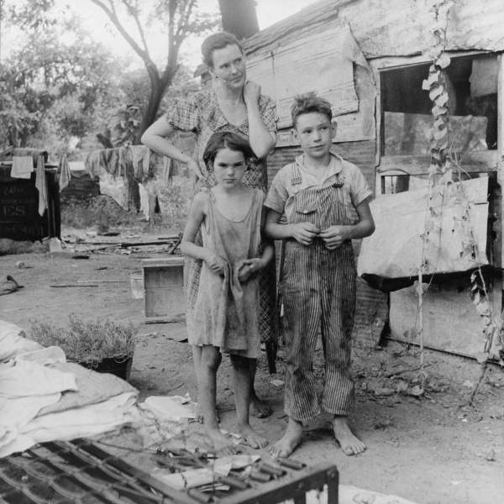
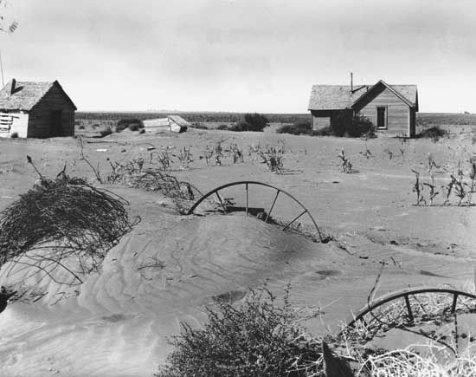
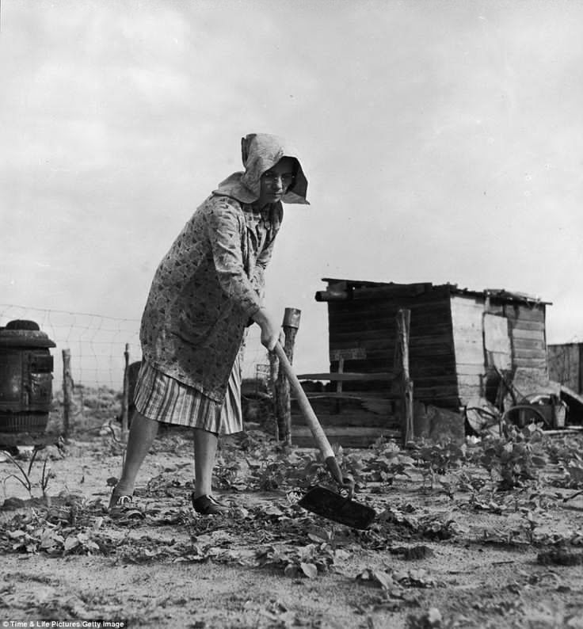

Slide 13
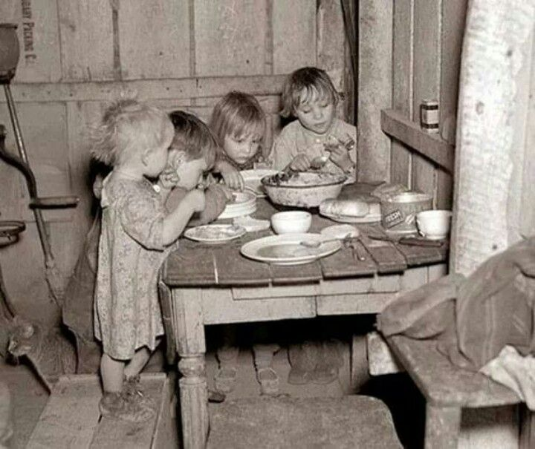
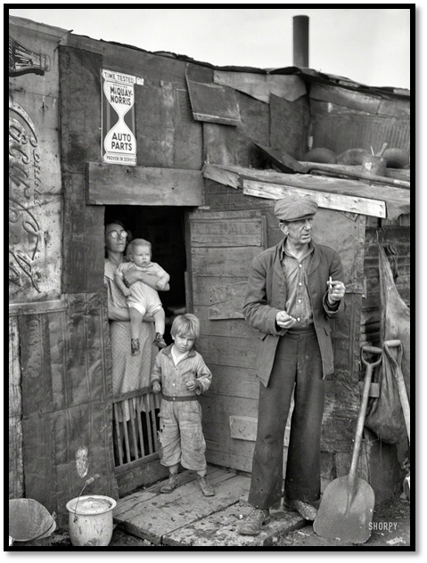
Widespread unemployment
As profits fell and it became clear consumers would need to reduce spending, workers began to lose their jobs.
By 1932, the unemployment rate in the United States had reached 25%. Unemployed workers who had no savings could not pay their debts, and many lost their homes.
Homeless and unemployed people settled in camps of shacks and tents in rundown areas. These camps became known as Hoovervilles, named after Herbert Hoover, the U.S. president when the Depression started. Hooverville residents slept in packing crates if they were lucky; if not, they slept on the ground. They begged for food from people who still had jobs and housing.

Slide 14
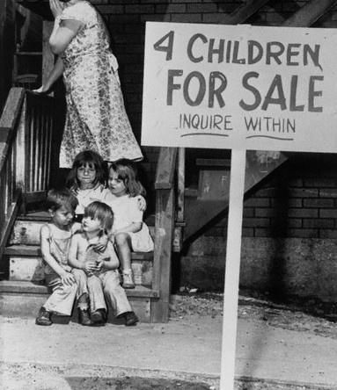
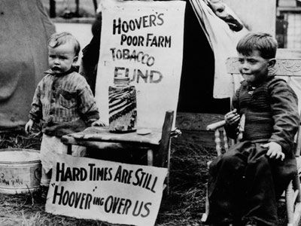
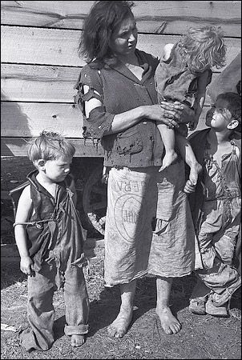
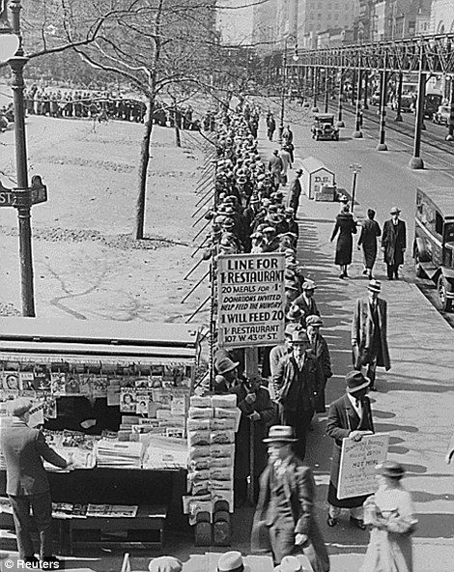
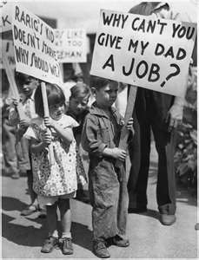

Slide 15
Students will create a chart divided into four sections explaining the causes of the Stock Market Crash 1929. Those causes of the crash will be presented with comments for each reason given for the crash.

Slide 17
Why did many families move north during the Great Migration?
How did unrestricted submarine warfare lead to WWI?
Explain an argument in favor of and against the 19th amendment.
Explain an argument in favor of and against the 18th amendment.
Why was the Espionage Act so controversial?
Why did the US want to stay neutral before WWI?
What legislation had been passed ensuring our neutrality before WWI?
In your opinion, should Eugene V. Debs have been arrested for violating the Espionage Act? Explain.

