Slide 1
SSUSH15 Analyze the origins and impact of U.S. involvement in World War I. a. Describe the movement from U.S. neutrality to engagement in World War I, including unrestricted submarine warfare and the Zimmerman Telegram. b. Explain the domestic impact of World War I, including the origins of the Great Migration, the Espionage Act, and socialist Eugene Debs. c. Explain Wilson’s Fourteen Points and the debate over U.S. entry into the League of Nations.

Slide 2
Use a textbook to define: neutral- Espionage Act (in index)- Eugene V. Debs-

Slide 3
Standard Breakdown

Slide 4
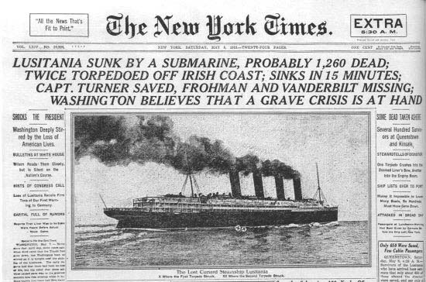
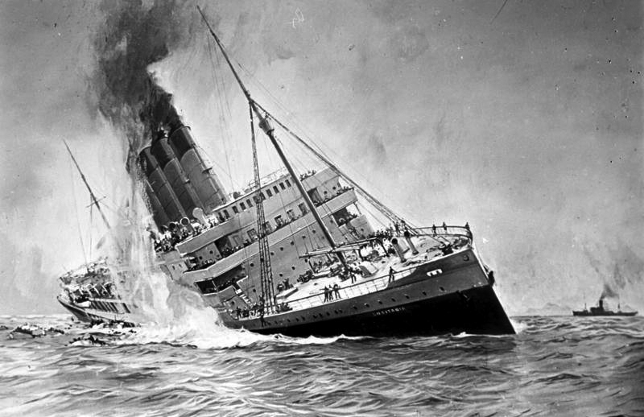
Origins of WWI
When World War I began in Europe in 1914, President Woodrow Wilson was determined to guarantee U.S. neutrality and to keep the United States out of the war.
But in 1915, the luxury liner Lusitania was sunk by a German submarine, killing most of the people onboard, including more than 100 U.S. citizens. This led to a crisis between the United States and Germany that was only resolved when Germany agreed to abandon unrestricted submarine warfare that endangered U.S. trade and American lives.

Slide 5
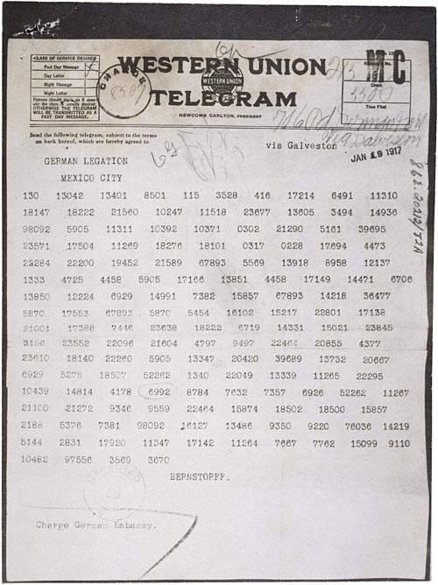
Zimmerman Telegram
The Zimmerman telegram was a top secret, coded message sent by German Foreign Minister Arthur Zimmerman to his country’s diplomatic delegation in Mexico in January 1917.
The communication was an attempt to draw Mexico into warfare should the United States join the Allies in Europe. The interception and de-coding of the Zimmermann Telegram revealed a promise to the Mexican Government that Germany would help Mexico recover the territory it had ceded to the USA (Texas, New Mexico, and Arizona) following the Mexican-American War.
The Zimmerman telegram was published in newspapers across the country and sparked nationwide outrage during WWI and helped to bring about American participation in the Great War.

Slide 6
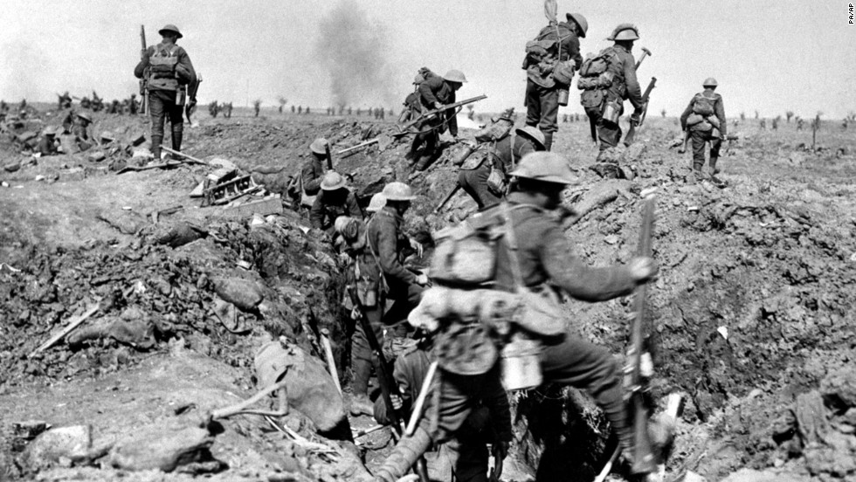
However, in 1917, Germany resumed unrestricted submarine warfare, creating great anti-German feelings among Americans. This heightened tension led to the United States’ decision to enter the war.
The Western front, which ran through Belgium and France, was a virtual stalemate since the early years of the war. A system of trenches had been dug by each side. Machine-gun nests, barbed wire, and mines blocked the opposing side from capturing the enemy trench. Each side would repeatedly send their soldiers "over the top" of the trenches into the no man's land of almost certain death with very little territorial gain. Now young American men would be sent to these killing fields.

Slide 7
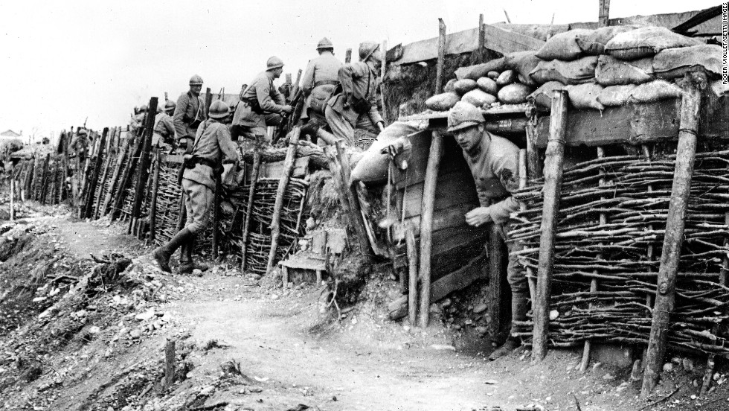
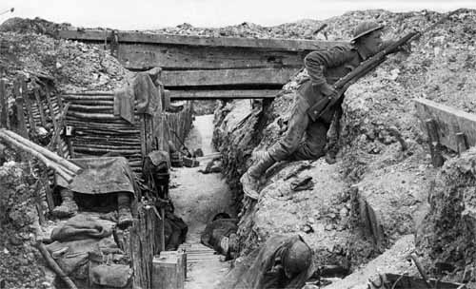
Americans in WWI
The first problem was raising the necessary number of troops. Recruitment was of course the preferred method, but the needed numbers could not be reached simply with volunteers. Conscription was unavoidable, and Congress passed the SELECTIVE SERVICE ACT in May 1917. All males between the ages of 21 and 30 were required to register for military service in the draft.
By the end of the war, over four and a half million American men, and 11,000 American women, served in the armed forces. 400,000 African Americans were called to active duty.

Slide 8
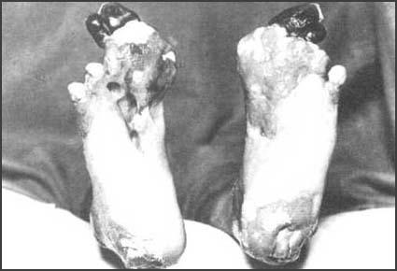
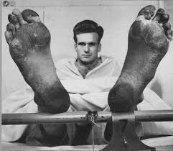
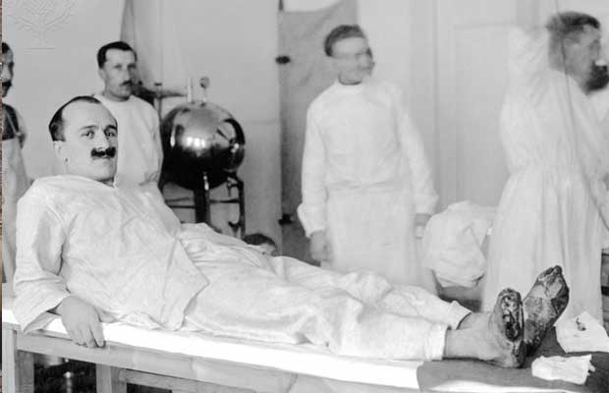
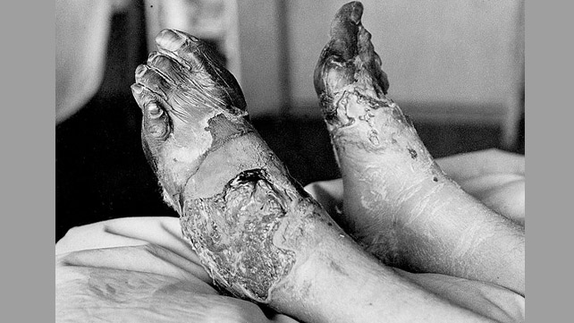

Slide 9
SSUSH15 Analyze the origins and impact of U.S. involvement in World War I. b. Explain the domestic impact of World War I, including the origins of the Great Migration, the Espionage Act, and socialist Eugene Debs. c. Explain Wilson’s Fourteen Points and the debate over U.S. entry into the League of Nations.

Slide 10
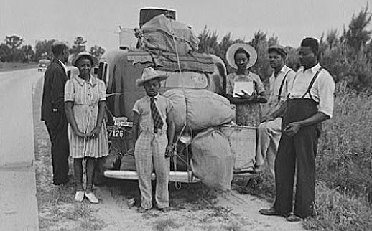
Impact of WWI
The war created jobs in northeastern and midwestern cities. African Americans, tired of living under the repression that was common in the South, moved to the North by the thousands and established themselves in ethnically distinct and culturally rich neighborhoods. This movement of African Americans was called the Great Migration.

Slide 11
WWI impact
During the war, laws were passed that prohibited people from speaking out against it. The Espionage Act of 1917 made it a crime to communicate any information that would interfere with U.S. military operations or aid its enemies. Wilson supported this law to silence critics and pacifists.
The Supreme Court handed down a landmark decision on this issue in the SCHENCK V. UNITED STATES verdict. The majority court opinion ruled that should an individual's free speech present a "clear and present danger" to others, the government could impose restrictions or penalties. Schenck was arrested for sabotaging the draft. The Court ruled that his behavior endangered thousands of American lives and upheld his jail sentence.
Socialist Party leader Eugene V. Debs was imprisoned for 10 years and ran for President from his jail cell in 1920. He polled nearly a million votes.

Slide 12
Close Reading
Read the article on the Lusitania
Use highlighters to highlight key ideas and main points
Circle any words you don’t know
Underline key vocabulary
Write questions, thoughts and predictions in the margins

Slide 13
Writing
Students will read a short article about the sinking of the Lusitania and the unrestricted use of submarine warfare.
Students will write a letter to a family member or friend from the perspective of a Lusitania survivor and include what they want the US government to do in response.
Describe the sinking of the ship, the experience of being rescued, your feelings about the attack and what you would want the government to do in response
This should be AT LEAST a full page

Slide 14
3rd block Warm Up:
What are the differences between Presidential and Radical Republican Reconstruction?

Slide 15
Students will write their own reconstruction plans. What would be your requirements for Southern states to come back into the Union? You must include requirements for Southern states to be readmitted to the Union and rights of freed slaves.

Slide 16
Closing
Make a prediction: how do you think WWI will end? What do you think will be in the peace treaty?

Slide 17
Warm Up
Answer: What do you remember about the temperance and women's suffrage movements? Make a list.

Slide 18
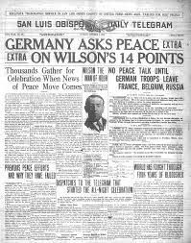
Wilson’s 14 Points
Before the United States entered the war, Wilson gave a speech in which he described Fourteen Points he felt were key to avoiding future wars.
One point called for the creation of an international peacekeeping organization called the League of Nations. During the postwar treaty negotiations, Wilson worked hard to get as many as possible of his Fourteen Points included in the treaty and succeeded in securing the creation of the League of Nations. However, American opposition to the League of Nations ultimately led the Senate to refuse to ratify the treaty.

Slide 19
League Of Nations
Isolationists in the Senate believed that by joining the League the United States would become involved in future conflicts in Europe and elsewhere. Though Wilson traveled across America to create public support for the treaty’s ratification, the Senate eventually rejected it.
The United States never joined the League of Nations.

