Slide 1
Unit 1
Write down your essential question
You have a quiz TOMORROW (8/12)! Review your notes and let me know what I need to review with you.
Middle Passage

Slide 2
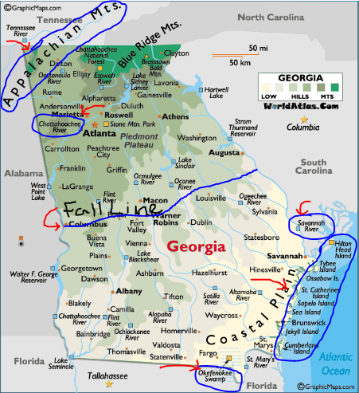

Slide 3
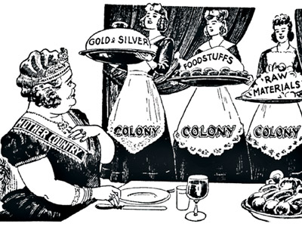
What is mercantilism?
This theory held that Earth had a limited supply of wealth in the form of natural resources, especially gold and silver, so the best way to become a stronger nation was to acquire the most wealth.
Because the world’s wealth was thought to be limited, the more one country had, the less any other country could have. Consequently, as a nation became stronger and wealthier, its enemies became poorer and weaker.

Slide 4
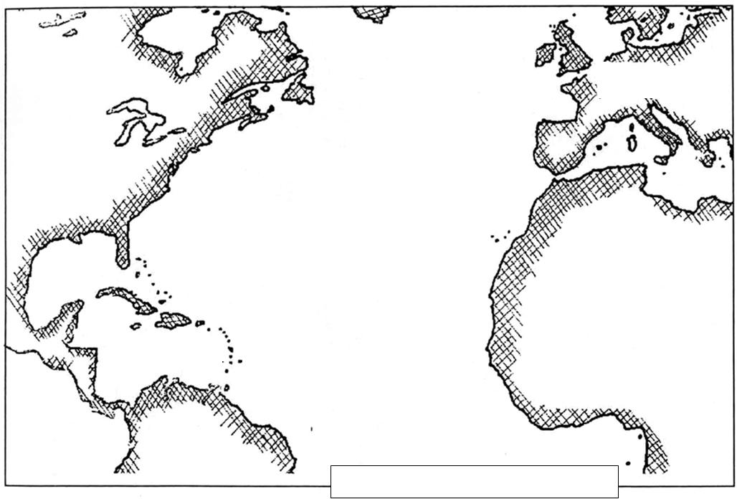

Slide 5
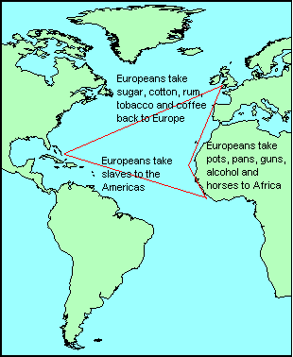
Trans-Atlantic Trade
First, British ships loaded with rum, cloth, and other English goods sailed to Africa, where they were traded for Africans originally enslaved by other Africans.
Then, in the Middle Passage, the slaves would be transported to the New World. The crew would buy tobacco and other American goods using profits they made from selling the slaves in the colonies, and ship the tobacco and goods back to Britain.

Slide 6
Slavery Grows
Cash Crops become big business in the South
– Tobacco, Rice, Indigo
Plantations develop across the south
Slaves in the south became the most "economical" means of labor
• 1690: 13,000 African slaves
• 1750: 200,000 Black slaves

Slide 7
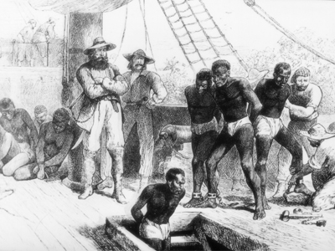
Middle Passage
The sea voyage that carried Africans to North America was called the Middle Passage because it was the middle portion of a three-way voyage made by the slave ships.
It was said that people in the colonial port cities could smell the slave ships arriving before they could see them. The slaves were packed like bundles of firewood. About two of every ten slaves died during the passage.

Slide 8
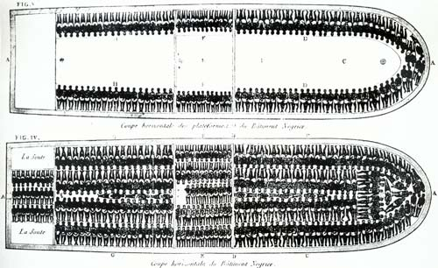
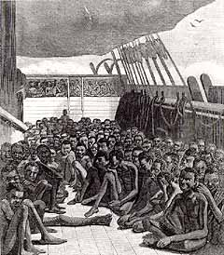
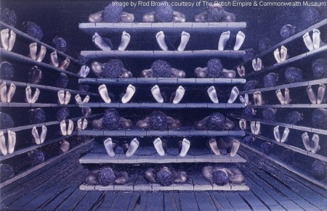
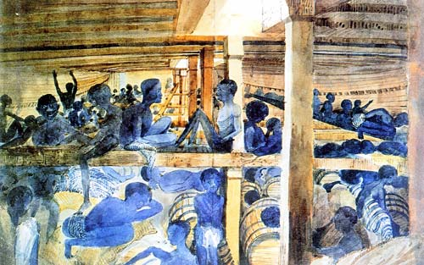

Slide 9
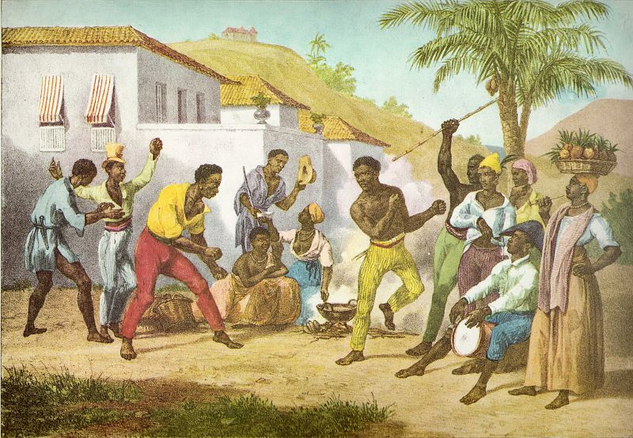
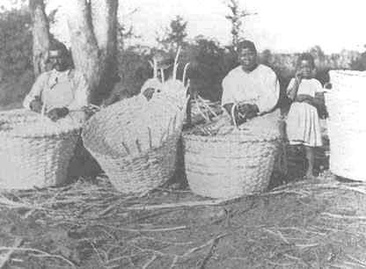
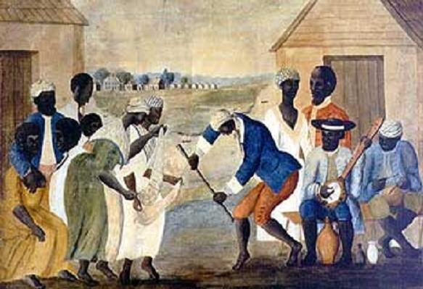
Slave Culture
In America, slaves attempted to “make the best” of their lives while living under the worst of circumstances.
Slave communities were rich with music, dance, basket weaving, and pottery making. Enslaved Africans brought with them the arts and crafts skills of their various tribes.
There could be a hundred slaves working on one farm and each slave might come from a different tribe and a different part of Africa.

Slide 10
Ticket out the door
1. What is mercantilism?
2. Why was the journey from Africa to the Americas called the Middle Passage?

