Slide 1
Unit 1
Check task board. You have new groups. YOU MUST SIT WITH YOUR ASSIGNED GROUP! I will be checking!
Benjamin Franklin and the Great Awakening
Use the next 10 minutes to study SILENTLY for your quiz. Be respectful of those around you trying to study!!!

Slide 2
Peer Grade
Number Missed | Grade
1 | 91
2 | 82
3 | 73
4 | 64
5 | 55
6 | 46
7 | 37
8 | 29
9 | 20

Slide 3
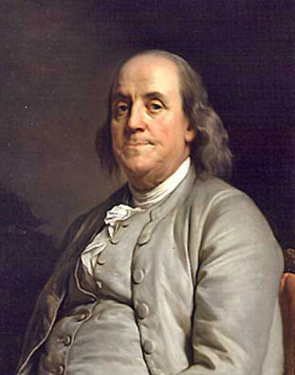
Early Life
He attended grammar school at age eight, but was put to work at ten.
Apprenticed as a printer to his brother James, who printed the New England Courant, at age twelve, and published his first article there, anonymously, in 1721.
Young Benjamin was an avid reader, inquisitive and skeptical. Through his satirical articles, he poked fun at the people of Boston and soon wore out his welcome, both with his brother and with the city.
Ran away to New York and then on to Philadelphia at the age of 16, looking for work as a printer. He managed a commission to Europe for the purpose of buying supplies to establish a new printing house in Philadelphia, but found himself abandoned when he stepped off ship.

Slide 4
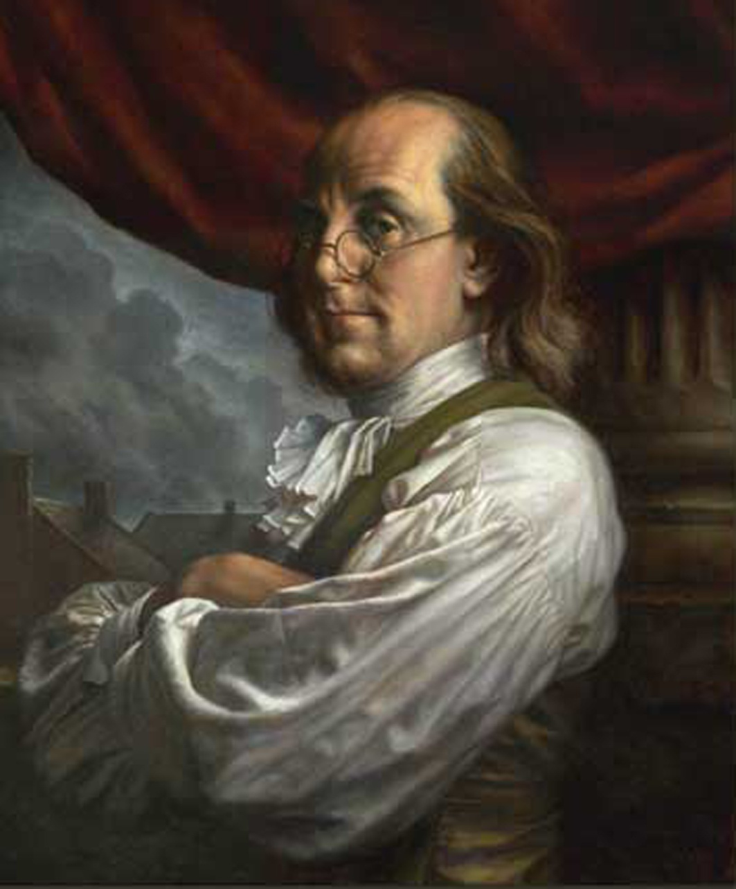
Rise to Fame
Came back to Philadelphia in 1732 and set up shop as a printer. He was appointed clerk of the Pennsylvania Assembly in 1736, and as Postmaster the following year.
In 1741 he began publishing Poor Richard's Almanac, a very popular and influential magazine.
Elected to the Pennsylvania Assembly in 1751 and served as an agent for Pennsylvania (and ultimately for three other colonies) to England, France, and several other European powers.
He was elected to the Continental Congress in 1775, where he played a crucial role in the rebellion against Gr. Britain, including service to Jefferson in editing the Declaration of Independence.

Slide 5
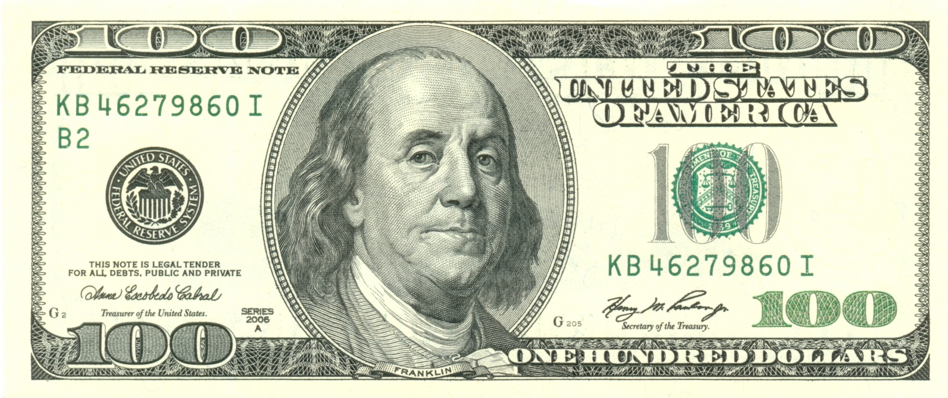
Later Life
Franklin, who was by this time wealthy, retired from publishing, continued to serve an important role in the gov
He was the United States first Postmaster General, Minister to the French Court, Treaty agent and signer to the peace with Gr. Britain & Member of the Constitutional convention
Involved with writing the Articles of Confederation, Dec of Independence, Treaty of Paris and US Constitution
was one of the earliest advocates for the abolition of slavery, and for the protection of the rights of Native Americans

Slide 6
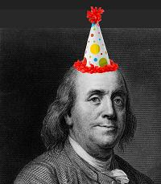
Benny Franklin Fun Facts
Established the colonies' first circulation library for all interested citizens. The Library Company of Philadelphia, housed not only books but also specimens of natural history and scientific apparatus like stuffed snakes, a dead pelican, and a collection of fossils.
He had LOTS of pen names:
Richard Saunders, Silence Dogood, Anthony Afterwit, Polly Baker, Alice Addertongue, Caelia Shortface, Martha Careful, Busy Body, and Benevolous
Inventions
Bifocals
Electricity?
Lightning Rod
Urinary catheter
Franklin Stove
Map of the Gulf Stream
Flippers for Swimming
Glass harmonica
Daylight savings time

Slide 7
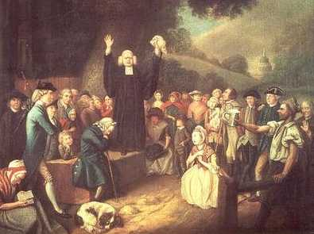
The Great Awakening
Religious revival in the colonies during the 1730's-1740's
preachers traveled encouraging people to rededicate their lives to God and act like it daily
organized Christianity in the colonies grows
Baptist and Methodist churches grow tremendously
Schools also saw greater enrollment because education was essential to studying and understanding the Bible

Slide 8
Example of Social Mobility | Example of Individualism

