Slide 1
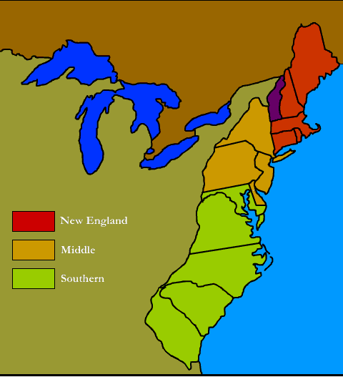
Unit 1
Journal:
Which colony would you want to live in and why? Consider location, culture, economics and specific issues for those colonies.

Slide 2
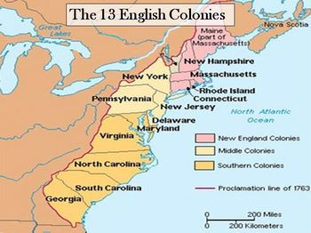
13 Original Colonies

Slide 3
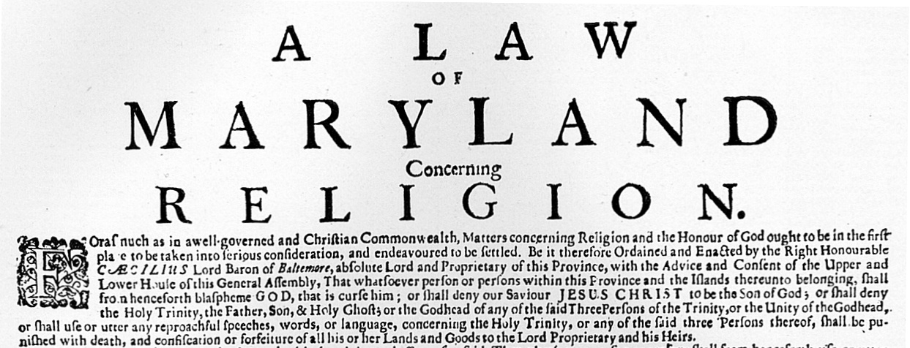
Maryland
The creation of Maryland started in 1632 when King Charles I gave land to Cecilius Calvert, also known as Lord Baltimore. Lord Baltimore wanted Maryland to be a safe refuge for Catholics. In 1649, The Toleration Act was passed. This was the first law in America that said that all Christians were free to worship in their own ways.

Slide 4
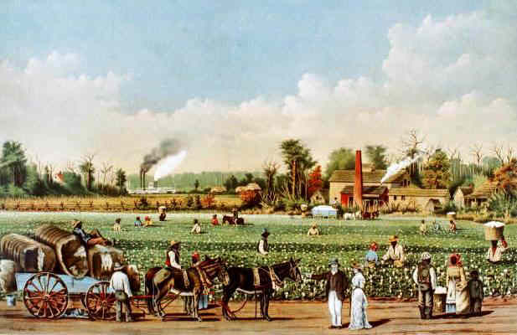
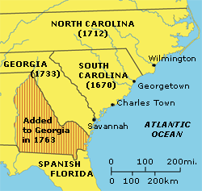
North and South Carolina
Later, King Charles II started Carolina in 1663. He did this to keep the French and Spanish away. In 1729 though, Carolina split into North Carolina and South. The Northern part had very few harbors, no rich soil, and spoiled land.
However, the southern part had excellent farmland, rich soil, and plenty of harbors. It grew much faster than the northern part. Because of its differences, Carolina became two separate colonies, North Carolina and South Carolina.

Slide 5
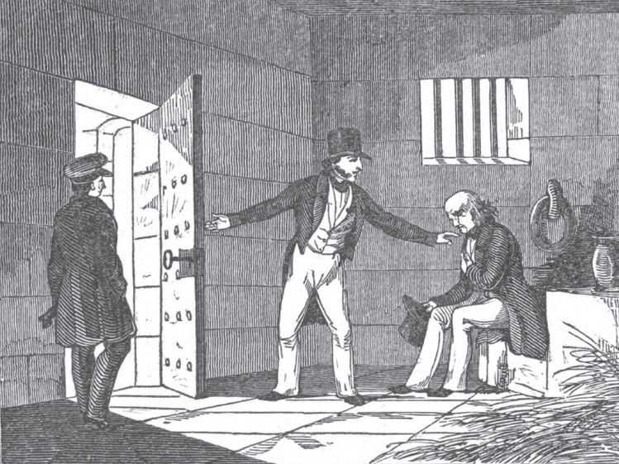
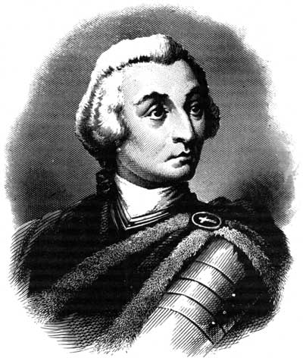
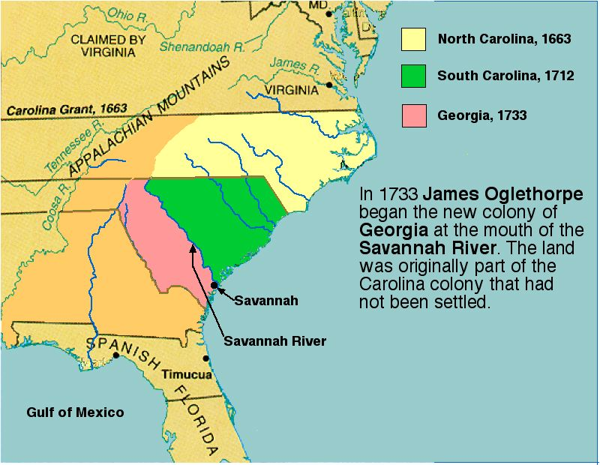
Georgia
In 1732, the colony of Georgia was started when King George II gave land to James Oglethorpe. Georgia was named after King George II.
Oglethorpe wanted Georgia to be a to be a place where debtors and poor people could start new lives. The colonists would not elect a legislature.
At first, slavery wasn’t allowed. However, when people voted, the majority said that they wanted slavery to become legal.

Slide 6
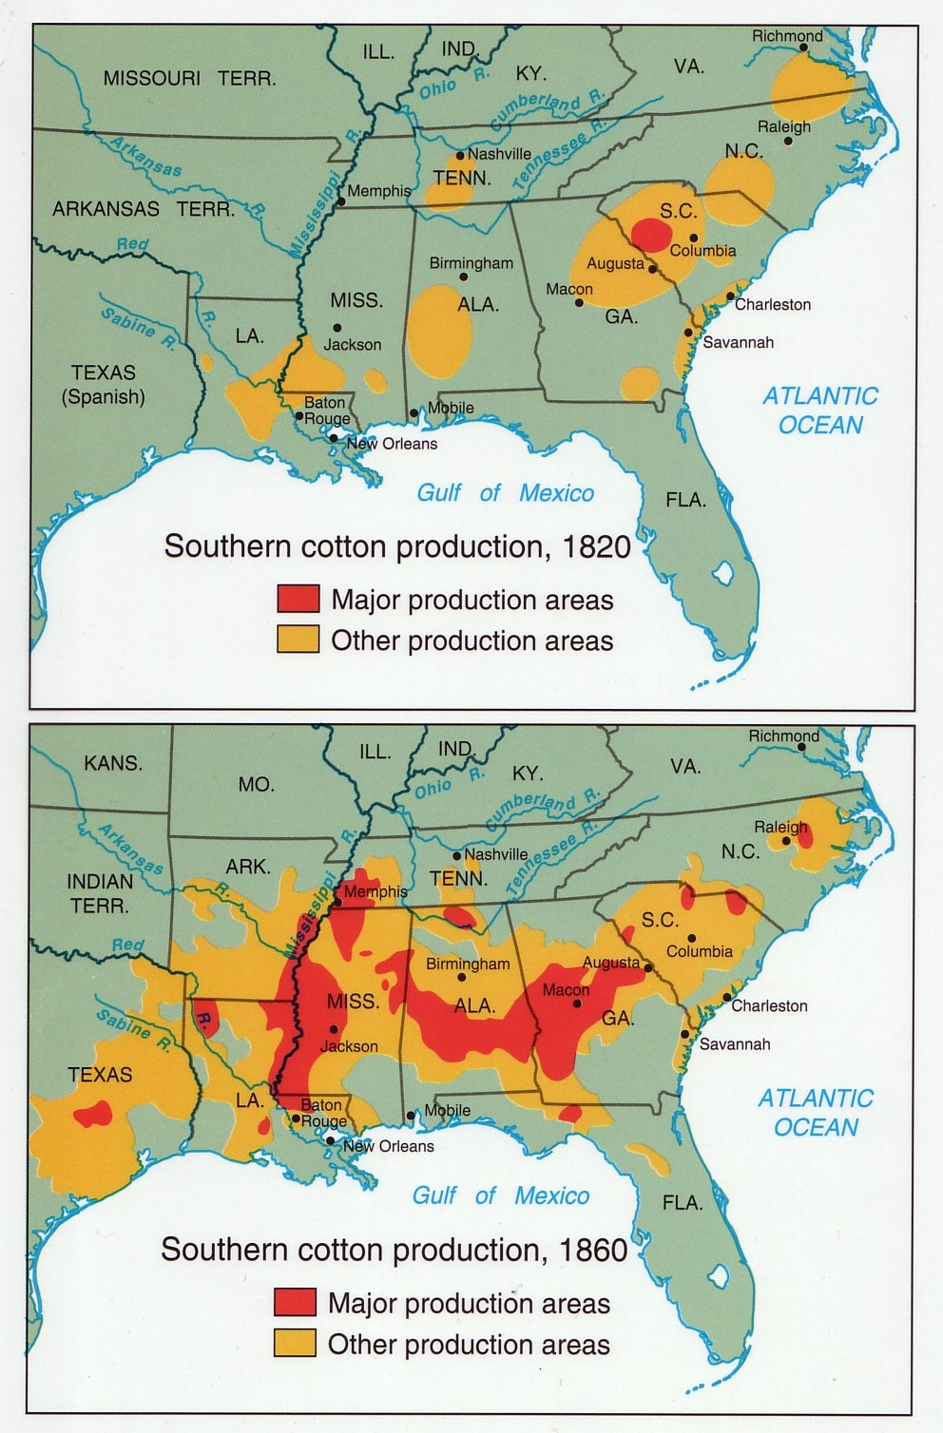
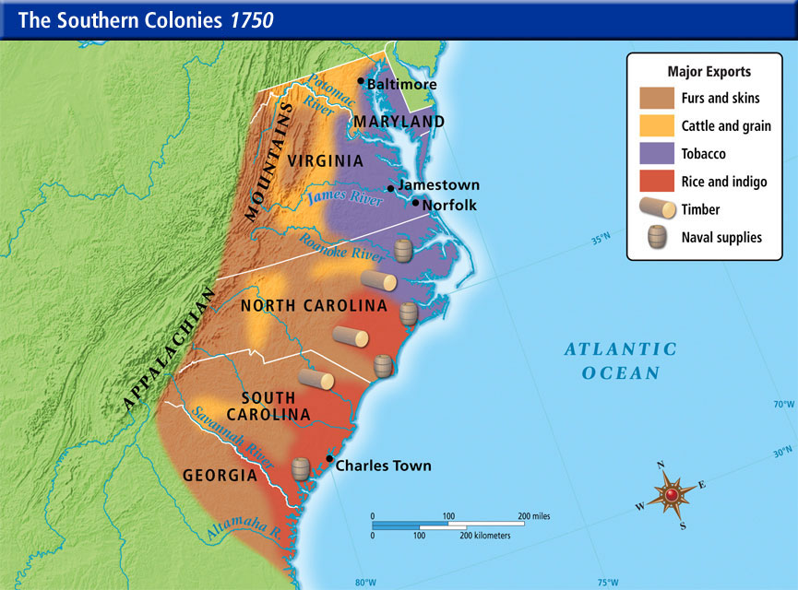
Agriculture
The Southern Colonies had warm and damp climate, which meant growing plants was easy.
Virginia and Maryland’s major cash crop was tobacco. North Carolina’s main cash crop was pine forests.
South Carolina and Georgia’s main cash crops were rice and indigo. Rice grew in the hot, wet tidewater region. Indigo was a plant that can be turned into a blue dye. Georgia also grew cotton, which was useful for weaving.

