Slide 1
Unit 1
New Amsterdam, Quebec, and Pennsylvania
Virginia colony survived largely because the English
colonists
A. were well cared for by the Virginia Company.
B .developed lasting friendships with Native Americans.
C. worked cooperatively for the good of the colony.
D. began growing tobacco for sale.
Puritans migrated to New England to
A. escape religious persecution.
B. establish Catholic missions.
C. maintain the practices of the Anglican Church.
D. start tobacco plantations.
Warrior Word: exemplary (ex-em-pla-ry) (adjective) outstanding, and example to others

Slide 2
Warm Up
Students will write up a newspaper article as though they had witnessed the Salem Witch Trials. They will describe the events as well as make predictions about how this will effect the Puritan society in the future.
Article should be at least 2 full paragraphs and provide an accurate and detailed description. THIS IS FOR A GRADE.

Slide 3
Warm Up- Course Pretest
Clear off your desk.
Move all bags to the front of the room.
Make sure you have a sharpened pencil. If you don’t have one, I have some up front near the pencil sharpener.

Slide 4
2nd Block New Groups
1: J. Hart, T. Eady, A. Dupont
2: V. Carswell, D. Hodges, B. Mays
3: A. Yates, S. Malone, J. Myrick
4: A. Grimes, K. Chambless, D. Lewis
5: D. Yorker, T. Bowles, A. Lowe
6: A. Motes, J. Davis, T. Kent, C. Williams

Slide 5
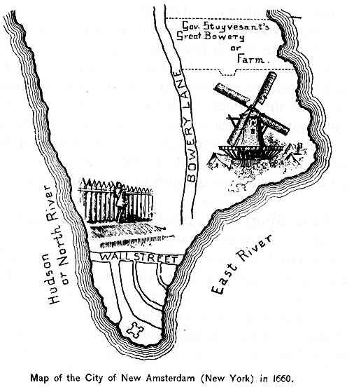
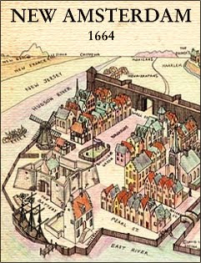
New Amsterdam
Sponsored by the West India Company, 30 families arrived in North America in 1624, establishing a settlement on present-day Manhattan. Dutch settlers did not take much of an interest in agriculture and focused on the more lucrative fur trade.
In 1626, General Peter Minuit arrived in Manhattan, charged by the West India Company to help the struggling colony. Minuit "purchased" Manhattan Island from Native American Indians for the price of 60 guilders, formally established New Amsterdam.

Slide 6
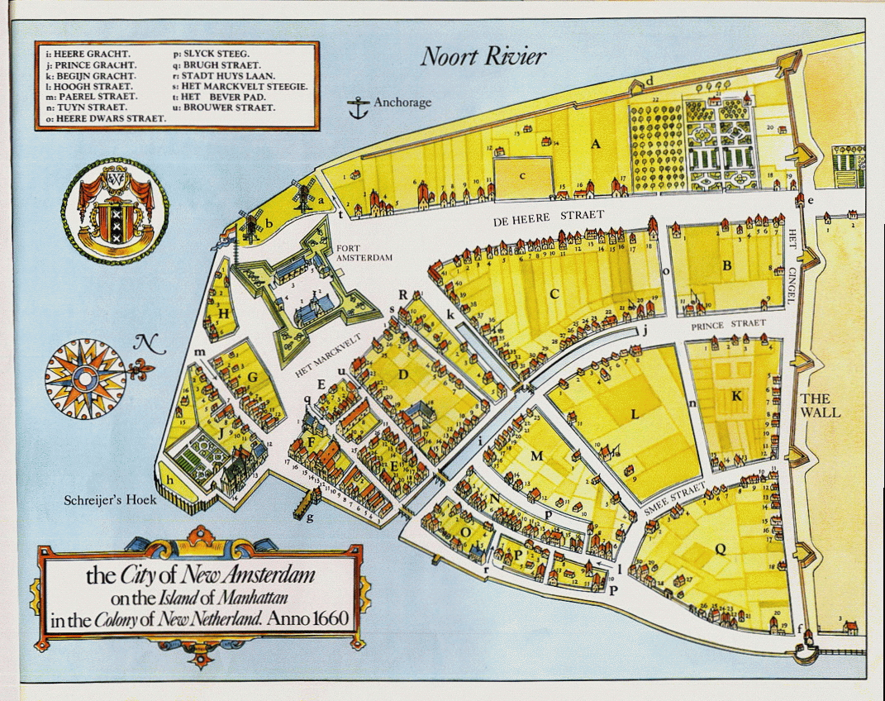

Slide 7
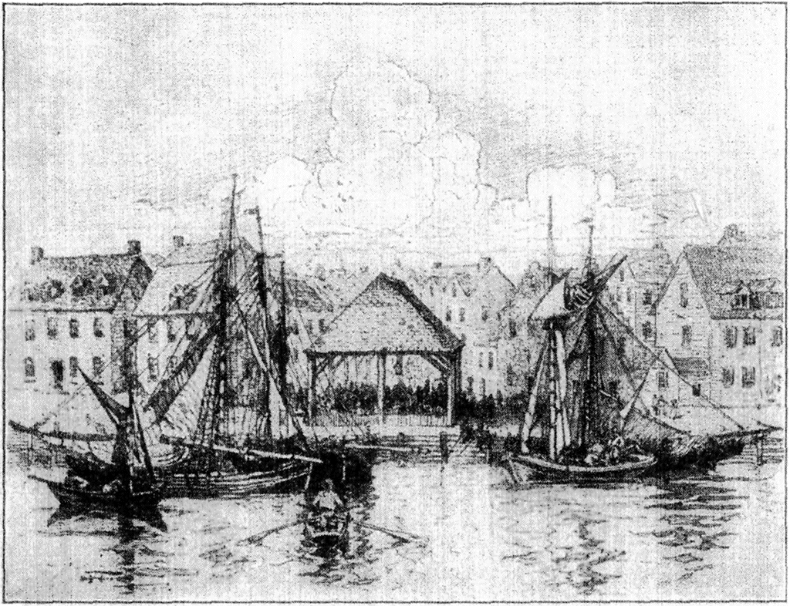
English Take Over
The Dutch lost New Netherland to the English during the Second Anglo-Dutch War in 1664. Along the West Coast of Africa, British charter companies clashed with the forces of the Dutch West India Company over rights to slaves, ivory, and gold in 1663. By 1664, both the Dutch and English were preparing for war.
King Charles of England granted his brother, James, Duke of York, American territories that included all of New Netherland. James immediately raised a small fleet and sent it to New Amsterdam.
Director General Stuyvesant, without a fleet or any real army to defend the colony, was forced to surrender the colony to the English war fleet without a struggle.
Notes:
The slow expansion of New Netherland, however, caused conflicts with both English colonists and Native Americans in the region. In the 1630s, the new Director General Wouter van Twiller sent an expedition out from New Amsterdam up to the Connecticut River into lands claimed by English settlers. Faced with the prospect of armed conflict, Twiller was forced to back down and recall the expedition, losing any claims to the Connecticut Valley.

Slide 8
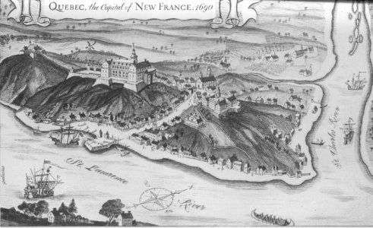
Quebec
France, like Great Britain, settled colonies to gain valuable natural resources of North America and export them to Europe. Quebec was the first permanent French settlement in North America.
The French instructed their colonists to spread the Catholic faith in the New World. The British encouraged their colonists to establish Protestantism.
The first inhabitants in New France were mostly single men. They arrived as indentured laborers.
Still has strong French culture.

Slide 9
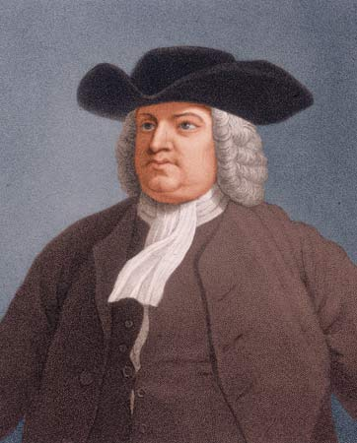
Pennsylvania
Pennsylvania was founded in 1681 by William Penn. Penn was issued a land grant by King Charles II because of a significant debt owed to his father, Admiral Penn. It was named Pennsylvania, which means Penn’s Woods, after Admiral Penn.
His goal was to create a colony that allowed for freedom of religion due to his desire to protect himself and fellow Quakers from persecution.

Slide 11
Performance task
Students will choose a colony and create a brochure to try to convince people in England to come and settle in that colony.
Brochure must include a picture, a description of the colonist's culture, description of population density, notable settlers, colony’s physical features and a detailed description of the economy

