Slide 1
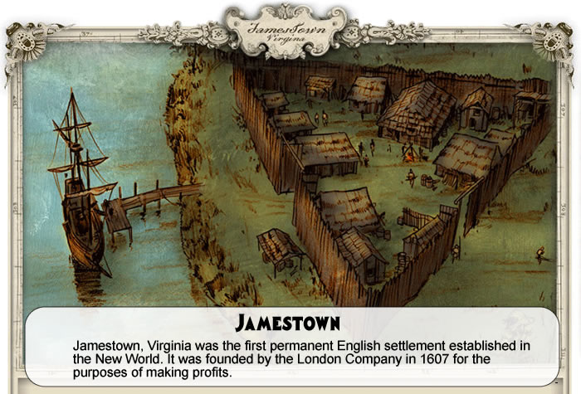
Journal: If you took over Jamestown after John Smith, what 5 rules would you implement for the colony and why?
Write your journal on a separate sheet of paper. This will stay in your interactive notebook and be checked at the end of the unit.

Slide 2
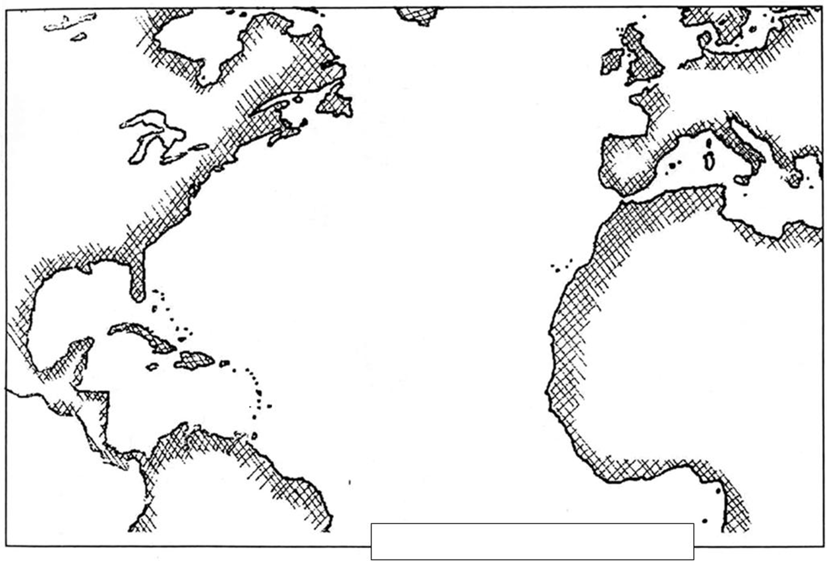

Slide 3
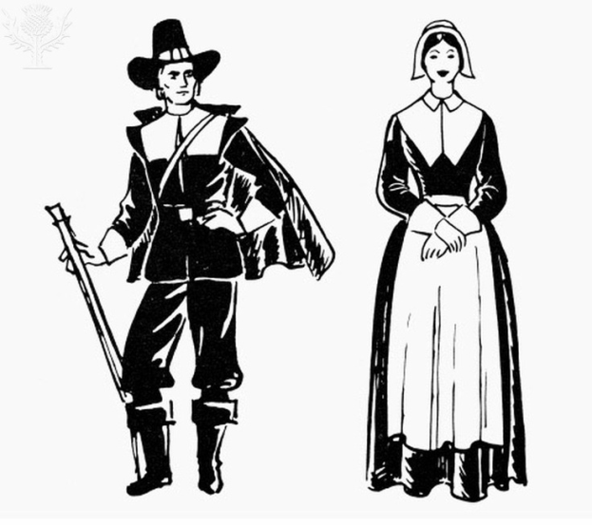
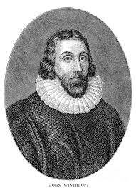
Who were the Puritans?
The Puritans were a group of people who criticized the corruption and leadership in the Church of England. The Church of England was the official church in England that everyone automatically belonged to.
Puritans believed that the final authority came from the Bible, not from church officials and every individual had direct access to the word of God.
Some Puritans wanted to completely separate from the Church of England (they were called Separatists). The group of Pilgrims who came on the Mayflower in 1620 were Separatists.
10 years after the Mayflower, a group of Puritans, led by John Winthrop landed in New England and established the Massachusetts Bay Colony. They were still loyal to the Church of England, but believed they could purify the behavior of individuals

Slide 4
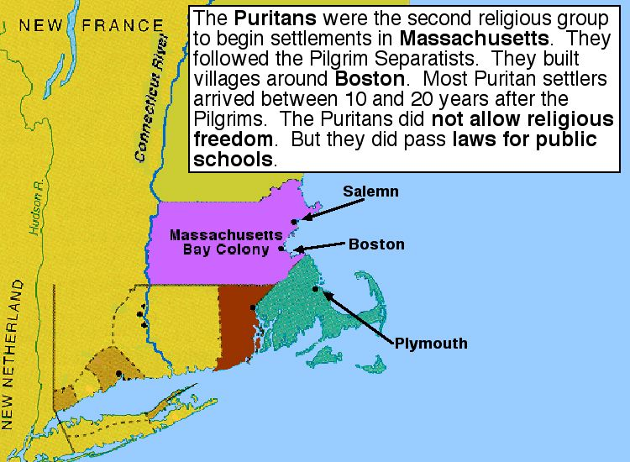
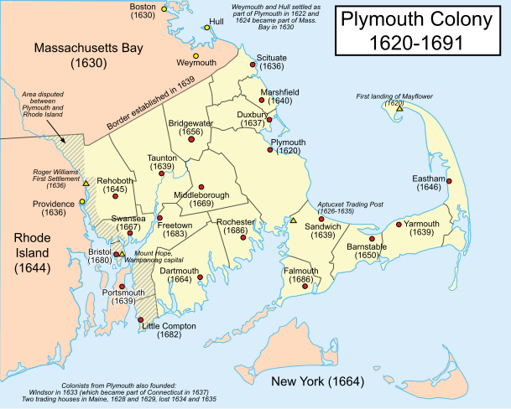
Plymouth Colony
Because they were outside the jurisdiction of the company and concerned that new Pilgrims (Separatists) among them might cause problems, the leaders signed the Mayflower Compact, an agreement establishing a civil government under the sovereignty of King James I and creating the Plymouth Plantation colony.

Slide 5
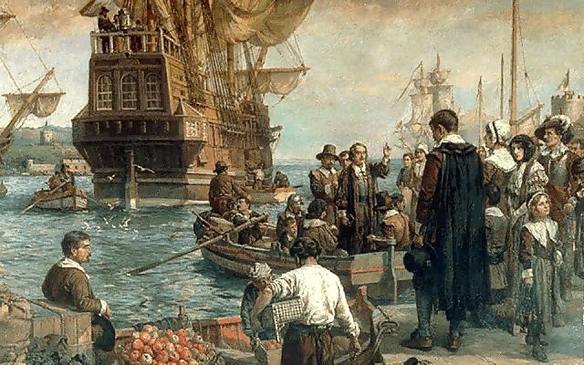
Massachusetts Bay
Harassment by the Church of England, a hostile Charles I, and an economic recession led the Non‐Separatist Puritans to decide to settle in North America. Puritan merchants bought the declining Virginia Company of Plymouth's charter in 1628 and received permission to found a colony in the Massachusetts area north of Plymouth Plantation. Between 1630 & 1640, more than twenty thousand Puritan men, women, and children came to the New World in the “Great Migration”.

Slide 6
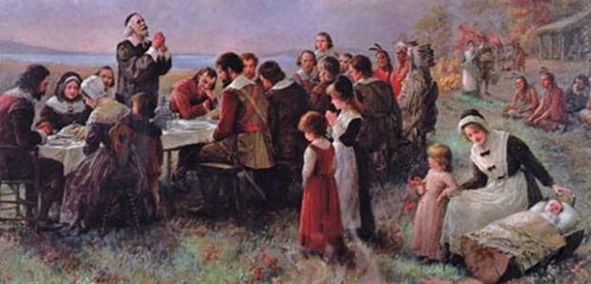
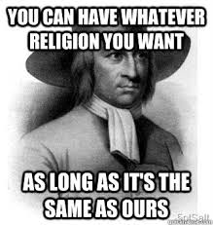
Half Way Covenant
Although church attendance was mandatory, not everyone was deemed worthy of membership. The New England Way was a rigorous examination of a person's spiritual beliefs to identify “saints,” or those qualified to be a church member. This test served to limit church membership and forced the next generation to modify procedures.
Massachusetts Bay was a theocratic society, or a society in which the lines between church and state were blurred. Church membership, for example, was required for men to vote for elected local officials. Many of the colony's laws were based on Puritan values. Single men and women could not live on their own.
Their restrictive membership requirements made it difficult for the Puritan churches to maintain themselves.
In 1662, the Half‐Way Covenant was adopted to address the problem. It allowed the church members' baptized children who would not give testimony to achieve sainthood (and thereby church membership) a “half‐way” membership in the congregation. This change in the rules meant that the children's children could receive baptism after all. Without sainthood, however, they could neither vote on church matters nor take communion.
Notes:
Education was a high priority in Puritan society because literacy was essential to Bible study. Laws were passed calling for the creation of grammar schools to teach reading and writing, and Harvard College was founded in 1636 to train the clergy. Disrespectful servants, errant husbands, and disobedient wives were subject to civil penalties, and rebellious children could even be put to death. The laws also provided a degree of protection for women by punishing abusive men and compelling fathers to support their children.

Slide 7
Massachusetts Bay Colony Charter Changes
Growing problems between the colony and England resulted in the annulment of the company’s charter in 1684 & the substitution of royal government under a new charter in 1691. The charter of 1691 merged the Plymouth colony & Maine into the Massachusetts Bay Colony.
Change also came from outside. Massachusetts's 1691 royal charter made property ownership rather than church membership the qualification for voting and provided for the toleration of religious dissenters.

Slide 8
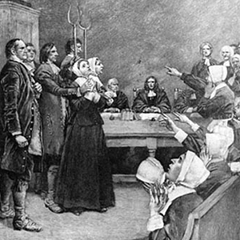
Salem Witch Trials 1691-1692, in Salem Village, Massachusetts
Betty Parris, 9 year old daughter of the village’s minister, Samuel Parris, and his niece, Abigail Williams, fell ill. The girls complained of pinching, prickling, knifelike pains, and the feeling of being choked. 3 more girls showed similar symptoms.
Rev Parris and several doctors began to suspect that witchcraft was responsible for the girls’ behavior. They pressed the girls to name the witches who were tormenting them. The girls named three women, who were then arrested. The third accused was Parris’s Indian slave, Tituba. Tituba confessed to being a witch, and testified that four women and a man were causing the girls’ illness. The girls continued to accuse people of witchcraft, including some respectable church members. The new accused witches joined Tituba and the other two women in jail.

Slide 9
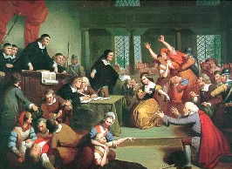
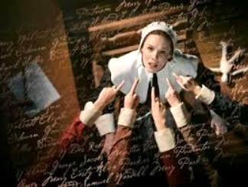
Salem Witch Trials
If they confessed to witchcraft, they could escape death but would have to provide details of their crimes and the names of other participants. On the other hand, it was very difficult to prove one’s innocence. The Puritans believed that witches knew magic and could send spirits to torture people. However, the visions of torture could only be seen by the victims. If they screamed and claimed that the accused witch was torturing them, the judge would have to believe their visions, even if the accused witch was not doing anything visible to the girls. Between June and October, twenty people were convicted of witchcraft and killed and more than a hundred suspected witches remained in jail.

Slide 10
Answer the essential question on same sheet as journal from yesterday:
Why did English settlers come to Virginia, and how did they survive once they arrived?

Slide 11
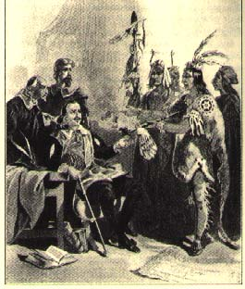
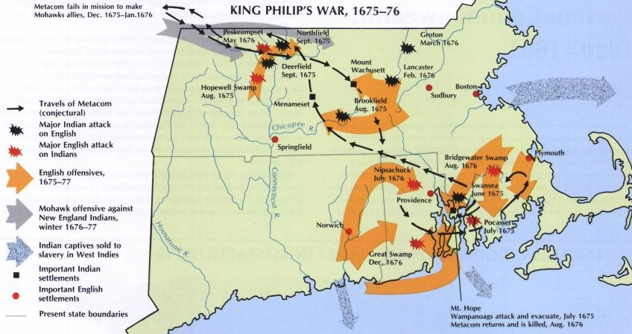
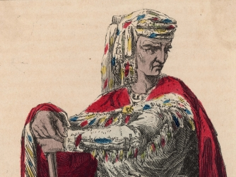
King Phillip’s War
King Phillip’s War (1675–1676) was an early and bloody conflict between English colonists and Native Americans. It was named after the leader of the Native Americans. King Phillip’s Native American name was Metacom. Many colonists died in the war, but it caused such a heavy loss of life among the Native American population that large areas of southern New England became English settlements.

Slide 12
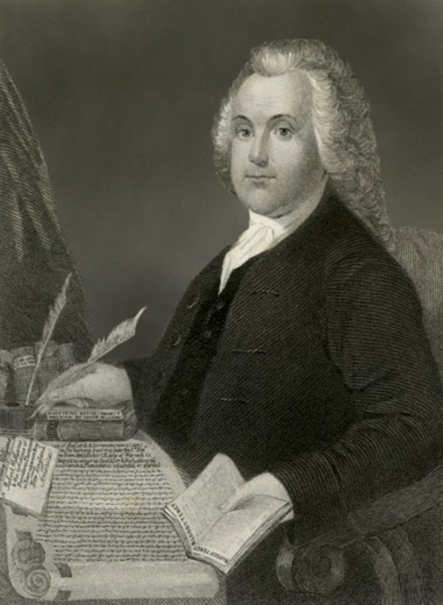
Colony of Rhode Island
Rhode Island was founded by Roger Williams in 1636, who had been banished from the Massachusetts colony for his advocacy of religious tolerance and the separation of church and state
Williams purchased land from the Narragansett Indians and founded the first permanent white settlement in Providence in 1636. His firm belief in religious freedom, tolerance and the separation between church and state governed the colony of Rhode Island and inspired the future founders of the United States.

Slide 13
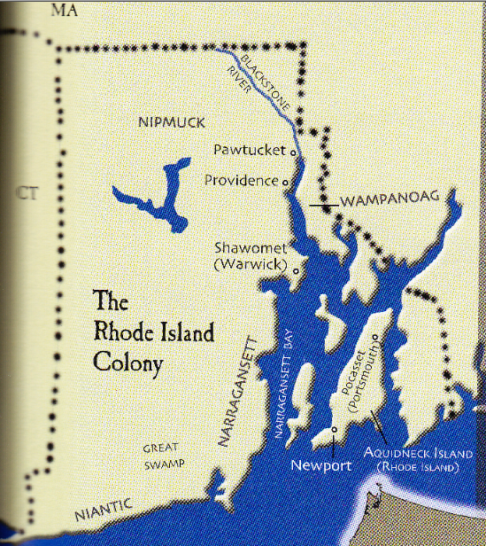
Town Meetings and Legislature in RI
In 1663, a royal charter was granted to them by Charles II. This charter required an assembly, consisting of a governor, deputy-governor, and ten assistants, with the representatives from the several towns, all to be chosen by the freemen.
The government of Providence was in the hands of the inhabitants; with the legislative, judicial, and executive functions exercised for several years by its citizens, in town meetings. Two deputies were appointed, from time to time, whose duty it was to preserve order, to settle disputes, to call town meetings, to preside over them, and to see that their resolutions were executed.

Slide 14
Close reading and RACE
Highlight key information
Underline key vocabulary
Circle words or concepts you don’t understand
Make notes in the margins

