Slide 1
1. Be sure you are sitting with the right group. If you are new to this class, find an empty seat.
2. Answer these questions on a sheet of paper.
1. What states surround Virginia today?
2. What do you think a cash crop is? (definition or example)
3. What is your definition of slavery?

Slide 2
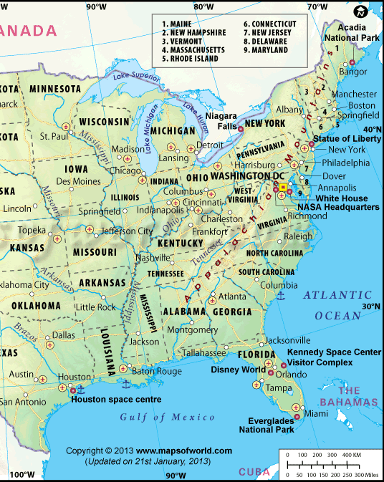

Slide 3
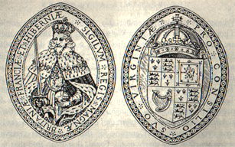
What was the Virginia Company?
Formed with charter from King James I (1606)
Was a joint stock corporation charged with the settlement of Virginia.
Had the power to appoint the Council of Virginia, the Governor and other officials & the responsibility to provide settlers, supplies, and ships
Notes:
It was not until 1606 that the Virginia Company of London received a charter from the newly-crowned King James I. Following the precedent set by other companies such as the Moscovy Company and East India Company, the Virginia Company was a joint-stock company, which sold shares. All who purchased shares at a cost of £12 10s shared in the success or failure of the venture. The Virginia Company was formed both to bring profit to its shareholders and to establish an English colony in the New World. The Company, under the direction of its treasurer Sir Thomas Smith, was instructed to colonize land between the 34th and 41st northern parallel.

Slide 4
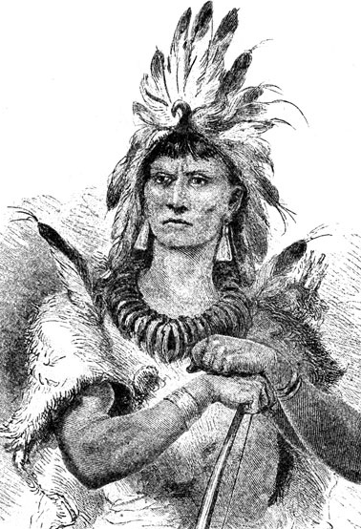
What about the Native Americans?
Disease, famine, and continuing attacks of neighboring Algonquians took a tremendous toll on the population.
There were times when the Powhatan Indian trade revived the colony with food in exchange for glass beads, copper, and iron tools.
The Algonquians (1622) attacked the plantations killing over 300 of the settlers.

Slide 5
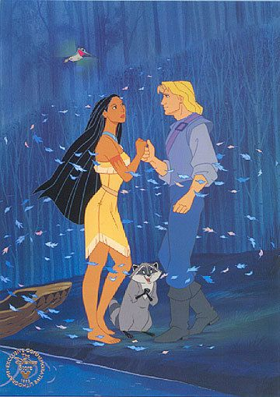
Captain John Smith
If you don’t work, you don’t eat.
It appears that eventual structured leadership of Captain John Smith kept the colony from dissolving.
The "Starving Time" winter followed Smith's departure in 1609 during which only 60 of the original 214 settlers at Jamestown survived.
Notes:
When Captain John Smith became Virginia's third president, he proved the strong leader that the colony needed. Industry flourished and relations with Chief Powhatan's people improved. In 1609, the Virginia Company received its Second Charter, which allowed the Company to choose its new governor from amongst its shareholders. Investment boomed as the Company launched an intensive recruitment campaign. Over 600 colonists set sail for Virginia between March 1608 and March 1609.

Slide 6
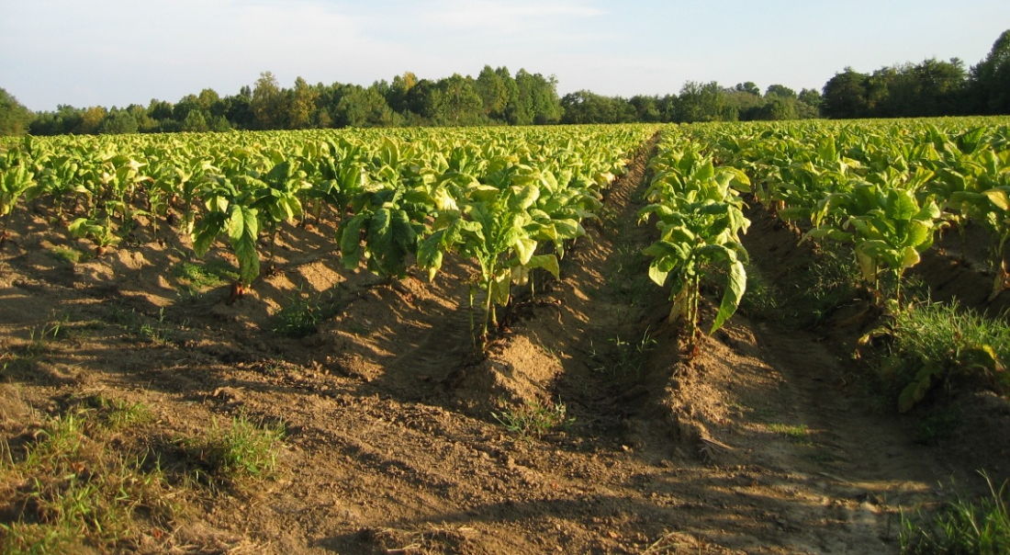
Tobacco
No gold had been found in Virginia. Attempts at producing glass, pitch & tar had been barely profitable could be made more cheaply in Europe.
John Rolfe succeeded by growing a sweet variety of tobacco which was all the rage in England.
Virginia’s rich soil, temperate climate, coastal harbors, and river systems aided the colony’s growth, especially the Jamestown settlement.
Easy access to commercial waterways allowed colonists to export tobacco and other natural resources to England, as well as to import much-needed manufactured goods from English markets. The trans- Atlantic trade made it possible for the colony to prosper and expand.
Notes:
Early industries such as glass manufacture, pitch and tar production and beer and wine making took advantage of natural resources and the land's fertility. However, settlers could not devote as much time as the Virginia Company would have liked to their financial responsibilities. They were too busy trying to survive. Because growing tobacco also required a lot of hard work and labor, more people were needed to work in the fields.

Slide 7
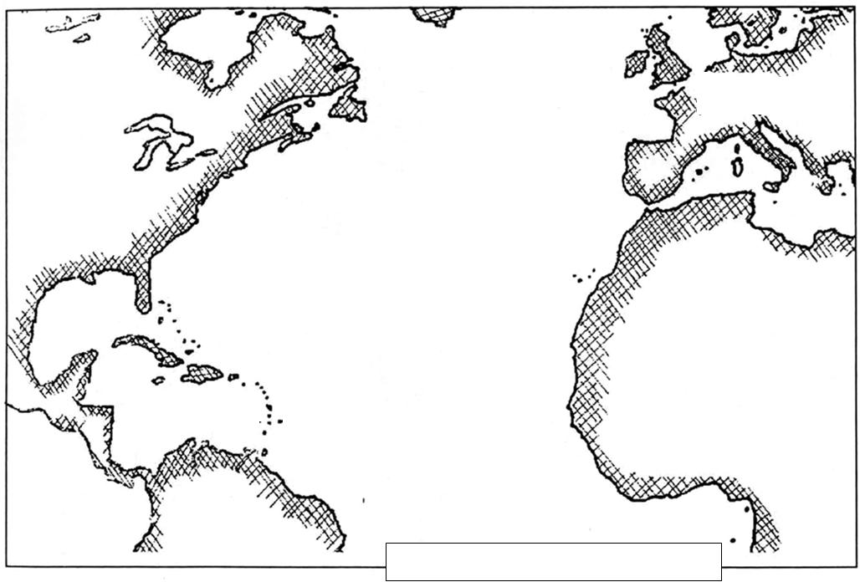
Trans-Atlantic Trade

Slide 8
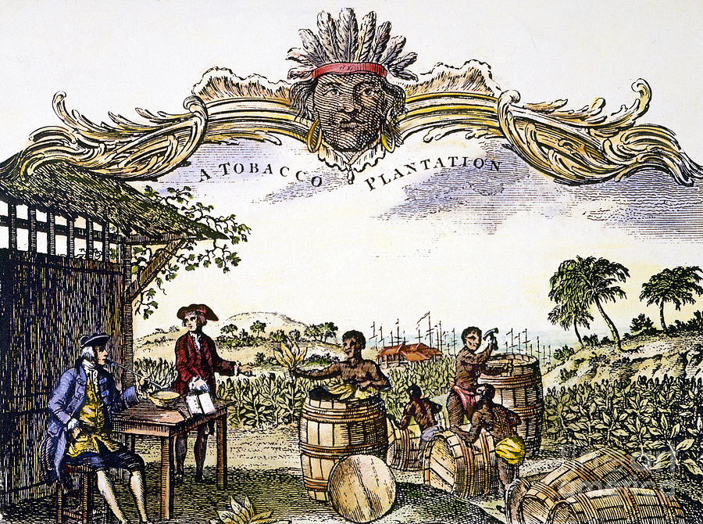
Slavery
A Dutch slave trader exchanged his cargo of Africans for food in 1619. The Africans became indentured servants, similar in legal position to many poor Englishmen who traded several years of labor in exchange for passage to America.
The more workers, the more tobacco they could grow and the greater the profit they could make. Indentured servitude met this need at first, but later slavery became an institution in Virginia
Notes:
The popular conception of a race-based slave system did not fully develop until the 1680s.

Slide 9
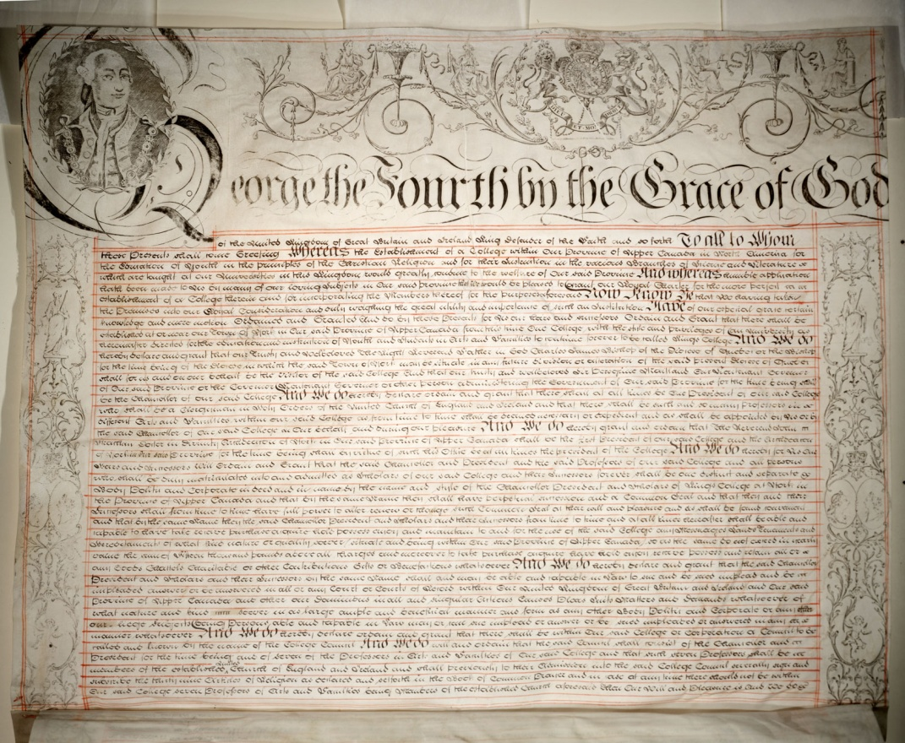
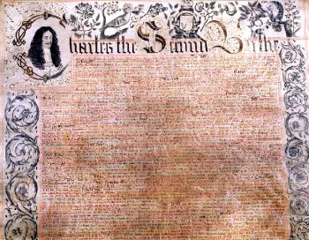
What Happened to the Company?
The charter was revoked in 1624 and Virginia became a Crown colony, largely as a result of the Indian Massacre of 1622.

Slide 10
So who was in charge?
The English kings who ruled the 13 original colonies reserved the right to decide the fate of their colonies, but not alone. The colonists drew upon their claims to traditional English rights and electing their own representatives.
In April, 1619, Governor George Yeardley announced that the Virginia Company had voted to abolish martial law and create a legislative assembly.
The Virginia House of Burgesses was the first popularly elected legislature in the New World.

Slide 11
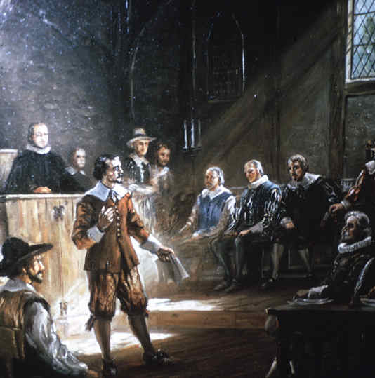
Who were the House of Burgesses?
The first assembly met on July 30, 1619
22 burgesses representing 11 plantations were elected representatives.
Only white men who owned a specific amount of property were eligible to vote for Burgesses.
King James I was a believer in the divine right of monarchs & tried to dissolve the assembly, but the Virginians would not agree. They continued to meet on a yearly basis to decide local matters.

Slide 12
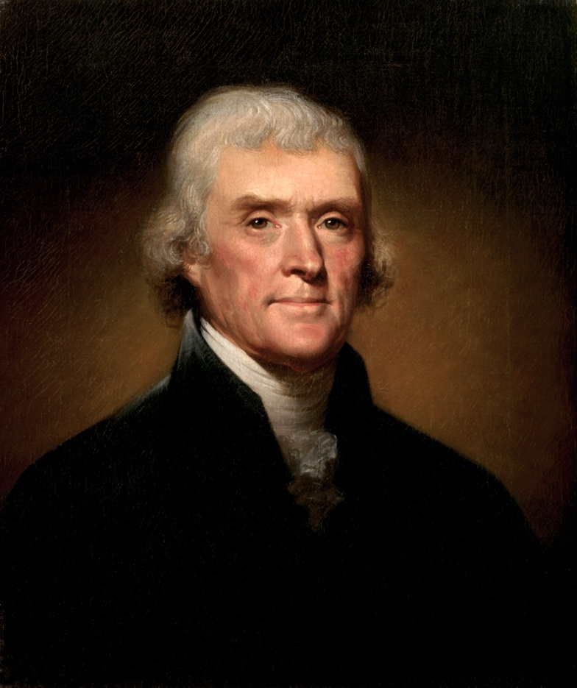
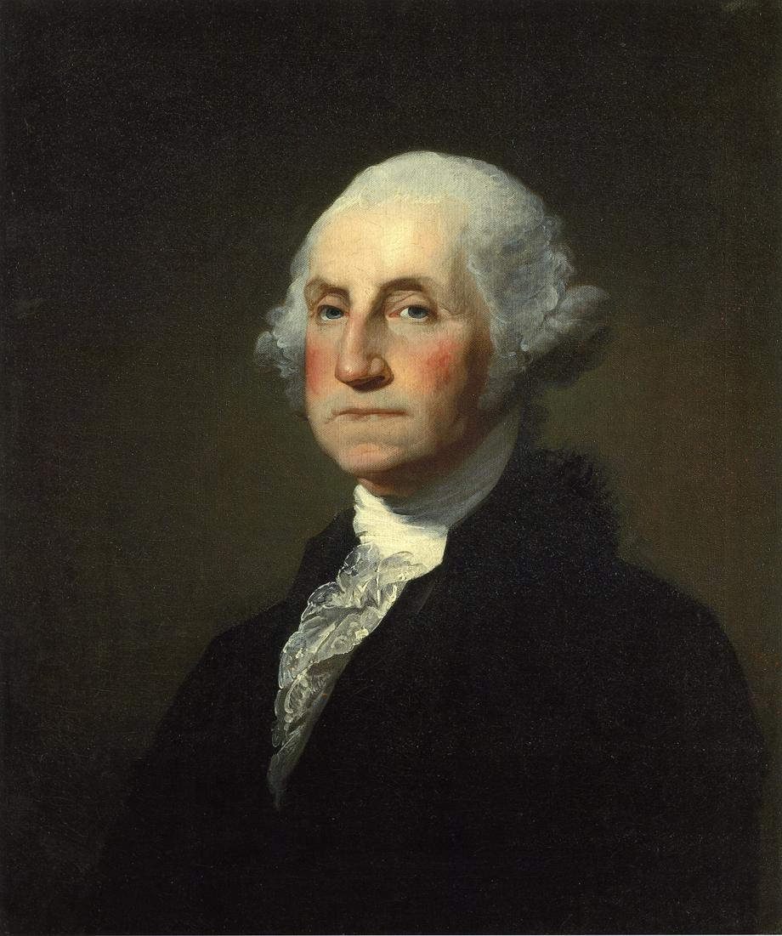
Famous Burgesses
Anyone know who these famous Burgesses were?

Slide 13
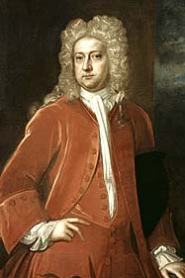
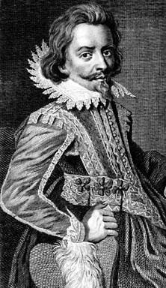
Bacon’s Rebellion
Gov William Berkeley vs. Nathaniel Bacon
Began with dispute with the Doeg Indians & Virginia militiamen, who also attacked the uninvolved Susquehannocks. The Natives began raiding the Virginia frontier.
All the colonists did not own land. Poor English and slave colonists staged an uprising against the governor and his landowning supporters. In what is called Bacon’s Rebellion, the landless rebels wanted harsher action against the Native Americans so more land would be available to the colonists.
Berkeley asked the General Assembly to adopt a plan that isolated the Susquehannocks while bringing in Indian allies on Virginia's side. Others, led by Bacon saw in the Susquehannock War an opportunity for an Indian war that would get Indian slaves and lands. Bacon led volunteers against some of Virginia's closest Indian allies. This led to a civil war -Bacon's followers against Berkeley loyalists.
Bacon died at the end of 1676 and England sent troops to stop the conflict. The rebellion was put down, and the Virginia House of Burgesses passed laws to regulate slavery so poor white colonists would no longer side with slaves against rich white colonists.

Slide 14
Think- Pair- Share
Read the short article on Bacon’s Rebellion and complete the cause/ affect flow chart on the back.
Then, In pairs write down answers to the following questions:
Why would the House of Burgesses be so significant to the creation of the United States?
Why is Bacon’s Rebellion significant to the creation of the United States?

Slide 15
Ticket Out the Door
Answer the following questions on a sheet of paper to turn in:
Why did the Virginia Company come to America to colonize?
Who helped the settlers survive? How?
What is the most profitable cash crop?
DON’T FORGET TO BRING BACK YOUR PARENT CONTACT SHEET BY FRIDAY!

Slide 16
Cause
Effect

