Slide 1
Use a textbook to define: neutral- Espionage Act (in index)- Eugene V. Debs-

Slide 2
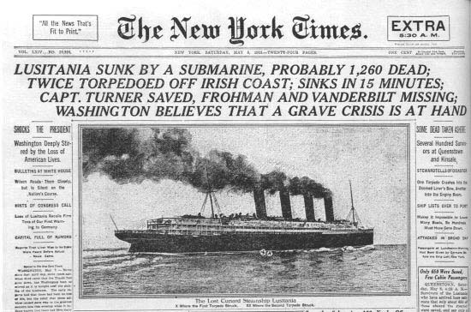
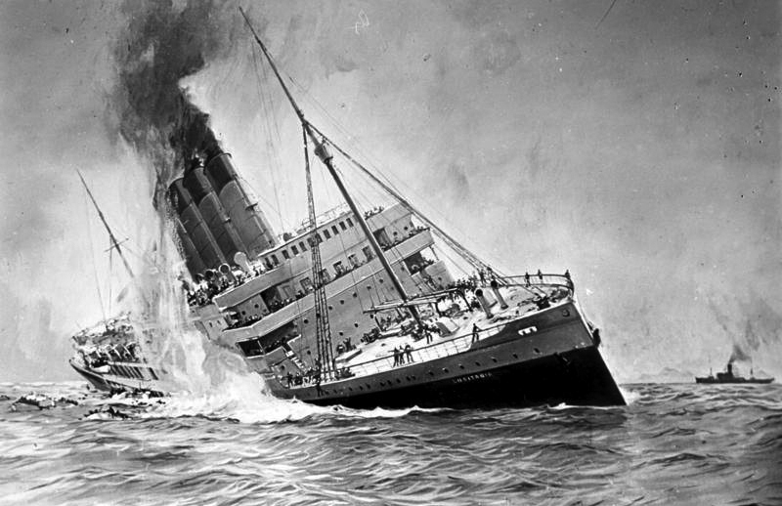
Origins of WWI
When World War I began in Europe in 1914, President Woodrow Wilson was determined to guarantee U.S. neutrality and to keep the United States out of the war.
But in 1915, the luxury liner Lusitania was sunk by a German submarine, killing most of the people onboard, including more than 100 U.S. citizens. This led to a crisis between the United States and Germany that was only resolved when Germany agreed to abandon unrestricted submarine warfare that endangered U.S. trade and American lives.

Slide 3
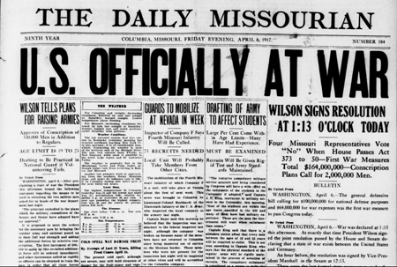
However, in 1917, Germany resumed unrestricted submarine warfare, creating great anti-German feelings among Americans. This heightened tension led to the United States’ decision to enter the war.

Slide 4
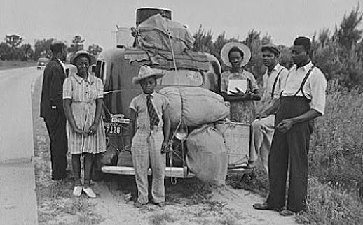
Impact of WWI
The war created jobs in northeastern and midwestern cities. African Americans, tired of living under the repression that was common in the South, moved to the North by the thousands and established themselves in ethnically distinct and culturally rich neighborhoods. This movement of African Americans was called the Great Migration.

Slide 5
WWI impact
During the war, laws were passed that prohibited people from speaking out against it. The Espionage Act of 1917 made it a crime to communicate any information that would interfere with U.S. military operations or aid its enemies.
Wilson supported this law to silence critics and pacifists. The next year, labor leader Eugene V. Debs, the Socialist Party’s presidential candidate in 1904, 1908, and 1912, was convicted for hindering military recruiting by making a speech against it; he was sentenced to 10 years in prison.
Many people supported such laws although they violated the spirit of the First Amendment.

Slide 6
Close Reading
Read the article on the Lusitania
Use highlighters to highlight key ideas and main points
Circle any words you don’t know
Underline key vocabulary
Write questions, thoughts and predictions in the margins

Slide 7
Writing
Students will read a short article about the sinking of the Lusitania and the unrestricted use of submarine warfare.
Students will write a letter to a family member or friend from the perspective of a Lusitania survivor and include what they want the US government to do in response.
Describe the sinking of the ship, the experience of being rescued, your feelings about the attack and what you would want the government to do in response
This should be AT LEAST a full page

Slide 8
3rd block Warm Up:
What are the differences between Presidential and Radical Republican Reconstruction?

Slide 9
Students will write their own reconstruction plans. What would be your requirements for Southern states to come back into the Union? You must include requirements for Southern states to be readmitted to the Union and rights of freed slaves.

Slide 10
Performance Task
Students will be given a conflict from this period of study. These conflicts include: World War I, World War II, Korean War, Bay of Pigs/ Cuban Missile Crisis, Vietnam War, Iranian Hostage Crisis/ Iran Contra Scandal, Persian Gulf War, and the War on Terrorism.
Each student's job is to create an exhibit on your assigned conflict that will be part of a museum on Isolation versus Globalization. The owners of the museum are looking for exhibits that explain isolation and pages that explain globalization.
The exhibit will be drawn on poster board or bulletin board paper. Once the whole class has completed their exhibit, we will arrange them in the hall in chronological order to create our museum.

Slide 11
Closing
Make a prediction: how do you think WWI will end? What do you think will be in the peace treaty?

Slide 12
Warm Up
Answer: What do you remember about the temperance and women's suffrage movements? Make a list.

Slide 13
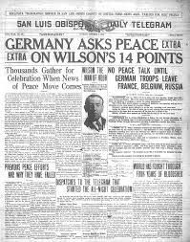
Wilson’s 14 Points
Before the United States entered the war, Wilson gave a speech in which he described Fourteen Points he felt were key to avoiding future wars.
One point called for the creation of an international peacekeeping organization called the League of Nations. During the postwar treaty negotiations, Wilson worked hard to get as many as possible of his Fourteen Points included in the treaty and succeeded in securing the creation of the League of Nations. However, American opposition to the League of Nations ultimately led the Senate to refuse to ratify the treaty.

Slide 14
League Of Nations
Isolationists in the Senate believed that by joining the League the United States would become involved in future conflicts in Europe and elsewhere. Though Wilson traveled across America to create public support for the treaty’s ratification, the Senate eventually rejected it.
The United States never joined the League of Nations.

Slide 16
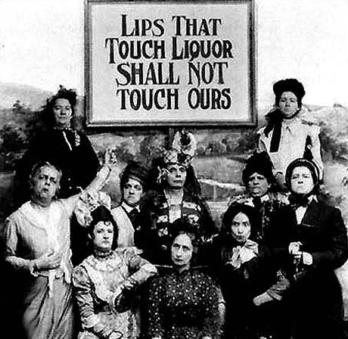
18th Amendment
Social changes seen during the war led to two constitutional amendments. Americans’ anti-German feelings led to a campaign to outlaw beer and other alcoholic beverages.
This campaign well suited the Progressive Era’s opposition to saloons. Congress passed the Eighteenth Amendment, which prohibited “the manufacture, sale, or transportation of intoxicating liquors.”

Slide 17
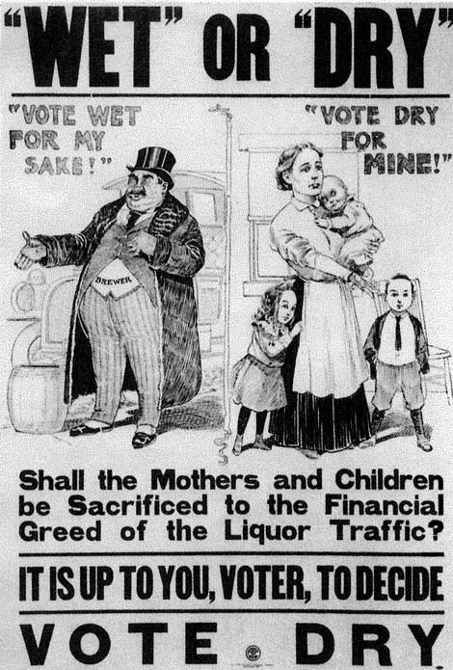
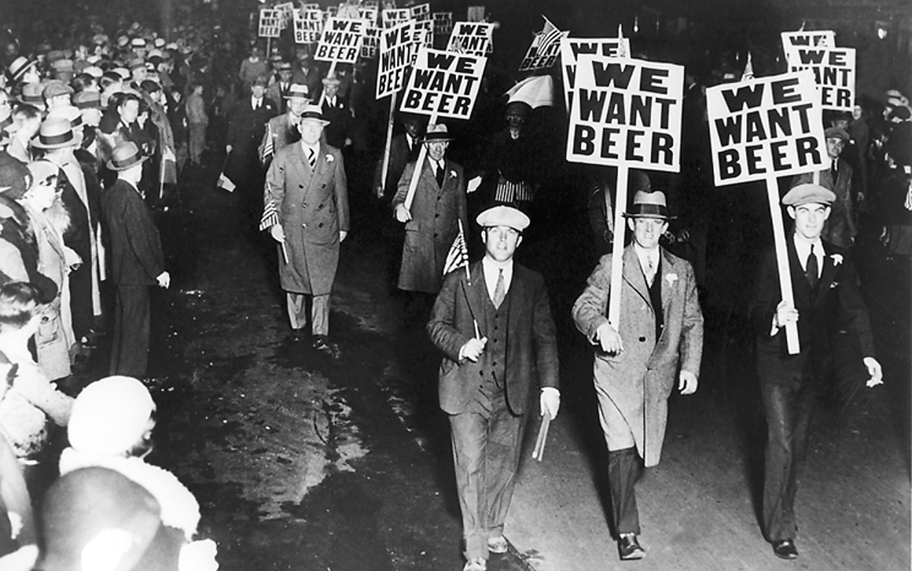

Slide 18
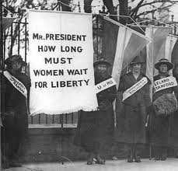
19th Amendment
Ratification of the Nineteenth Amendment, which gave women the right to vote, was helped by the country’s gratitude for women’s economic contributions during the war.
The women had filled jobs in factories after men volunteered and were drafted into military service.

Slide 19
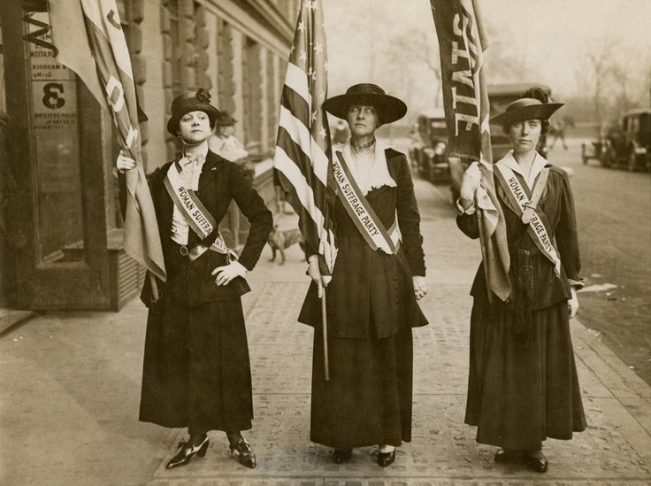
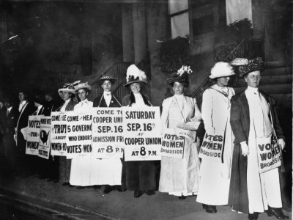
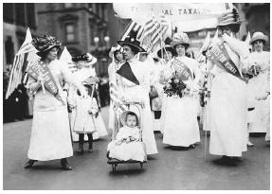

Slide 20
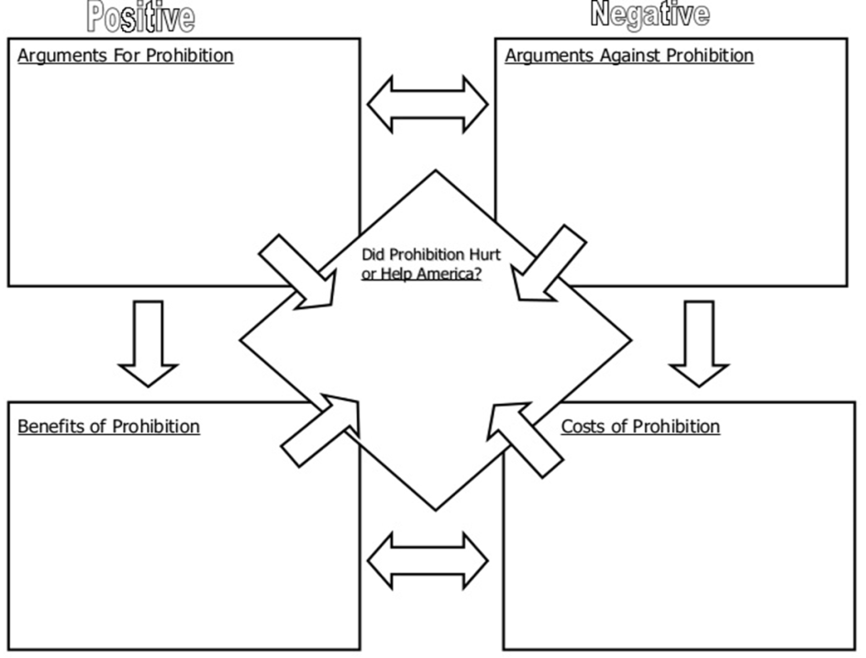

Slide 21
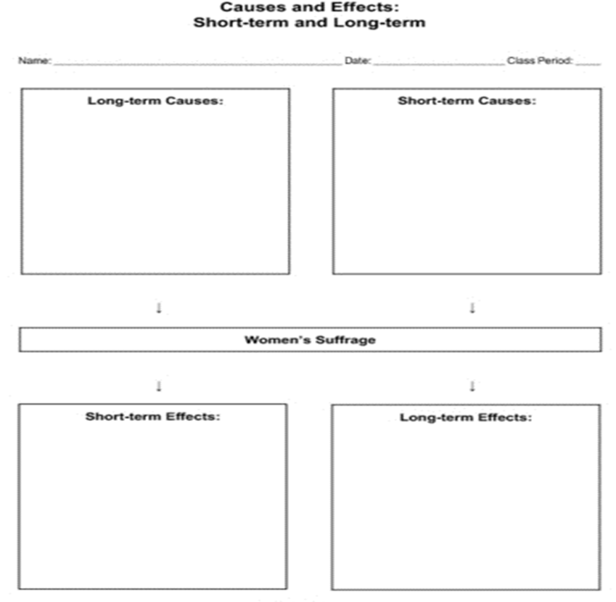

Slide 22
Group work
In groups of 3, students will choose either the 18th or 19th amendments and research how that law changed America and American's reactions to it.
They will create a campaign ad for that amendment which will either encourage or discourage its ratification.

Slide 23
Homework:
Students will read the 14 points document and answer 3 analysis questions to check for understanding.

Slide 24
3rd Block
Closely read the packet on the Transcontinental railroad.
Answer the following analysis questions:
1&2 on page 9
All questions on page 13
2 on page 18
1-3 on page 24
* If you write on a separate sheet of paper, please label your questions with the pages number they go with

