Slide 1
Journal: We have discussed the Chinese role in constructing the railroads in the west. How do you think that the Chinese were treated by other groups?

Slide 2
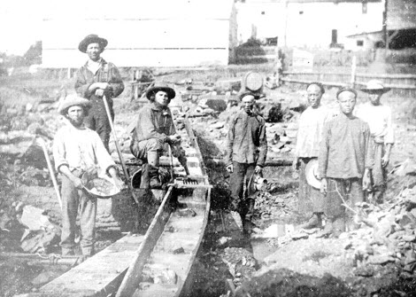
Asian American Rights
In earlier decades, Asians had immigrated to California and other areas of the American West. Then, in the 1880s, Asian Americans faced anti-immigrant sentiment. When Chinese immigrants accepted low wages for jobs whites had held, employers lowered the pay for all workers. This angered the white workers.
They encouraged Congress to pass the Chinese Exclusion Act, which it did in 1882, thereby banning all future Chinese immigration.

Slide 3
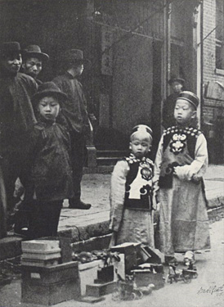
Japanese Americans
Japanese Americans also faced racial prejudice. It was against California law for them to buy land or become U.S. citizens, and the federal government worked with the government of Japan to limit Japanese immigration.

Slide 4
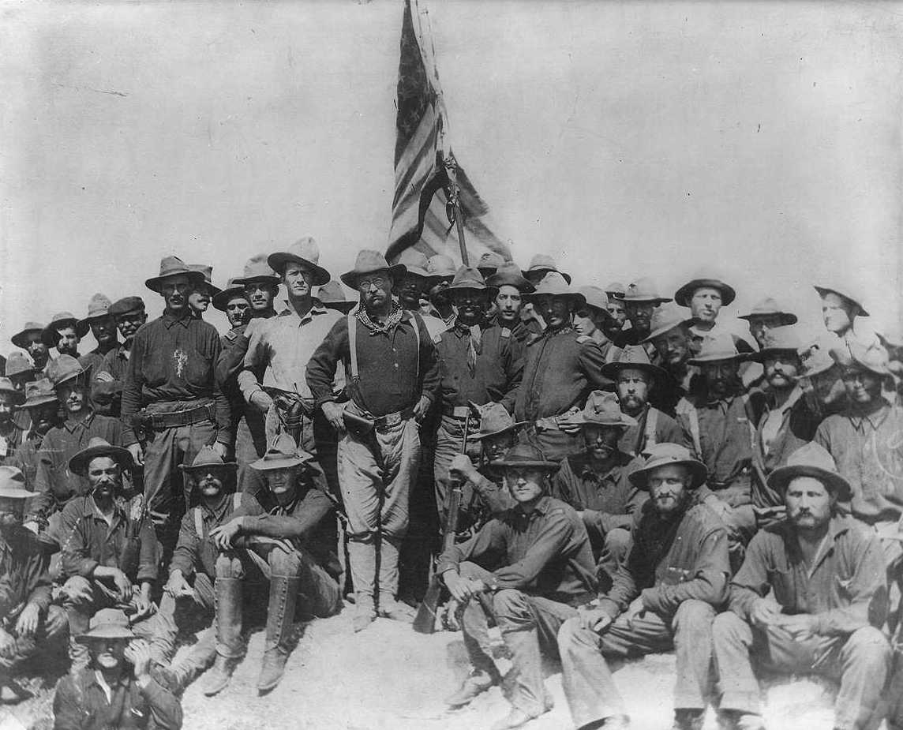
Spanish American War
In the last decades of the 19th century, some Americans were eager to spread democracy into Latin America and other world regions. Other Americans argued that American expansion was not the best way to spread America’s democratic traditions.
In 1898, the United States went to war with Spain after the Spanish refused to grant independence to rebels fighting a revolutionary war in Cuba, a Spanish colony. Supporters of American expansion were eager to gain U.S. territory in Latin America, leading to a “war fever” that also encouraged the U.S. government to seek a military solution to the Cuban war for independence.
The war lasted less than four months. The Spanish were driven out of Cuba, which became an independent country, and out of Puerto Rico, which became an American territory.

Slide 5
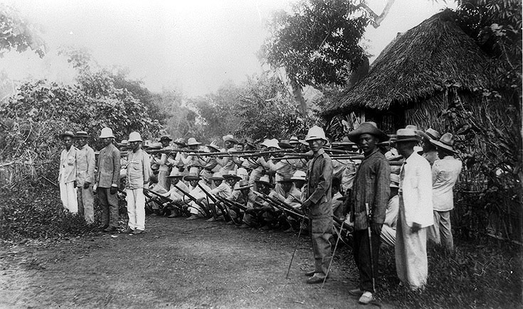
Philippine- American War
The first battles of the Spanish-American War took place in the Philippines, another Spanish colony in which Spain refused to grant independence to rebels fighting a revolutionary war.
The U.S. Navy quickly defeated the Spanish navy, and Americans debated whether the United States should expand its territory to include the Philippines or respect Filipino independence. When the U.S. military was ordered to keep the Philippines as an American territory, the Philippine-American War broke out in 1899.
The war lasted about three years. In the end, the Philippines was a U.S. territory until1946.

Slide 6
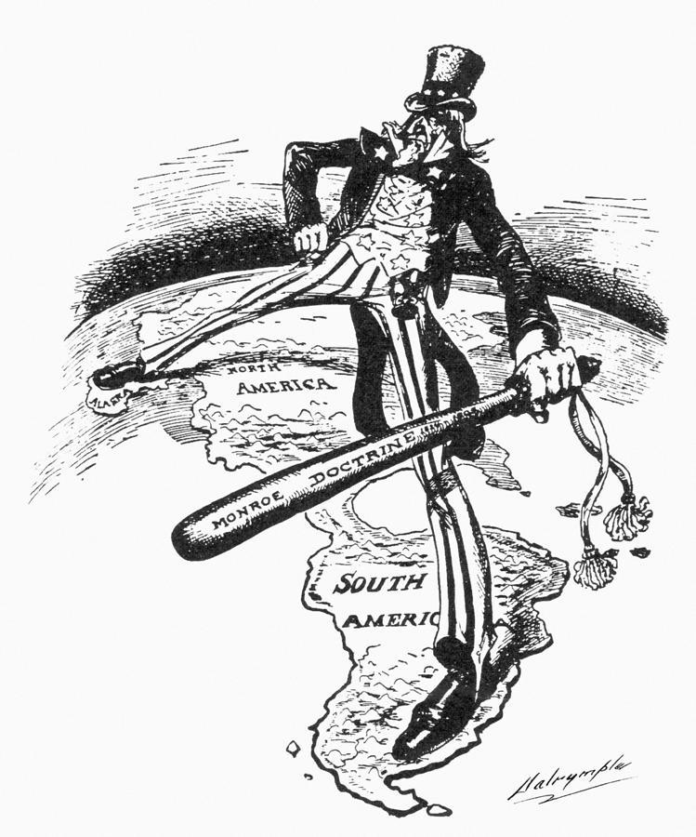
US Action in Latin America
The Caribbean region and Latin America remained unstable. Many of the area’s countries owed large amounts of money to European countries because they had borrowed it to build modern energy plants and transportation systems.
President Theodore Roosevelt feared European countries would take advantage of this instability to gain power and influence in the region.
He announced to the world that the United States had the right to intervene in Latin American countries in economic crisis, whether or not a European power planned to intervene.
This policy is called the Roosevelt Corollary to the Monroe Doctrine. In contrast, President James Monroe’s original doctrine had been to get involved in the affairs of the Americas only when needed to end the intervention of a European power.

Slide 7
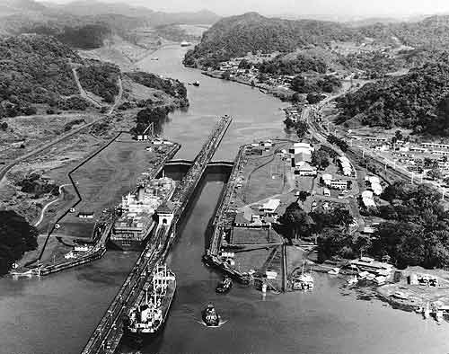
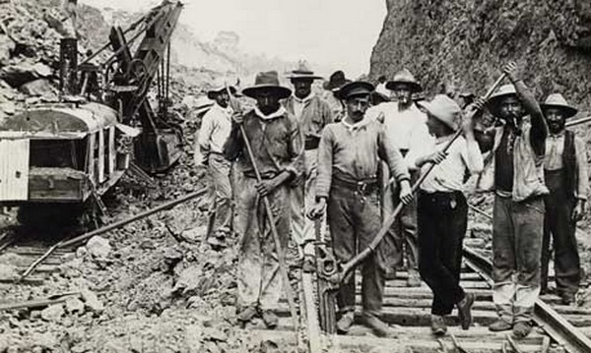
Panama Canal
America now controlled territory in the Atlantic and Pacific oceans. Seeking a faster sea route from the Atlantic to the Pacific than the voyage around the tip of South America, the U.S. government built a shipping canal across the narrow Central American country of Panama.
The Panama Canal was the biggest engineering project of the era. When the Panama Canal opened in 1914, a voyage from San Francisco to New York was cut from14,000 miles to 6,000 miles.

Slide 8
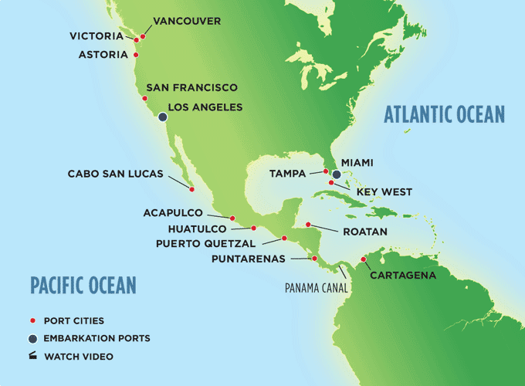

Slide 9
Political Cartoon
What is the artist trying to tell you?
What do the details mean?
What is the overall message of the cartoon?
Who is the cartoon’s intended audience?
Where would this cartoon have been accepted?
What does the artist use to justify his/her stance?
What stereotypes do you see? How are the figures portrayed?

Slide 12
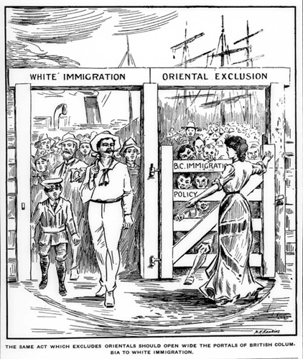

Slide 13
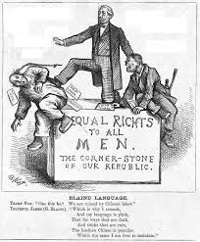

Slide 15
SSUSH 1d 4. French colonists came to America mainly in order to:
a. Farm.
b. Seek precious metals.
c. Find religious freedom.
d. Engage in the fur trade.
SSUSH 2a 5. According to the system of mercantilism, a favorable balance of trade exist for a country when:
a. Its trading partners charge no import taxes.
b. The value of imports equals that of exports.
c. The value of imports is greater than that of exports.
d. The value of exports is greater than that of imports.
SSUSH 2d 6. The significance of the Great Awakening was that it:
a. Revived intolerance for other religions.
b. Led to the foundation of colleges and universities.
c. Did not lead to unity among the American colonist.
d. Created a strong following for the Roman Catholic Church

Slide 16
Students will create a timeline dated from 1619 – 1676 of the Jamestown colony incorporating key events relevant to the outbreak of Bacon’s Rebellion.
Students will explain why a particular event was placed on the timeline and the relevance this event has in regards to movement and migration and conflict and change.

