Slide 1
ssush13

Slide 2
Write Question and answer on same sheet from yesterday
During the colonial era, why did Europeans benefit most from transatlantic trade?
A) Native Americans were enslaved and provided low cost labor
B) mercantilist laws gave those countries a huge advantage in trade
C) gold from British North America provided Europeans with vast wealth
D) industrial goods produced there were demanded throughout the world
Why was the Fourteenth Amendment NOT successfully implemented in Southern states during the Reconstruction Era?
A) Southern states refused to acknowledge the amendment because of its provisions.
B) Most Southern legislatures had been disbanded by the United States military.
C) A majority of Southern states elected to remain outside the Union following the war.
D) Southern states were allowed to make their own decisions about segregation
legislation.
Which of the following contributed MOST to the forced removal of Native Americans from the Great Plains from 1867 to 1890?
A) the desire to establish military posts
B) the building of new canals
C) the westward shift of the frontier
D) the desire for more land to grow cotton

Slide 3
Intro to standard
This standard will measure your knowledge of Progressive reforms and African Americans’ struggle for equal rights.
The progress of business and industry inspired reformers to make important improvements in America’s political and social environment. These reformers were known as Progressives. Progressive reforms strengthened American democracy in ways we carry forward into our own time.
Meanwhile, African Americans found themselves left out of reform efforts when southern whites denied basic rights to black citizens.

Slide 4
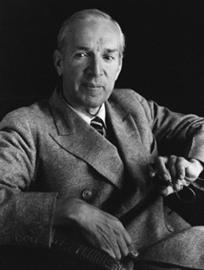
Muckrakers
Many reforms came about after journalists investigated and exposed political corruption, child labor, slum conditions, and other social issues.
These journalists were called muckrakers, and famous among them were Upton Sinclair and Ida Tarbell. In his novel The Jungle, Sinclair told the story of European immigrants working in Chicago’s meatpacking industry. The book exposed the poor labor practices and unsanitary conditions that produced contaminated food. Congress was pressured to pass laws to regulate the meatpacking industry and to require meat packers to produce food that was safe to consume.

Slide 5
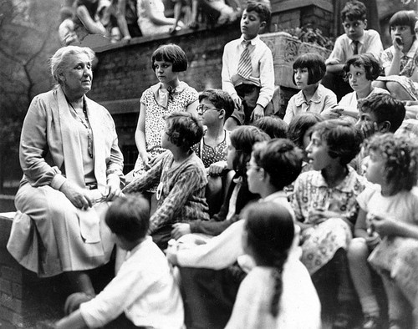
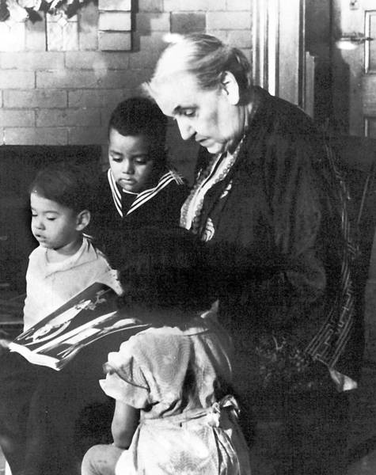
Jane Addams
Women Progressives, in particular, sponsored laws to end child labor and to require government inspections of workplaces.
Jane Addams brought a British idea, the settlement house, to the United States, when she established Hull House in Chicago.
Hull House was a social service agency that provided trained workers to help recent immigrants and working-class citizens learn about home economics, basic medical care, the English language, legal rights, and other topics important to low-income urban residents.

Slide 6
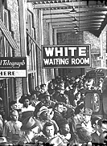
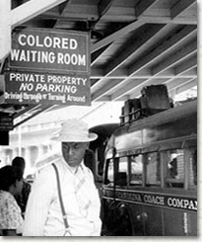
Plessy vs Ferguson
Race relations in the South worsened. African Americans were denied basic rights. They suffered worse racial discrimination and segregation than what they had encountered in the years after the Civil War. Southern and border states passed segregation laws that required separate public and private facilities for African Americans.
These were called Jim Crow laws (after a character in an old minstrel song) and resulted in inferior education, health care, and transportation systems for African Americans. In 1896, the U.S. Supreme Court upheld the constitutionality of Jim Crow laws in Plessy v. Ferguson. Under the “separate but equal” doctrine, the Court ruled racial segregation was legal in public accommodations such as railroad cars.

Slide 7
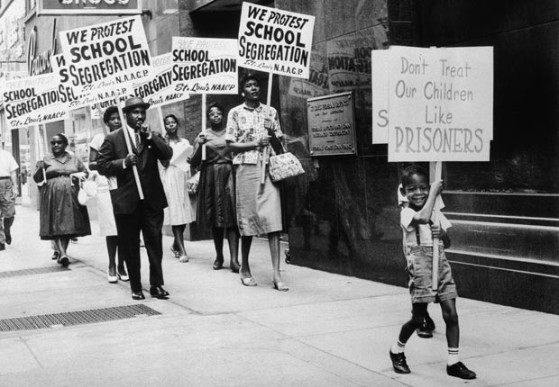
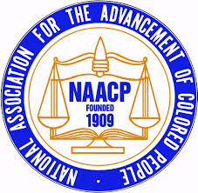
NAACP
African Americans disagreed about how to best oppose Jim Crow laws. One group, which sought full social and economic equality for African Americans, eventually formed the National Association for the Advancement of Colored People to seek full civil rights for African Americans. Better known today as the NAACP, this group still keeps its original name in honor of the people who founded it to help overturn Plessy v. Ferguson.

Slide 8
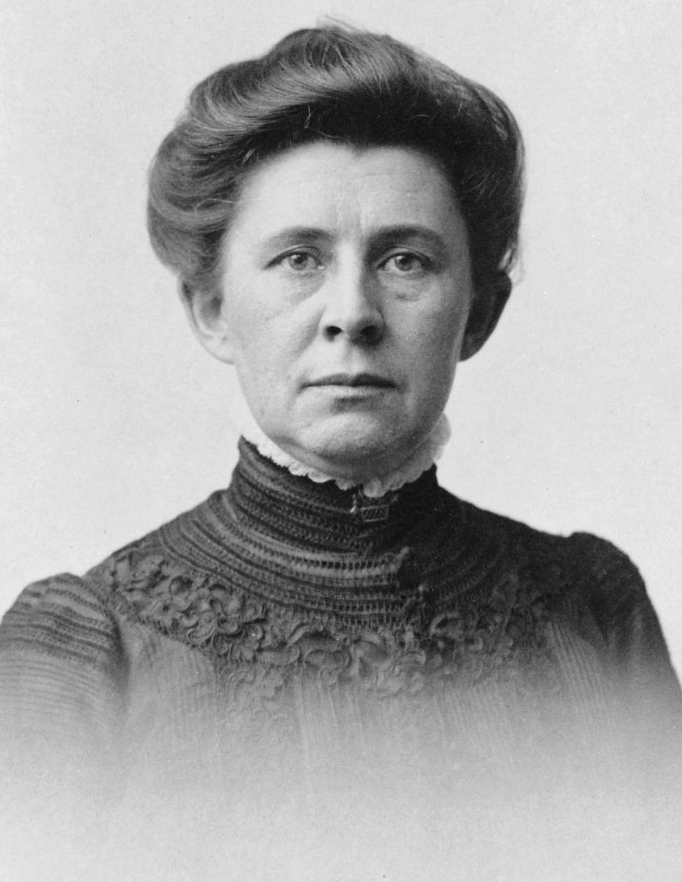
Ida tarbell
In a series of magazine articles, Tarbell exposed political corruption in New York, Chicago, and other cities, and criticized Standard Oil Company’s unfair business practices. Her findings angered the public and contributed to the government’s decision to break up the Standard Oil Trust.

Slide 9
Close Read
Read and answer the questions on the muckrakers

Slide 10
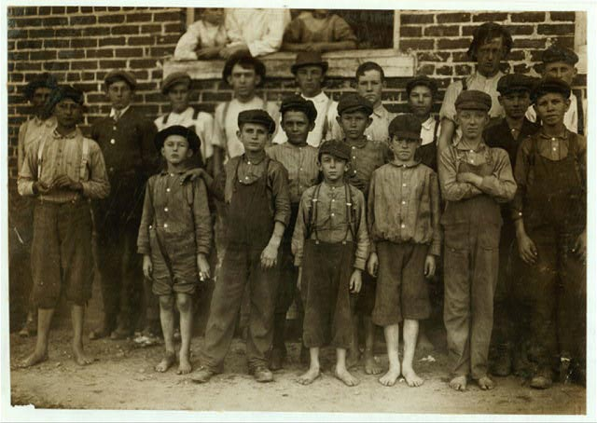
Progressive Reforms
The Progressives supported new ideas and policies they believed would improve people’s lives.
They supported increased government regulation of business and industry, efforts to protect consumers and workers, and policies to conserve natural resources.
Their efforts to improve living conditions for the poor in cities led to more and better libraries, schools, hospitals, and parks.

Slide 11
Progressive reforms
The Progressives also opposed political bosses and had scorn for citizens’ lack of control over them. Progressive election reforms helped to increase ordinary citizens’ direct control of government in these ways:
• Supporters of any new law could collect voters’ signatures on an initiative to force a public vote on the issue. This prevented government officials from ignoring the desires of citizens.

Slide 12
Progressive Reforms
• When enough citizens supported an initiative, the government had to present the issue to the public as a referendum on which the public could vote. This also prevented government officials from ignoring the desires of citizens.

Slide 13
Progressive Reforms
• Citizens could remove public officials from office before their terms expired by organizing a recall election. This allowed citizens to control who serves in government.

Slide 14
17th Amendment
Another Progressive reform was the direct election of senators. Under the U.S. Constitution, each state’s legislature elected that state’s U.S. senators. The Progressives favored the adoption of an amendment to the Constitution that gave voters the right to elect their U.S. senators. They succeeded in their efforts with the adoption of the Seventeenth Amendment in 1913.

Slide 15
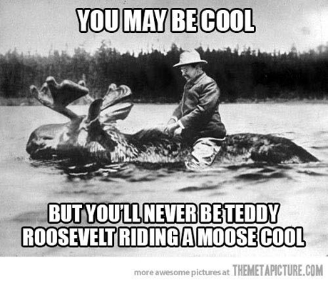
Teddy Roosevelt
President Theodore Roosevelt also began a Progressive conservation movement, which conserved millions of acres of wilderness lands, particularly in western states. His efforts led to the establishment of a national park system that included Yosemite in California and Yellowstone in Wyoming.

