Slide 1
SSUSH12

Slide 2
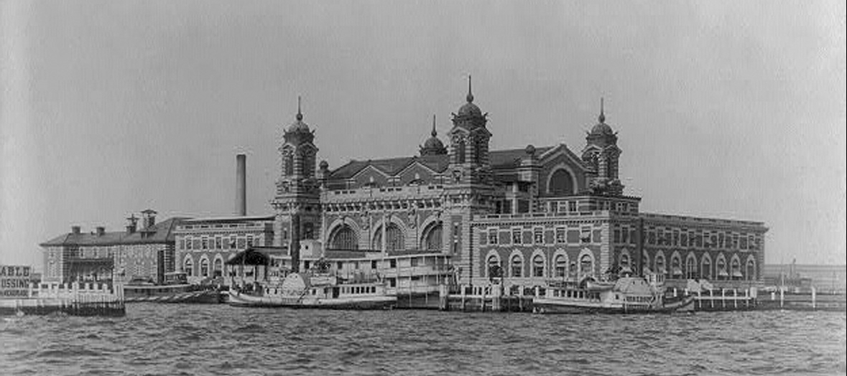
Ellis Island
In the decades after the Civil War, more and more Europeans immigrated to America. They differed from earlier immigrant groups, who mostly came from northern and western Europe, were typically Protestant, spoke English, and arrived with the government’s welcome. In contrast, many of the new immigrants came from eastern and southern Europe, often were Jewish or Catholic, and usually spoke no English.
The U.S. government welcomed the wealthy among these new immigrants but forced poorer people to pass health and welfare tests at government reception centers such as the Ellis Island Immigrant Station located in New York Harbor. Whether Asian or European, these new immigrants tended to settle in areas populated by people from the same countries who spoke the same languages and worshipped in the same ways.

Slide 3
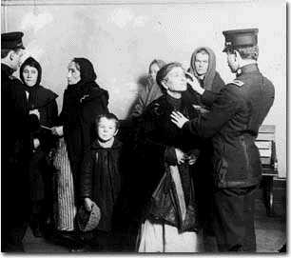
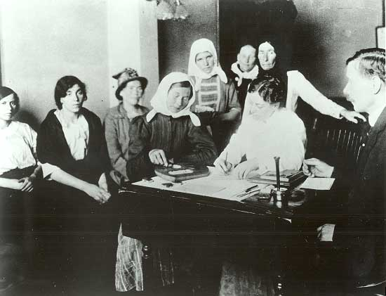
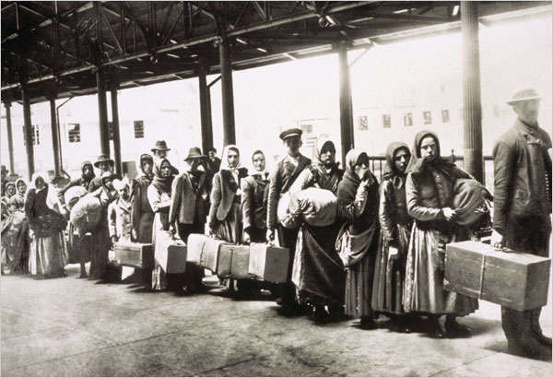

Slide 4
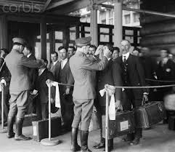
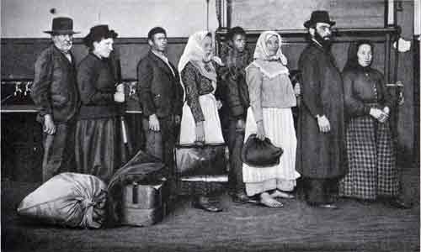
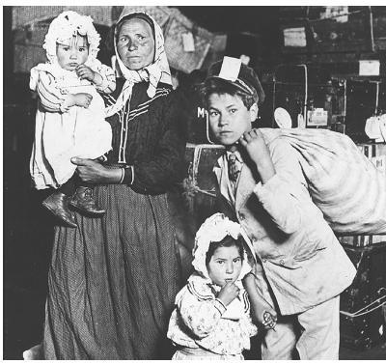

Slide 5
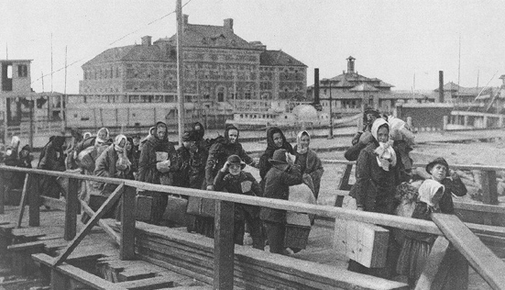
Ellis Island
poverty and political instability were common in their home countries, the new immigrants were likely to be poor.
They could not afford to buy farmland, so they worked as unskilled laborers and lived mostly in cities.
There they created communities to imitate the cultures of their home countries, and these communities had foreign language newspapers, ethnic stores and restaurants, and houses of worship. The new immigrants did not blend into American society the way earlier immigrants had.

Slide 6
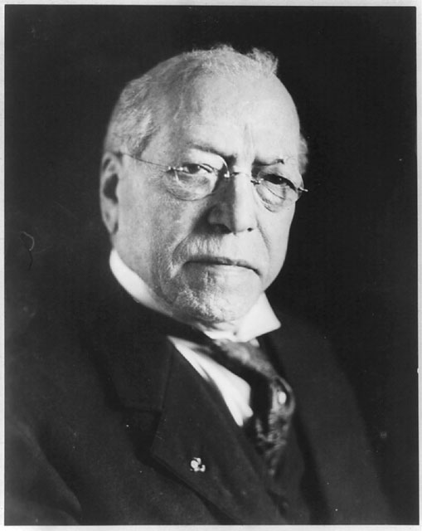
American Federation of Labor
Unskilled laborers were subject to low wages, long workdays, no vacations, and unsafe workplaces. Because individual workers had little power to change the way an employer ran a business, workers banded together in labor unions to demand better pay and working conditions. Then the labor unions banded together for even more power to change the ways employers ran their businesses.
The American Federation of Labor, or AFL, was led by Samuel Gompers. He was president of the AFL from 1886 to 1894 and from 1895 to his death in 1924.
His goal was to use strikes (work stoppages) to convince employers to give workers shorter workdays, better working conditions, higher wages, and greater control over how they carried out their workplace responsibilities.

Slide 7
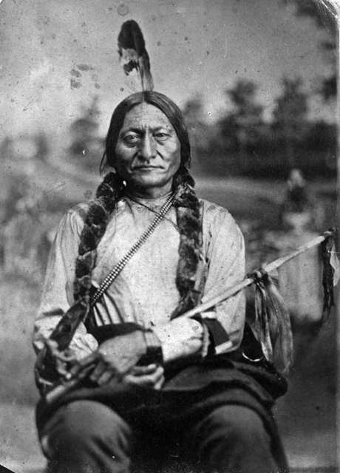
Sitting Bull
As eastern regions of the United States became more industrialized after the Civil War, people seeking rural livelihoods moved farther and farther west. In turn, Native Americans had to compete with these newcomers for land.
For example, the Sioux signed a treaty with the U.S. government promising “no white person or persons shall be permitted to settle upon or occupy” Sioux territory in the Dakotas but, when gold was discovered there, the government tried to buy the land from the Sioux, who refused to sell it. The Sioux leader, Sitting Bull, then fought U.S. Army troops, led his people to a brief exile in Canada, and finally agreed to settle on a reservation.

Slide 8
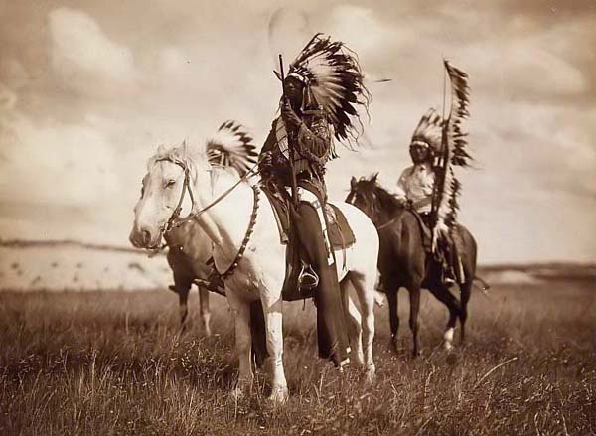
Sioux
About 10 years later, Sitting Bull’s people became associated with a Sioux religious movement. The Native Americans believed their ceremonies would cleanse the world of evil, including the white man, and restore the Sioux’s lost greatness.
Government officials ordered Sitting Bull’s arrest. He died in a brief gun battle.

Slide 9
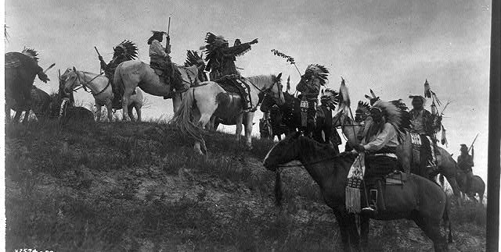
Wounded Knee
After Sitting Bull died, several hundred of his people fled to an area of South Dakota called Wounded Knee. U.S. soldiers went there to confiscate weapons from the Sioux.
A gun was fired––nobody knows by whom––and U.S soldiers then opened machine-gun fire, killing more than 300 Sioux.
This ended the Native Americans’ long conflict against Americans settling Native American lands.

Slide 10
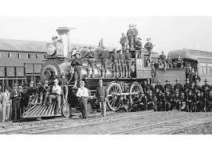
Pullman Strike
During poor economic times in the 1870s and 1890s, violence erupted when employers sought to fire some workers and to lower the wages of those still employed.
In 1894, when the Pullman railcar factory near Chicago fired almost half its workforce and cut wages by 25% to 50%, its workers went on strike. Other railway workers refused to switch Pullman cars on or off trains. Rail traffic west of Chicago came to a halt. The Pullman company responded by hiring new workers, but these workers were attacked by strikers when they attempted to go to work.
Leaders of the railroad industry convinced the government to declare the situation illegal. President Grover Cleveland sent the U.S. Army to restore peace. Both big business and the U.S. government feared labor unions were a menace to America’s capitalist economy.

