Slide 1
SSUSH11
Journal: What do you think is the most important invention in history? Why?

Slide 2
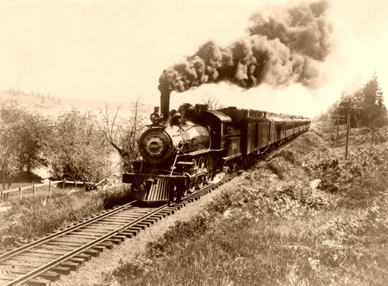
Social Change in the 1900s
The modern United States was created by social changes associated with the growth of big business and advances in technologies.
After Reconstruction, railroad companies and the steel and oil industries expanded and major inventions changed how people lived.
Questions about this standard will measure your knowledge of these changes and the factors that brought them about.

Slide 3
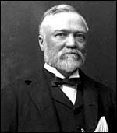
Steel
Scottish-born Andrew Carnegie (1835-1919) was an American industrialist who amassed a fortune in the steel industry then became a major philanthropist.
Carnegie worked in a Pittsburgh cotton factory as a boy before rising to the position of division superintendent of the Pennsylvania Railroad in 1859.
While working for the railroad, he invested in various ventures, including iron and oil companies, and made his first fortune by the time he was in his early 30s. In the early 1870s, he entered the steel business, and over the next two decades became a dominant force in the industry.
In 1901, he sold the Carnegie Steel Company to banker John Pierpont Morgan for $480 million. Carnegie then devoted himself to philanthropy, eventually giving away more than $350 million.

Slide 4
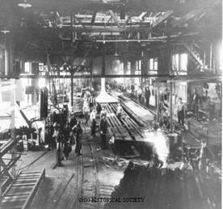
Steel
The growth of American railroads helped expand the industries that supplied the railroad companies’ need for steel rails laid on wood ties, iron locomotives burning huge quantities of coal, wooden freight cars, and passenger cars with fabric-covered seats and glass windows. The railroads were the biggest customers for the steel industry because thousands of miles of steel track were laid.
In turn, the railroads had a great impact on the steel industry. To supply their biggest customers, steel producers developed cheap, efficient methods for the mass production of steel rails. These low-cost methods enabled more industries to afford the steel companies’ products.

Slide 5
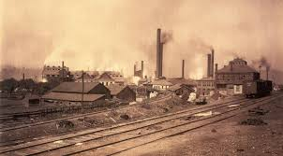
Steel
The rapid rise of the steel and railroad industries between the end of the Civil War and the early 1900s spurred the growth of other big businesses, especially in the oil, financial, and manufacturing sectors of the economy.
These big businesses acquired enormous financial wealth. They often used this wealth to dominate and control many aspects of American cultural and political life, and as a consequence of these practices, by the beginning of the 20th century big business became the target of government reform movements at the state and national levels.

Slide 6
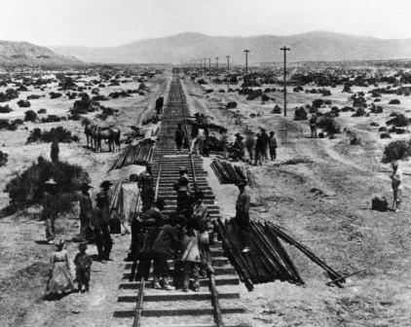
Railroads
The federal government granted vast areas of western land to railroad owners so they would lay train track connecting the eastern and western states. To complete this heavy work, the owners relied mainly on Chinese labor.
These Asian immigrants accepted lower pay than other laborers demanded. The work was dangerous. Many Chinese died in the explosive blasts they ignited to clear the path across the railroad companies’ land. Many others died under rock slides and heavy snowfalls before the first transcontinental railroad was completed in 1869.

Slide 7
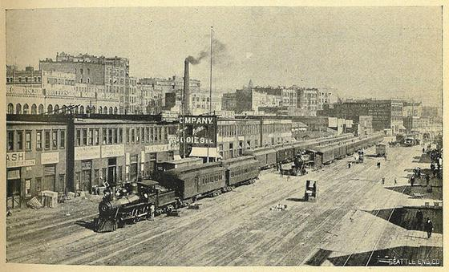
Railroads
The railroad companies contributed to the development of the West by selling low-cost parcels of their western land for farming.
Settlers traveled west on the trains to farm on the fertile soil. Western farmers used the trains to ship their grain east, and western cattle ranchers shipped their steers to eastern butchers.
Both farmers and ranchers sold their goods to people they could not easily reach without railroads. The railroads earned money by transporting the settlers west and the goods east.

Slide 8
oil
Oil companies grew swiftly in this period, most notably the Standard Oil Company, founded by John D. Rockefeller. Standard Oil was the most famous big business of the era.
Rockefeller also gained control of most other oil companies and created what is called a trust. By means of a trust, Rockefeller came to own more than 90% of America’s oil industry.

Slide 9
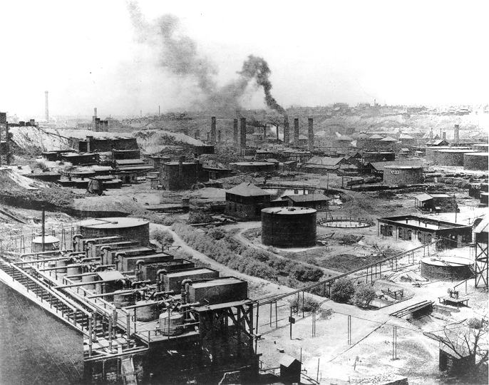
OIl
Standard Oil thus became a monopoly––a single company that controlled virtually all the U.S. oil production and distribution.

Slide 10
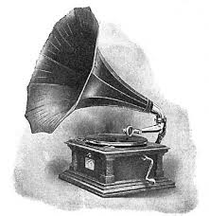
Thomas Edison
The effects of technological advances made after Reconstruction forever changed how people lived. The most famous inventor of the period is Thomas Edison.
He invented the electric lightbulb, the phonograph, motion pictures, a system for distributing electrical power, and many other technologies powered by electricity. Edison also established the concept of industrial research, and he founded a research laboratory staffed by engineers and technicians in New Jersey.

Slide 11
Inventions
Edison’s technological achievements were used by other inventors, as evidenced by the development of long-distance electricity transmission, which enabled Edison’s electric light to illuminate buildings, streets, and neighborhoods across the United States.
Electricity soon replaced steam as the source of power for factories. It replaced horses as the means to power streetcars. Of greatest impact, perhaps, was electricity’s replacing humans as the source of power for household appliances. Edison’s inventions eliminated much manual labor that had been associated with everyday household activities and improved Americans’ quality of life.

