Slide 1
Unit 2
Journal: If you were living in the colonies, would you want to remain loyal to England or gain your independence? Explain your answer.
(Consider the dangers/ consequences of fighting against your country. Would it be worth it to you?)
The American Revolution

Slide 2
Guidelines for test corrections
You may correct you test if you made an 89 or below.
In order to get credit you must:
Re-write the question on a separate sheet of paper
Write the correct answer
Staple the sheet to the back of the test and turn it back in
YOU WILL NOT GET CREDIT OF YOU DO NOT WRITE THE QUESTION
You will get half credit back for every correction
You may use your books, notes, etc.

Slide 3
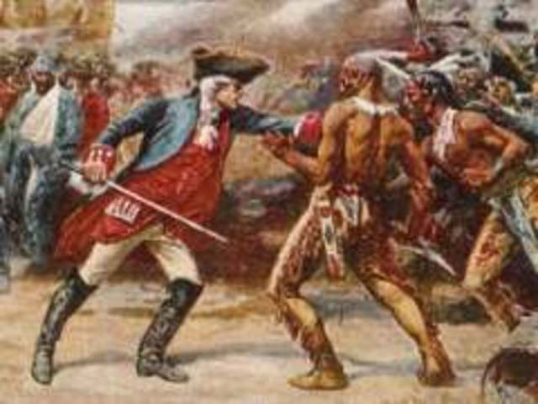
French and Indian War (1756- 1763)
Colonial population: 250,000 in 1700 - 1.25 million in 1750
In the early 1750s, France’s expansion into the Ohio River valley. Conflict with the claims of the British colonies, especially Virginia.
British military effort was hurt by lack of interest in England, rivalries among the American colonies, and France’s winning the support of the Indians

Slide 4
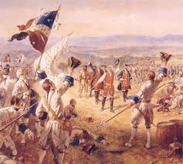
Results of French and Indian War
Treaty of Paris peace conference in 1763:
the British received Canada from France and Florida from Spain
Permitted France to keep its West Indian sugar islands
gave Louisiana to Spain.
The treaty strengthened the American colonies significantly by removing their European rivals to the north and south and opening the Mississippi Valley to westward expansion.

Slide 5
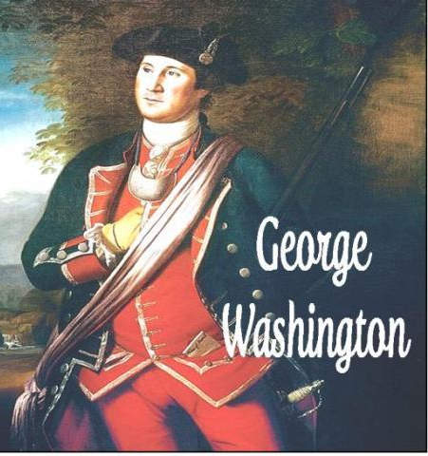
French and Indian War: How it lead to American Revolution
The English did ultimately come to dominate the colonial outposts, but at a cost that the resulting debt nearly destroyed the English government. It was that debt that caused the escalation of tensions leading to the Revolutionary War.
Parliament wanted:
1. to tax the colonies to recover money expended on the battle over North America
2. to restore the profitability of the East India Company to recover money spent on the battle over India

Slide 6
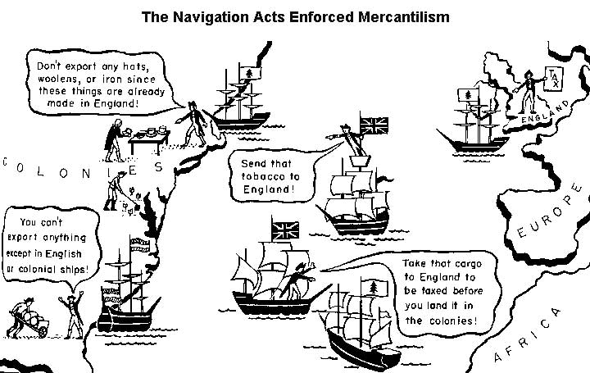
Navigation Acts
Britain required raw materials including copper, hemp, tar, and turpentine. They also required a great deal of money, and so they provided that all of these American products be shipped exclusively to England

Slide 7
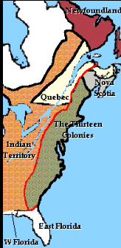
Proclamation of 1763
On October 7, 1763, King George III issued a proclamation that prevented colonial settlement west of the Appalachian Mountains.
He hoped to placate Native Americans who had sided against him during French and Indian War.
Enforcement was so weak that it did very little to curb the westward flow of pioneers. Even people like George Washington paid it no attention
Colonists saw it as a source of anti-British sentiment leading up to the American Revolution.

Slide 8
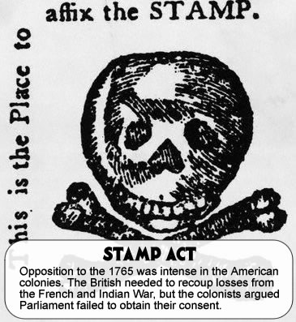
Stamp Act
required colonists to pay a tax on every piece of printed paper they used
Ship's papers, legal documents, licenses, newspapers, other publications, and even playing cards were taxed
The money collected was used to help pay the costs of defending and protecting the American frontier near the Appalachian Mountains

Slide 9
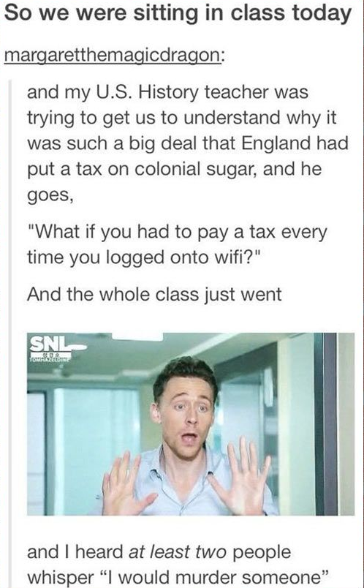
Why was the Stamp Act controversial?
In the past, taxes and duties on colonial trade had always been viewed as measures to regulate commerce, not to raise money.
The Stamp Act was viewed as a direct attempt by England to raise money in the colonies without the approval of the colonial legislatures

Slide 10
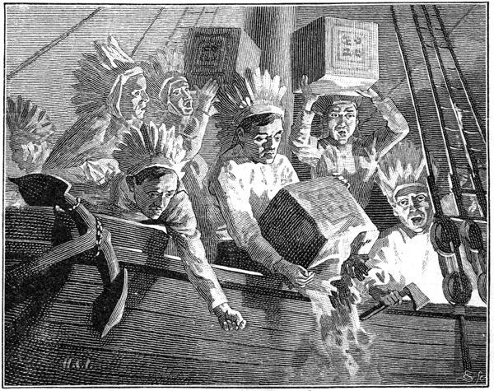
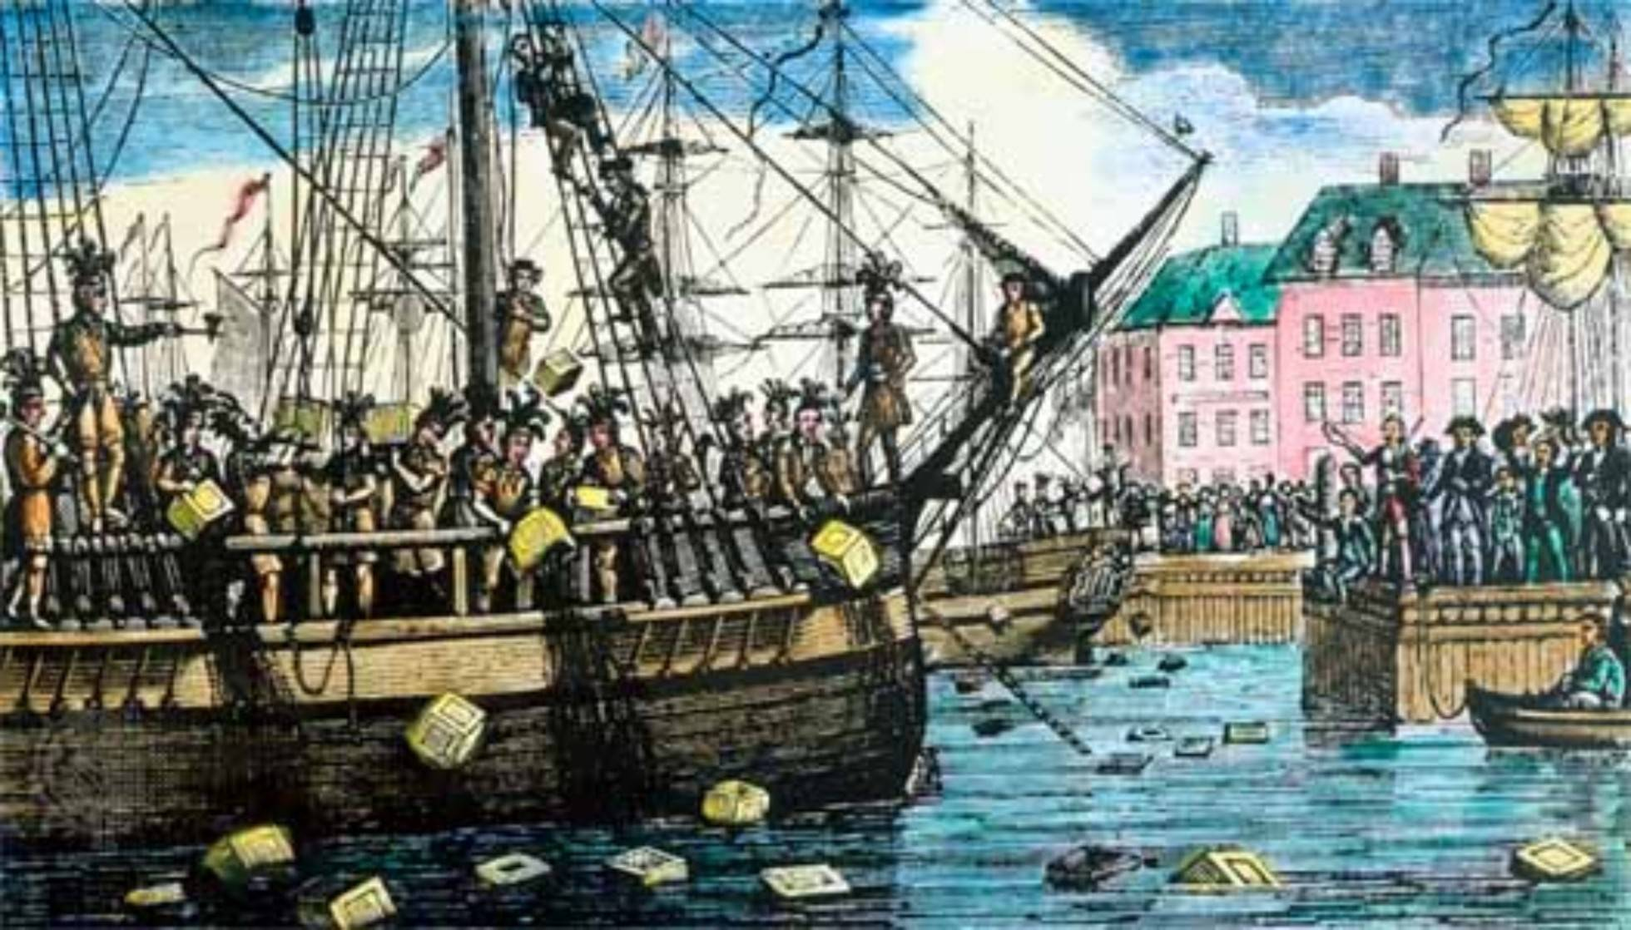
Boston Tea Party
Seeking to boost the troubled East India Company, British Parliament adjusted import duties with the passage of the Tea Act in 1773.
On the night of December 16, 1773, Samuel Adams and the Sons of Liberty boarded three ships in the Boston harbor and threw 342 chests of tea overboard

Slide 11
Intolerable Acts
Used to punish colonists for Boston Tea Party
Boston Port Bill: Boston Harbor was closed to trade until the owners of the tea were compensated. Only food and firewood were permitted into the port.
Massachusetts Government Act: Town meetings were banned, and the authority of the royal governor was increased.
Administration of Justice Act: protected British officials charged with capital offenses during law enforcement by allowing them to go to England or another colony for trial
Quartering Act: Greater freedom was granted to British officers who wished to house their soldiers in private dwellings.

Slide 12
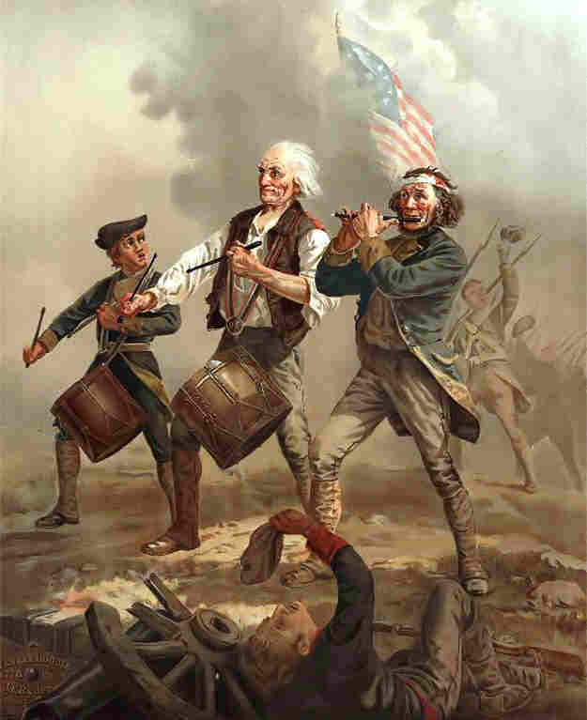
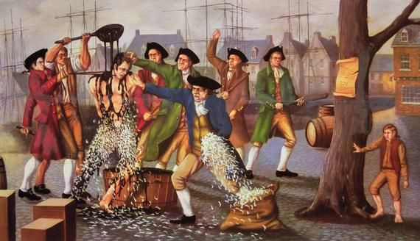
Sons and Daughters of Liberty
Originally formed in response to the Stamp Act, their activities were far more than ceremonial. It was the Sons of Liberty who ransacked houses of British officials. Threats and intimidation were their weapons against tax collectors, causing many to flee town. Images of unpopular figures might be hanged and burned in effigy on the town's Liberty Tree. Offenders might be covered in warm tar and blanketed in a coat of feathers.

Slide 13
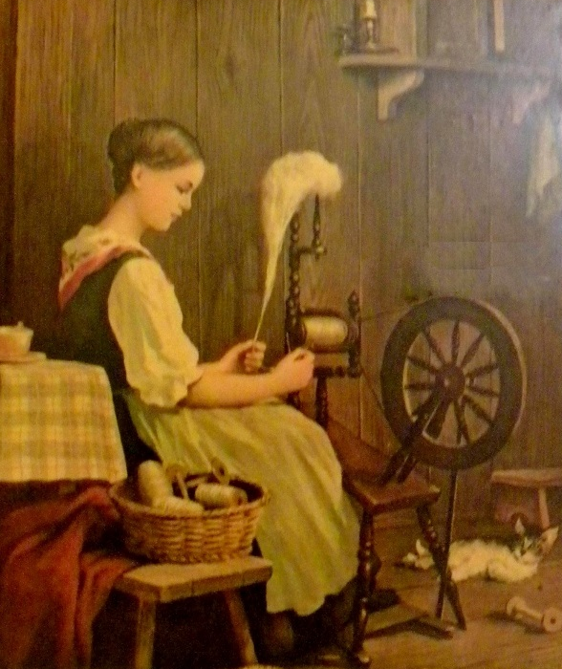
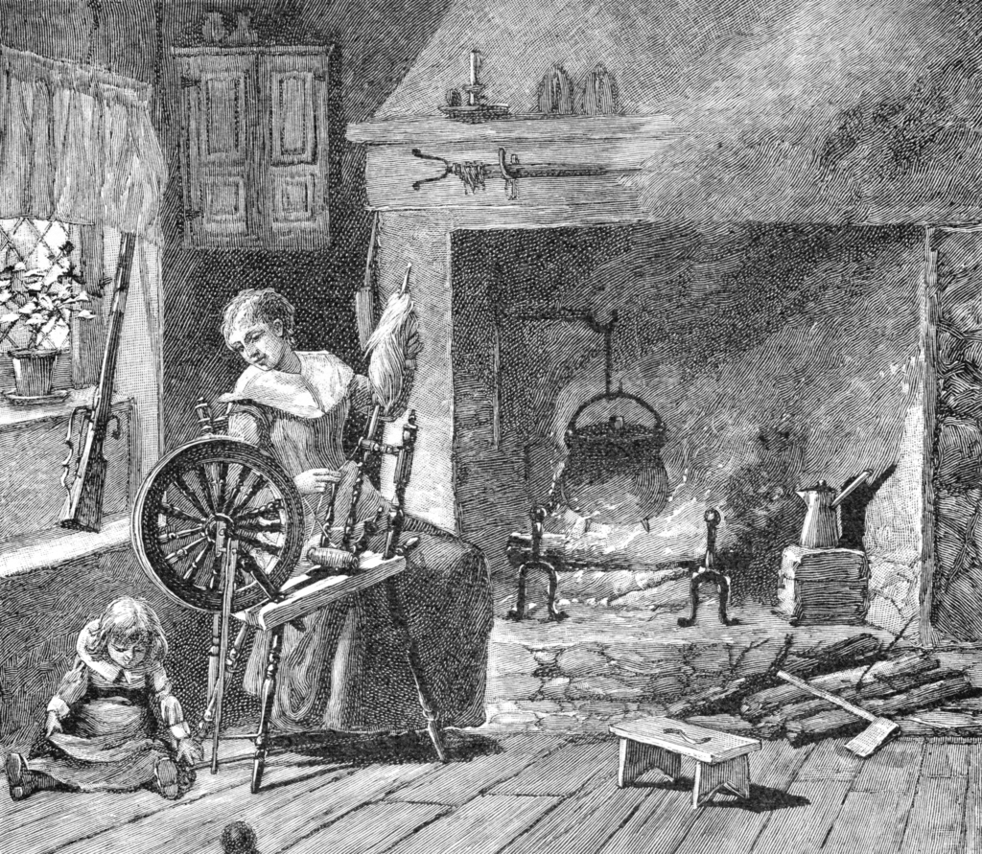
Daughters of Liberty
The Daughters of Liberty performed equally important functions. Once nonimportation became the decided course of action, there was a natural textile shortage.
Mass spinning bees were organized in various colonial cities to make homespun substitutes.
Since women often purchased consumer goods for the home, the Daughters of Liberty became instrumental in upholding the boycott, particularly where tea was concerned.

Slide 14
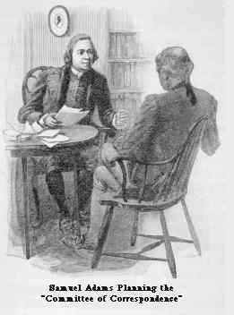
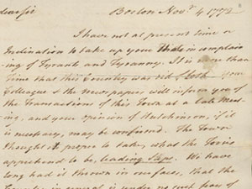
Committee of Correspondence
Another important function of the Sons of Liberty was correspondence.
found up and down the colonial seaboard.
Often they coordinated their activities
this private band of societies provided an inter-colonial network that would help forge unity. It should come as no surprise that the members of the Sons of Liberty were also often delegates to the later various Congresses

Slide 15
Causes of the American Revolution

Slide 16
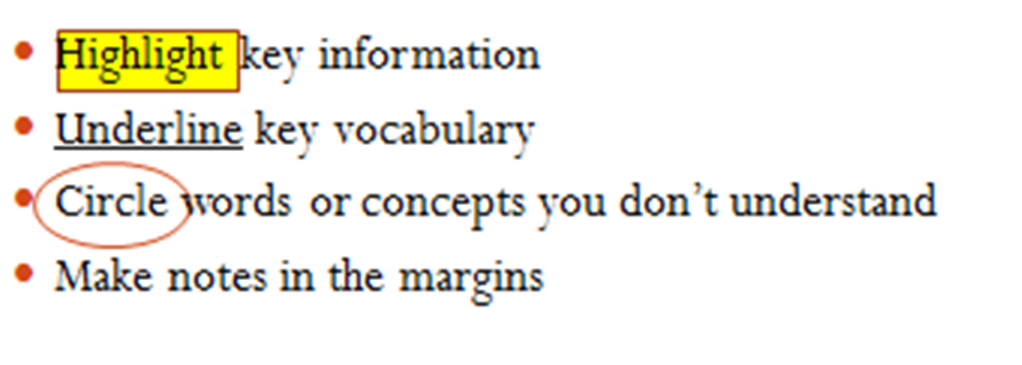
Boston Tea Party Close Reading

Slide 17
3rd block agenda
1. Course pre-test. When you are finished, turn it in on my desk up front
2. Finish your advanced organizer. Our Socratic discussion is tomorrow so you must finish TODAY! Remember, it is a quiz grade.
3. Test corrections for 2nd and 5th block.

Slide 18
3rd block- Geography
Your assignment is to finish the following:
The Wilco and Ga maps- labeled with physical, political and cultural features (turn in when finished)
Physical features sheet- Create your own place and include the landforms listed (turn in when finished)
The Climate zones chart (keep in interactive notebook)

Slide 19
Revolutionary Performance task:
War Museum Exhibit. The students are to choose from a list of people and events from the Revolutionary War and create an informational sign that advertises for the exhibit.
The student will choose 2 events and 1 person to feature. The sign will include a title, and explanation, and an illustration.

