Slide 1
Opposition to Equality
Journal: Imagine you were a slave when the Emancipation Proclamation was given. What types of rights would you now have? How would you be treated? What would you do?

Slide 2
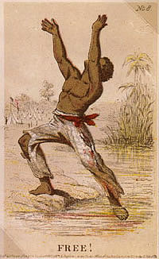
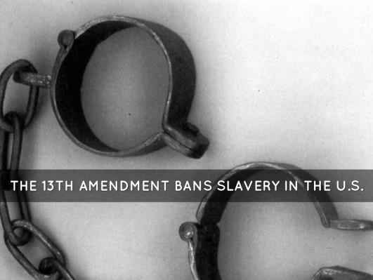
13th Amendment
Thirteenth Amendment: abolished slavery and involuntary servitude in the United States

Slide 3
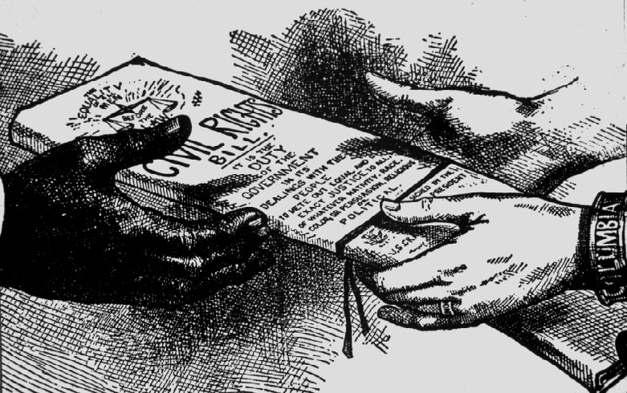
14th Amendment
Fourteenth Amendment: defined U.S. citizenship as including all persons born in the United States, including African Americans; guaranteed that no citizen could be deprived of his or her rights without due process

Slide 4
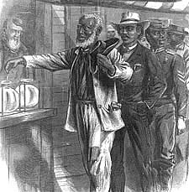
15th Amendment
Fifteenth Amendment: removed restrictions on voting based on race, color, or ever having been a slave; granted the right to vote to all male U.S. citizens over the age of 21

Slide 5
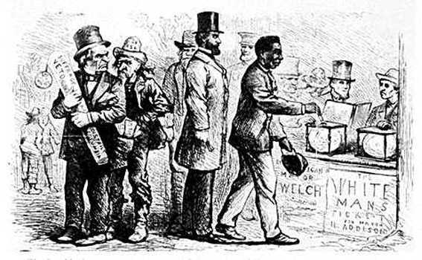
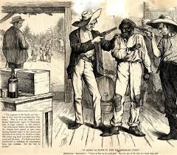
Black Codes
Not all white Southerners accepted the equal status of former slaves. After the Thirteenth Amendment abolished slavery, all former slave states enacted Black Codes, which were laws written to control the lives of freed slaves in ways slaveholders had formerly controlled the lives of their slaves.
Black Codes deprived voting rights to freed slaves and allowed plantation owners to take advantage of black workers in ways that made it seem that slavery had not been abolished.

Slide 6
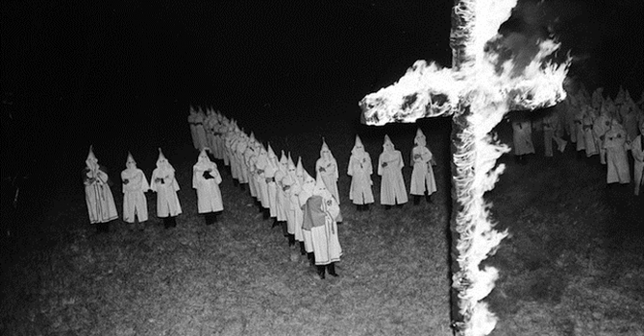
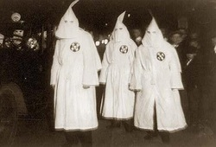
Ku Klux Klan
Other white Southerners formed secret societies that used murder, arson, and other threatening actions as a means of controlling freed African Americans and of pressuring them not to vote.
The Ku Klux Klan was the worst of these societies. The Klan, or KKK, was founded by veterans of the Confederate Army to fight against Reconstruction.
Some southern leaders urged the Klan to step down because federal troops would stay in the South as long as African Americans needed protection from the society.

Slide 7
Your turn
Research (using textbooks and iPads) the lasting impact of either the Black Codes, KKK and Reconstruction amendments and create a poster
Things to think about: How long did they last? Have they changed? If so, what caused that change? Do they still exist?
You may do this on poster paper
You may work quietly in your groups (NO MOVING!)

Slide 8
Brainstorm:
What do you think the term "Cold War" means? How would it be different than a hot war?

Slide 9
Read the Seneca Falls document and the dec of Ind. Answer the questions comparing and contrasting the 2.

