Slide 1
Impeachment
Quietly think about these questions and jot down some answers in your notebook:
What is impeachment? How many presidents have been impeached? How many have stepped down from office?

Slide 2
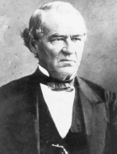
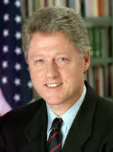
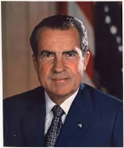
What is impeachment?
Impeachment is a formal process in which an official is accused of unlawful activity
Two presidents:
Andrew Johnson, Democrat/National Union, was impeached in 1868 after violating the then-newly created Tenure of Office Act. President Johnson was acquitted by the Senate, falling one vote short of the necessary 2/3 needed to remove him from office, voting 35-19 to remove him. The Tenure of Office Act would later be found unconstitutional by the Supreme Court of the United States in dicta.
Bill Clinton, Democrat, was impeached on December 19, 1998, by the House of Representatives on articles charging perjury (specifically, lying to a federal grand jury) by a 228–206 vote, and obstruction of justice by a 221–212 vote. The Senate vote to remove him from office fell short of the necessary 2/3, voting 45-55 to remove him on obstruction of justice and 50-50 on perjury.
Richard Nixon was never impeached. While the House Judiciary Committee did approve articles of impeachment against him and did report those articles to the House of Representatives, Nixon resigned before the House could consider the impeachment resolutions and was subsequently pardoned by President Ford.

Slide 3
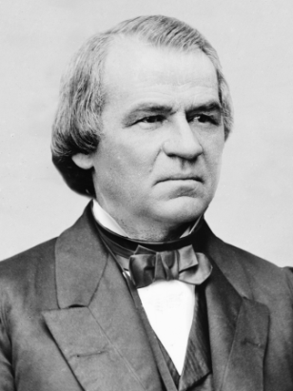
Andrew Johnson as President
Sworn in as president after Lincoln's assassination in April 1865, President Johnson enacted a lenient Reconstruction policy for the defeated South, including almost total amnesty to ex-Confederates, a program of rapid restoration of U.S.-state status for the seceded states, and the approval of new, local Southern governments, which were able to legislate "black codes" that preserved the system of slavery in all but name.
The Republican-dominated Congress greatly opposed Johnson's Reconstruction program and passed the "Radical Reconstruction" by repeatedly overriding the president's vetoes.
Under the Radical Reconstruction, local Southern governments gave way to federal military rule, and African-American men in the South were granted the constitutional right to vote.

Slide 4
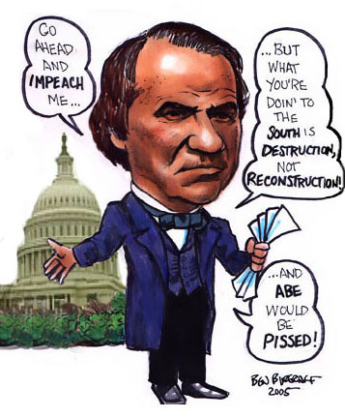
During the Reconstruction period, the biggest issue in northern and southern states alike was the impeachment of President Andrew Johnson.
The U.S. Constitution allows Congress to remove the president from office by impeaching (accusing) him of committing “high crimes and misdemeanors,” so Radical Republicans impeached Johnson when he ignored laws they had passed to limit presidential powers.
They passed these laws to stop Johnson from curbing the Radical Republicans’ hostile treatment of former Confederate states and their leaders.

Slide 5
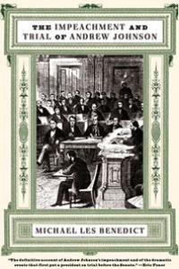
Results
After a three-month trial in the Senate, Johnson missed being convicted by one vote, so he was not removed from office merely because he held political opinions unpopular among politicians who had the power to impeach him.

Slide 6
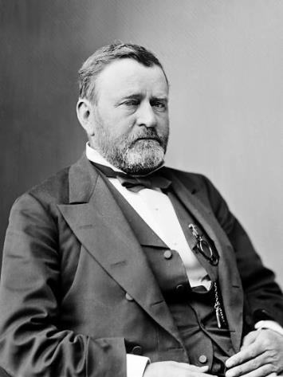
What next?
Because both votes fell short--by one vote--of the two-thirds majority needed to convict Johnson, he was judged not guilty and remained in office.
Nevertheless, he chose not to actively seek reelection on the Democratic ticket. In November, Ulysses S. Grant, who supported the Republicans' Radical Reconstruction policies, was elected president of the United States.

Slide 7
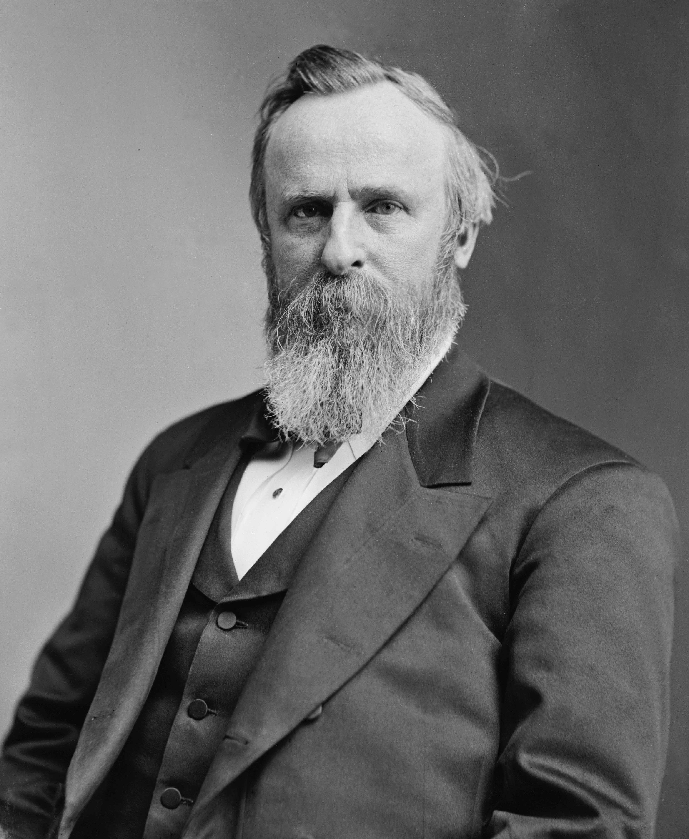
Election of 1876
All in all, the readmission of states proved difficult and led white Southerners to resist Reconstruction and to regard their Reconstruction state governments as corrupt.
Reconstruction came to an end when Union troops were withdrawn from the South as part of the Compromise of 1877, which resulted from the contested 1876 presidential election between Rutherford B. Hayes and Samuel Tilden
When the soldiers left and white Southerners regained control of their state governments, African Americans were left unprotected. The new southern governments quickly passed laws that deprived blacks of their rights and worked to strengthen the segregation of southern society.

Slide 8
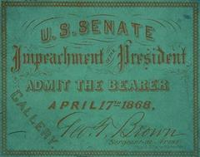
Close Reading
You have been given a copy of the tenure of Office Act and a short over view of its importance. This is the law that Johnson went through the impeachment trials for violating. Answer the questions. Be sure you read the question and answer it appropriately.

Slide 9
Who was the president after Johnson?

Slide 10
What agency was created to help freed slaves adapt to free life?

Slide 11
Amendment that gave slaves citizenship

Slide 12
Freed slaves in US

Slide 13
Gave the right to vote to black men

Slide 14
Laws passed to restrict the rights of blacks in the south

Slide 15
Law Johnson was accused of violating

Slide 16
2 things that ended Reconstruction

Slide 17
What happened to abandoned land in the South?

Slide 18
If you could not afford your own land, how did you make a living by farming?

Slide 19
What was lincoln’s plan for reconstruction?

Slide 20
What was congress’s plan for reconstruction?

Slide 21
What political party did Grant belong to?

Slide 22
Your turn
Students will create a timeline of Johnson's impeachment, and the subsequent elections that ended the Reconstruction period.
You may work in pairs and use the materials on the back table
Use your textbooks and iPads
Include Johnson’s offense, actions, the trial, the votes in Congress, and the next presidential election, etc. Begin with Johnson’s election and end with the end of Reconstruction
BE DETAILED
Must include
Hayes
(Comp of1877) and
Grant
10
15
20
25

Slide 23
