Slide 1
Reconstruction
Journal: Imagine you are a newly freed slave. How would your life be different during Reconstruction than it was during the Civil War and before?

Slide 2
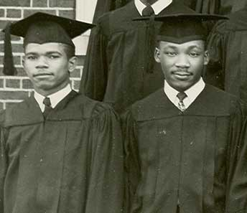
Morehouse College
During the Reconstruction period, African Americans made progress in many areas. Some of these gains lasted, but others did not.
Many African American children were able to attend free schools for the first time. African Americans started newspapers, served in public office, and attended new colleges and universities established for them.
One of these institutions, Morehouse College, was founded in Atlanta in 1867 as the Augusta Institute. A former slave and two ministers founded it for the education of African American men in the fields of ministry and education.

Slide 3
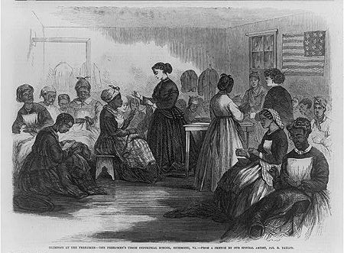
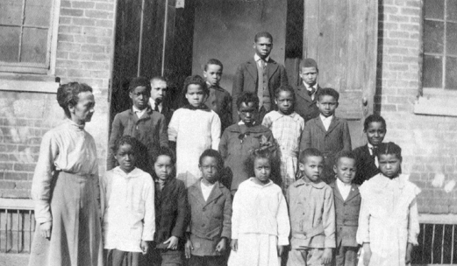
Freedmen’s Bureau
Congress also created the Freedmen’s Bureau to help African Americans make the transition to freedom.
The Freedmen’s Bureau helped former slaves solve everyday problems by providing food, clothing, jobs, medicine, and medical-care facilities.

Slide 4
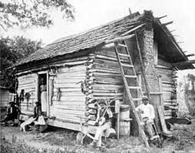
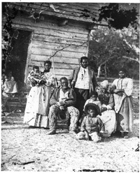
Land Grants
While the Freedman’s Bureau did help some former slaves acquire land unclaimed by its pre-war owners, Congress did not grant land or the absolute right to own land to all freed slaves.
Such land grants would have provided African Americans with some level of economic independence.
Without it, and with few skills outside of farming, the newly freed slaves had few options other than entering the sharecropping, crop lien, or tenant farming system, where they often ended up working for former slaveholders in conditions little different from slavery.

Slide 5
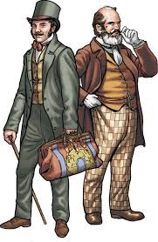
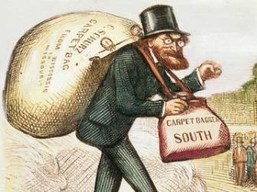
North and South
Northerners who traveled to the South to help the former slaves and to make money were called carpetbaggers.
Southerners who cooperated with the African Americans & carpetbaggers were called scalawags. These two groups also played a role in Reconstruction.

Slide 7
Poster- in groups of 3 or 4
Create a poster for the Freedman’s Bureau.
Include information on its creation, its projects, its success, the people who worked for it and areas that needed more help.
Include a visual representation

Slide 8
List- Oregon Trail Game
You are a settler headed west on the Oregon Trail. You may bring 5 items with you to support your family. What 5 items would you bring? You also have $200 to buy supplies along the way.

Slide 9
Rules
You are divided into 2 wagon trains. These trains are moving westward and each day has new challenges or triumphs. You will compile your supplies for your train based on your list.
Each “day” a representative from your wagon train will choose what will happen- either good or bad. If something bad happens 2 things can happen.
Sickness means 1 person in the group dies. Otherwise, the group does not advance forward.
If something positive happens, you move forward and can draw to see how many miles you will advance. If you choose to buy medicine, you may add back one person who had died to your wagon train.
Whichever group advances the farthest wins. If all members of a wagon train die, they lose.

Slide 10
Wagon Train 1 Wagon Train 2
Miles Miles
Fatalities Fatalities
Supplies lost Supplies lost
Money left Money Left
Available supplies Available Supplies

