Slide 1
Journal: Imagine you were living in Georgia as Sherman's troops marched through. What do you think that experience would be like?
extricate (ex-tri-cate) transitive verb: set free, release, get out of
Emancipation Proclamation

Slide 2
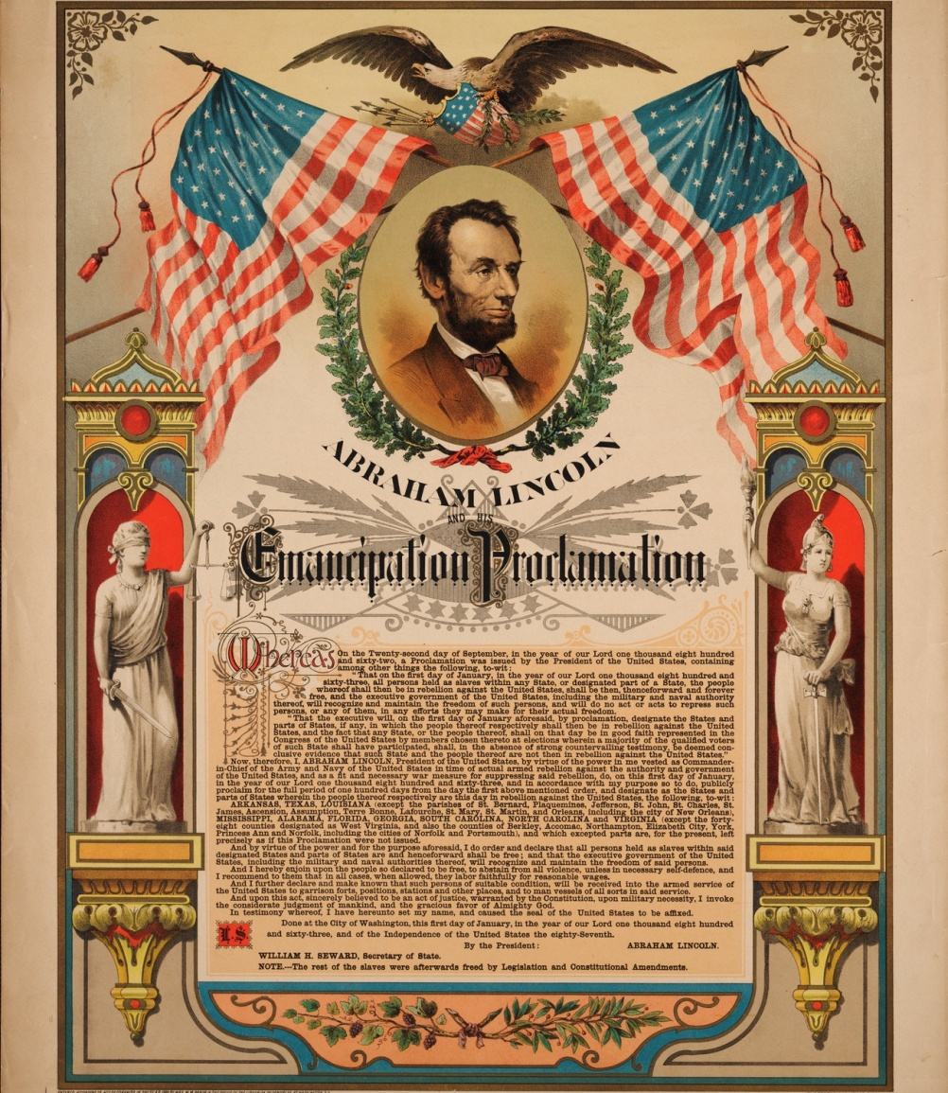
Emancipation Proclamation
Lincoln used his emergency powers again to issue the Emancipation Proclamation.
It emancipated (freed) all slaves held in the Confederate states. Lincoln did not expect Confederate slaveholders to free their slaves, but he thought news of the proclamation would reach southern slaves and encourage them to flee to the North.

Slide 3
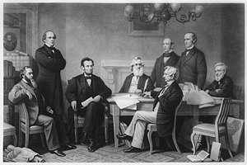
Why?
Lincoln believed one reason southern whites were free to join the Confederate Army was because slaves were doing war work that, otherwise, the whites would have to do.
Encouraging slaves to flee north would hurt the southern war effort.

Slide 4
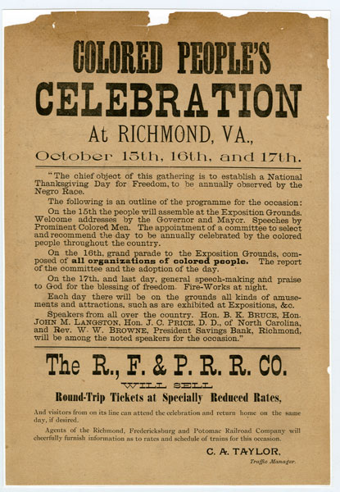
Why?
Although the Emancipation Proclamation did not free slaves held in the North, it was warmly welcomed by African Americans living in Union states. They understood the proclamation announced a new goal for the Union troops––besides preserving the Union, the troops were fighting for the belief that the United States would abolish slavery throughout the nation.

Slide 5
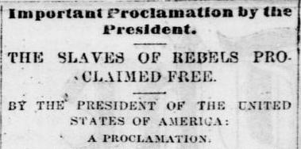
What it did
The announcement of Abraham Lincoln’s Emancipation Proclamation was one of the main actions of the Civil War. The Emancipation Proclamation freed all slaves residing in territory that was in rebellion against the federal government.
This encouraged slaves in the South to attempt to escape. As the number of runaway slaves climbed, the South’s ability to produce cotton and food declined. To counter this, the South devoted some of its manpower to keeping slaves from running away.

Slide 6
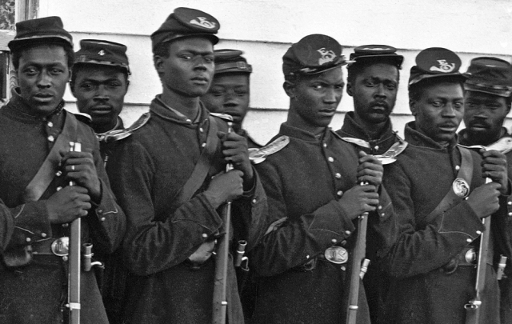
Results
In addition, following the proclamation, the North began to allow African Americans to join the Union army. While few served in combat, more than 150,000 African Americans took the place of white soldiers by garrisoning forts and working behind the front lines. This was the equivalent of giving the North a new army larger than the South’s.
Some historians believe this was enough to guarantee a northern victory. The
Emancipation Proclamation had a very practical effect on the outcome of the war. When you think about it, do not forget its impact on manpower and the outcome of the Civil War.

