Slide 1
End of the Civil War and Reconstruction
Answer these questions somewhere in your notes:
What does the term "reconstruction" mean? Why does the country need it after the Civil War?

Slide 2
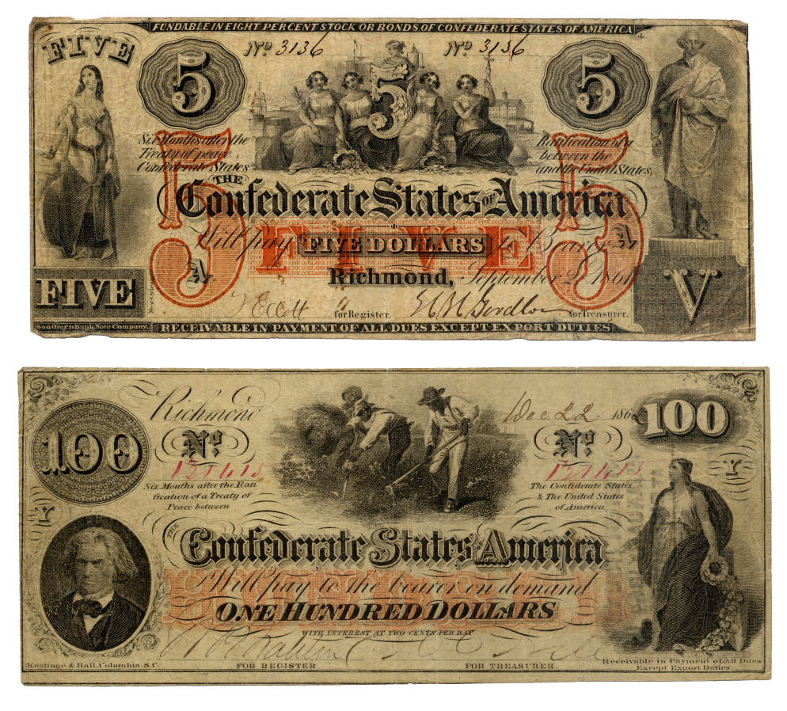
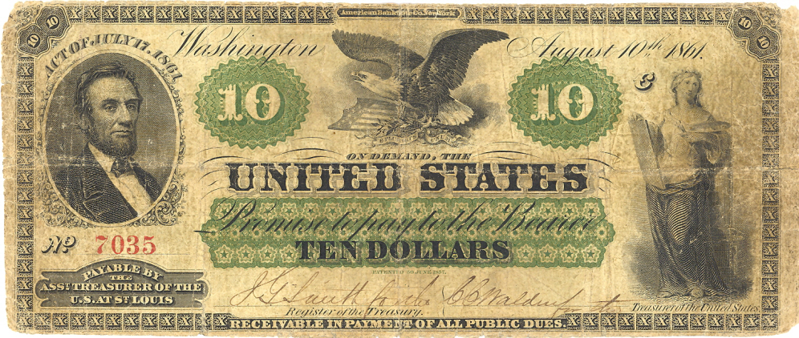
North versus South
When southern forces opened fire on Union forces at Fort Sumter, they began a war that would last four years and take the lives of 821,000 soldiers.
From the start, the Confederacy was at a serious disadvantage. The southern economy differed greatly from the economy of the northern states, and, in the end, the numerical and industrial superiority of the northern economy proved too much for the South to overcome.

Slide 3
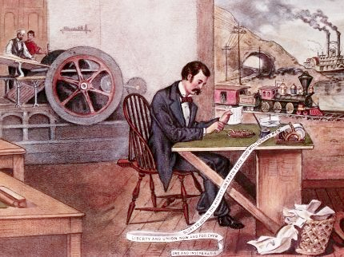
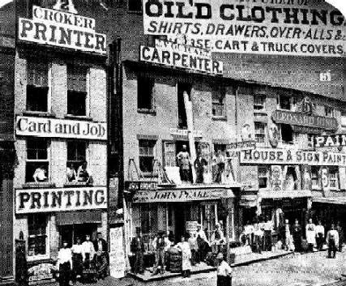
Northern Economy
Industry and trade
71% of U.S. population; 99% free, 1% slave; large enough to assemble an army capable of defending the Union
92% of U.S. industrial output; generous resources to produce weapons and other military supplies and equipment
Many citizens worked for someone else and owned no property. Even in large-scale farming regions, machines reduced the need for agricultural workers.
34% of U.S. exports; favored high tariffs on imported foreign goods to protect northern industries and workers’ jobs
More than twice as much as the South produced
71% of U.S. railroad network; efficient railway transport system. Ready capacity to transport troops and their supplies, food, etc.

Slide 4
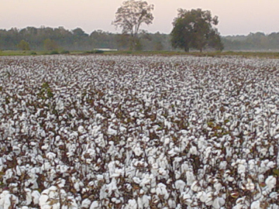
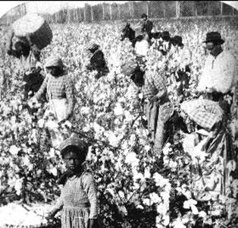
Southern Economy
Agriculture
29% of U.S. population; 67% free, 33% slave; too few free men to assemble an army capable of defending the South
8% of U.S. industrial output; minimal resources to produce many weapons and other military supplies and equipment
Though most Southerners owned slaves, the economy of the South as a whole depended on the production of cash crops such as cotton, corn, rice, and tobacco, which required human labor and depended on slavery.
66% of U.S. exports; favored low (or no) tariffs on imported goods to keep the prices of manufactured goods more affordable
Less than half as much as the North produced 29% of U.S. railroad network; inefficient railway transport system. Poor capacity to transport troops and their supplies, food, etc.

Slide 5
End of the Civil War and Reconstruction
Answer these questions somewhere in your notes:
What does the term "reconstruction" mean? Why does the country need it after the Civil War?

Slide 6
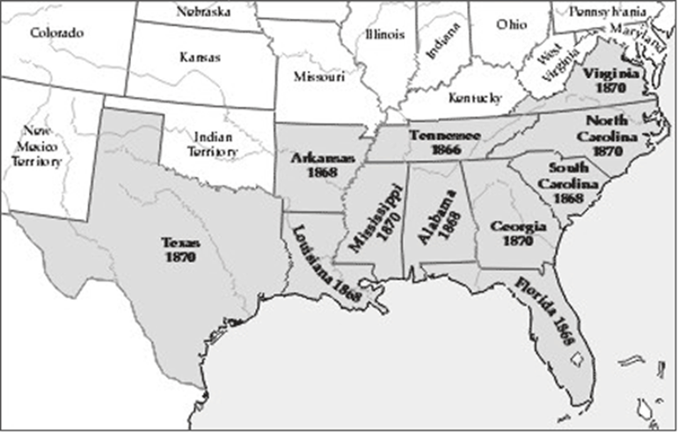
Presidential Reconstruction
The Reconstruction plans begun by President Abraham Lincoln and carried out by President Andrew Johnson echoed the words of Lincoln’s second inaugural address, which urged no revenge on former Confederate supporters.
The purpose of Presidential Reconstruction was to readmit the southern states to the Union as quickly as possible.
Republicans in Congress, however, were outraged by the fact that the new southern state governments were passing laws that deprived the newly freed slaves of their rights.

Slide 7
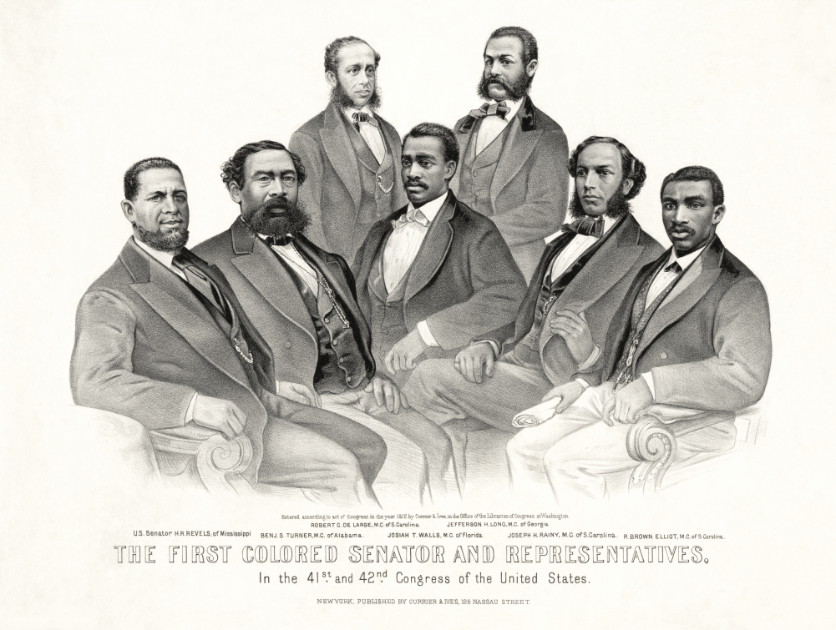
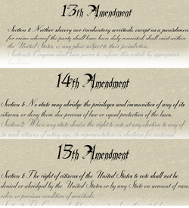
Radical Republican Reconstruction
To remedy the Radical Republicans’ outrage, Congress forced the southern states to reapply for admission to the Union and to take steps to secure the rights of the newly freed slaves.
This resulted in the creation of southern state governments that included African Americans.
The key feature of the effort to protect the rights of the newly freed slaves was the passage of three constitutional amendments during and after the Civil War.
Southern states were required to ratify all these amendments before they could rejoin the Union.

Slide 8
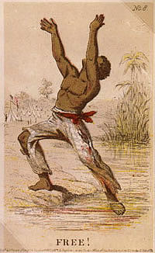
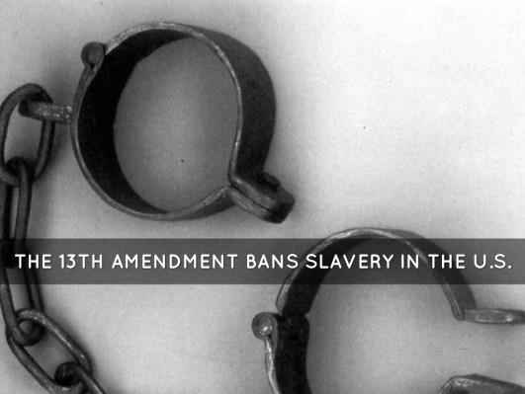
13th Amendment
Thirteenth Amendment: abolished slavery and involuntary servitude in the United States

Slide 9
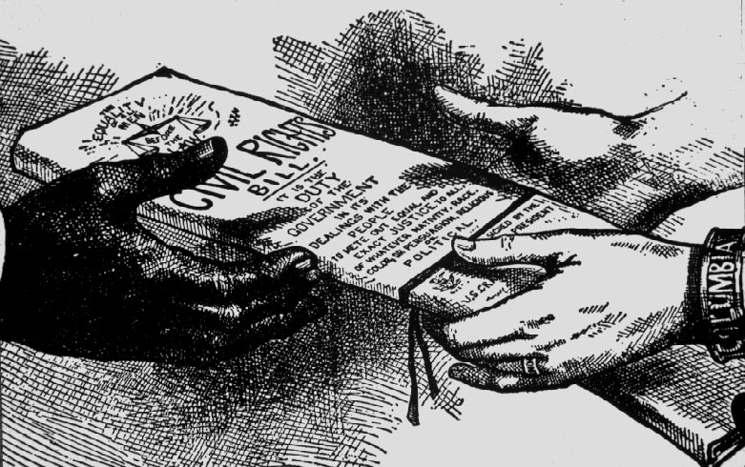
14th Amendment
Fourteenth Amendment: defined U.S. citizenship as including all persons born in the United States, including African Americans; guaranteed that no citizen could be deprived of his or her rights without due process

Slide 10
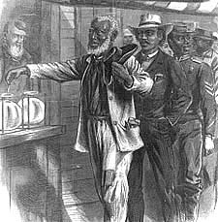
15th Amendment
Fifteenth Amendment: removed restrictions on voting based on race, color, or ever having been a slave; granted the right to vote to all male U.S. citizens over the age of 21

Slide 11
Presidential vs. Radical Republican

Slide 12
Do Humpty Dumpty sheet
Finish your close reading from yesterday
Do your test corrections

Slide 13
3rd
Read pages 11-12 in the Trail of Tears packet
Answer 1-4 on page 12 on a separate sheet of paper

Slide 14
4th Block
Take a few minutes to study quietly for your TEST
We will take the multiple choice/ matching section before lunch and the constructed response/ mapping section after.

