Slide 1
Write the question and the answer
1) The mid-Atlantic colony of Pennsylvania was founded by William Penn PRIMARILY because of his
A)loss in the war with the Dutch for control of New Amsterdam.
B)failure to successfully take power in Massachusetts Bay Colony.
C)wish to found a logical, well-planned, religiously tolerant colony.
D)desire to have a government in which all citizens could participate.
2) Which colony was home to the largest number of Quakers?
A)Georgia
B)New York
C)Pennsylvania
D)Massachusetts

Slide 2
Intro to key people
The political and military leaders of the Union and the Confederacy represented the different beliefs and values that separated the North from the South.
The northern leaders thought it was illegal for the southern states to secede from the Union. They considered the Confederates outlaws, not citizens of a separate country.
On the other hand, the southern leaders put loyalty to their home states above everything else. They fought for the Confederacy to protect their homes, even though they may have had misgivings about secession.

Slide 3
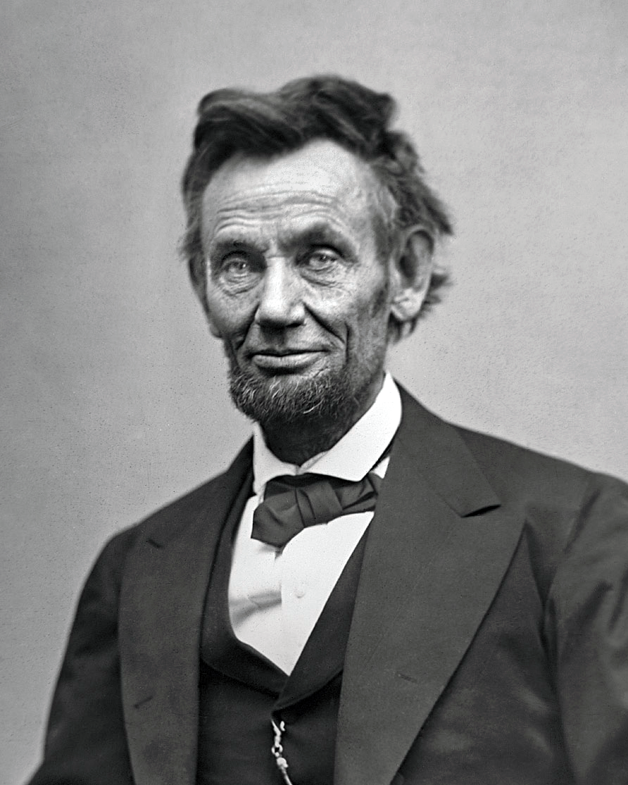
North/Union: President Abraham Lincoln
• U.S. representative from Illinois • President of United States of America, 1861–1865 • Appointed Gen. Ulysses S. Grant commanding general of Union armies • Issued Emancipation Proclamation • Promoted Thirteenth Amendment to Constitution

Slide 4
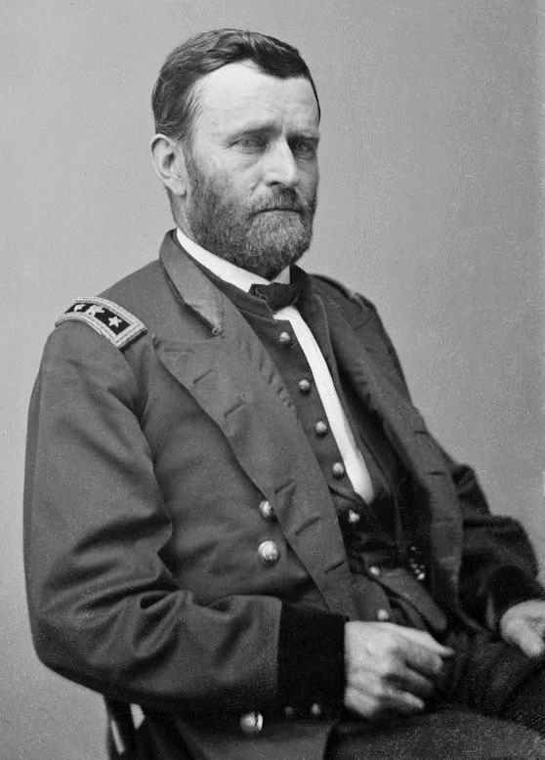
Ulysses S. Grant
• Graduated from U.S. Military Academy, West Point
• Won first Union victories
• Captured control of Mississippi River in Siege of Vicksburg
• Appointed commanding general of Union armies by Lincoln
• Accepted surrender of Confederate Gen. Lee to end Civil War

Slide 5
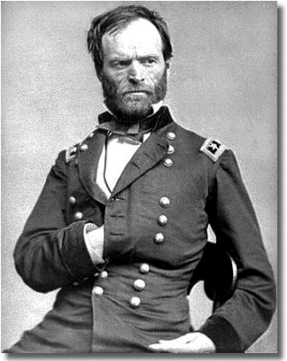
William Tecumseh Sherman
• Graduated from U.S. Military Academy, West Point
• Served under Gen. Grant during Siege of Vicksburg
• Destroyed Atlanta; ended Confederate’s ability to fight
• Accepted surrender of all Confederate armies in Carolinas, Georgia, and Florida

Slide 6
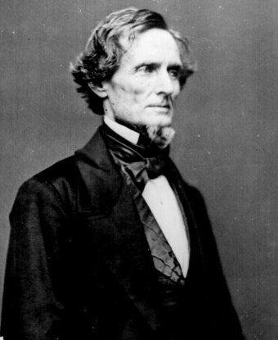
South/Confederacy: President Jefferson Davis
• Graduated from U.S. Military Academy, West Point
• U.S. senator from Mississippi
• U.S. secretary of war
• President of Confederate
States of America, 1861–1865
• Appointed Robert E. Lee as
general in chief of Confederate
armies

Slide 7
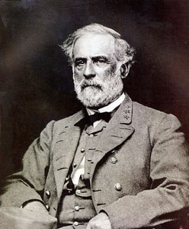
Robert E. Lee
• Graduated from U.S. Military Academy, West Point
• Fought larger Union armies to standoff at Battle of Antietam
• Defeated at Battle of Gettysburg
• Appointed general in chief of Confederate armies by Davis
• Surrendered to U.S. Gen. Grant to end Civil War

Slide 8
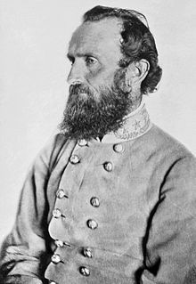
Thomas “Stonewall” Jackson
• Graduated from U.S. Military Academy, West Point
• Won First Battle of Bull Run
• Fought under Confederate Gen. Lee at Antietam and Second Bull Run
• Died in battle

Slide 9
Uncle Sam’s Real Estate Company
Objective: to attract immigrants for an emerging America
Friday’s assignment: Students will create a real estate brochure that outlines the formation of American culture with attention to territorial expansion, the emergence of industry, and reform in society in the post- War of 1812 environment.
Monday’s Assignment: Develop an advertisement for technological innovations ( Do this on your brochure if you have enough space. If not, do it on a separate sheet and staple it to the brochure.) Examples: New factories, tenant houses, interchangeable parts, canals, cotton gin, steam boat
Today’s Assignment: How would our nation have developed differently if immigrants had not populated America? Write a 1 page essay.

