Slide 1
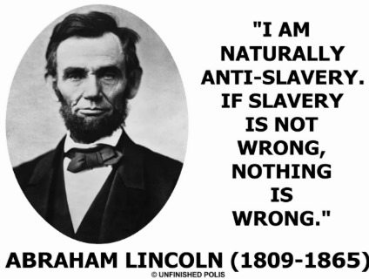
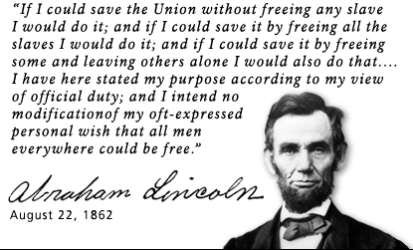
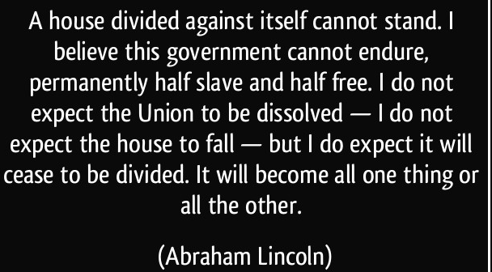
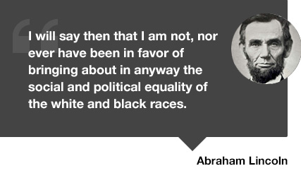
Journal: What do you think these words say about Lincoln’s views during the Civil War?

Slide 2
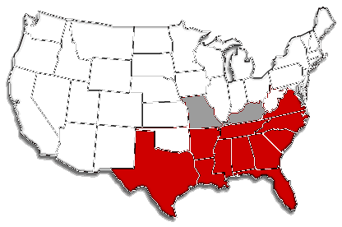
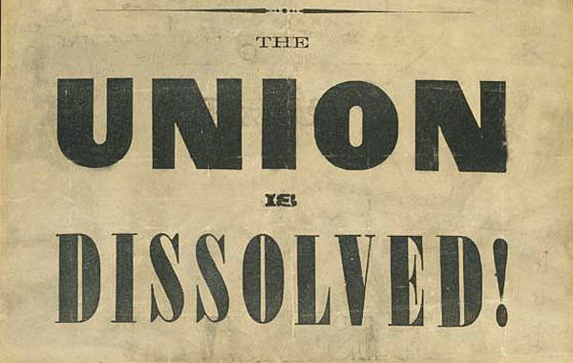
Secession
Republican Abraham Lincoln was elected president in 1860.
South Carolina voted to secede (separate from) the United States, followed by Mississippi, Florida, Alabama, Georgia, Louisiana, and then Texas.
They formed a new country called the Confederate States of America (the “Confederacy”).
When they attacked the U.S. Army base at Fort Sumter, South Carolina, in April 1861, the long-feared Civil War began.

Slide 3
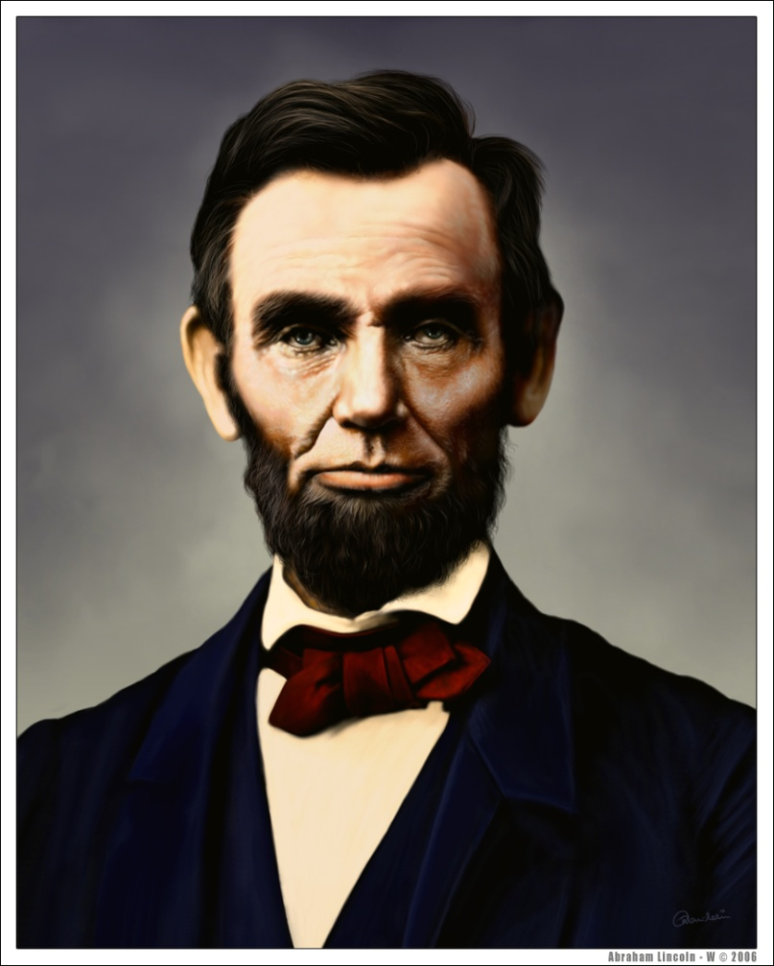
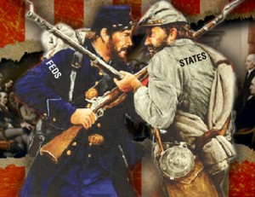
Preserving the Union
President Lincoln believed preservation of the United States (the “Union”) was the most important task for any U.S. president
He did not believe the southern states had the right to secede from the Union and thought they were merely rebelling against the government. He never considered the Confederacy a separate country.
When Lincoln called for a large volunteer army to preserve the Union, more states––Virginia, Arkansas, North Carolina, and Tennessee––seceded to join the Confederacy. Although Lincoln had often stated he wished only to restrict the spread of slavery, not to abolish it, over time he did embrace the idea of ending slavery in the United States.

Slide 4
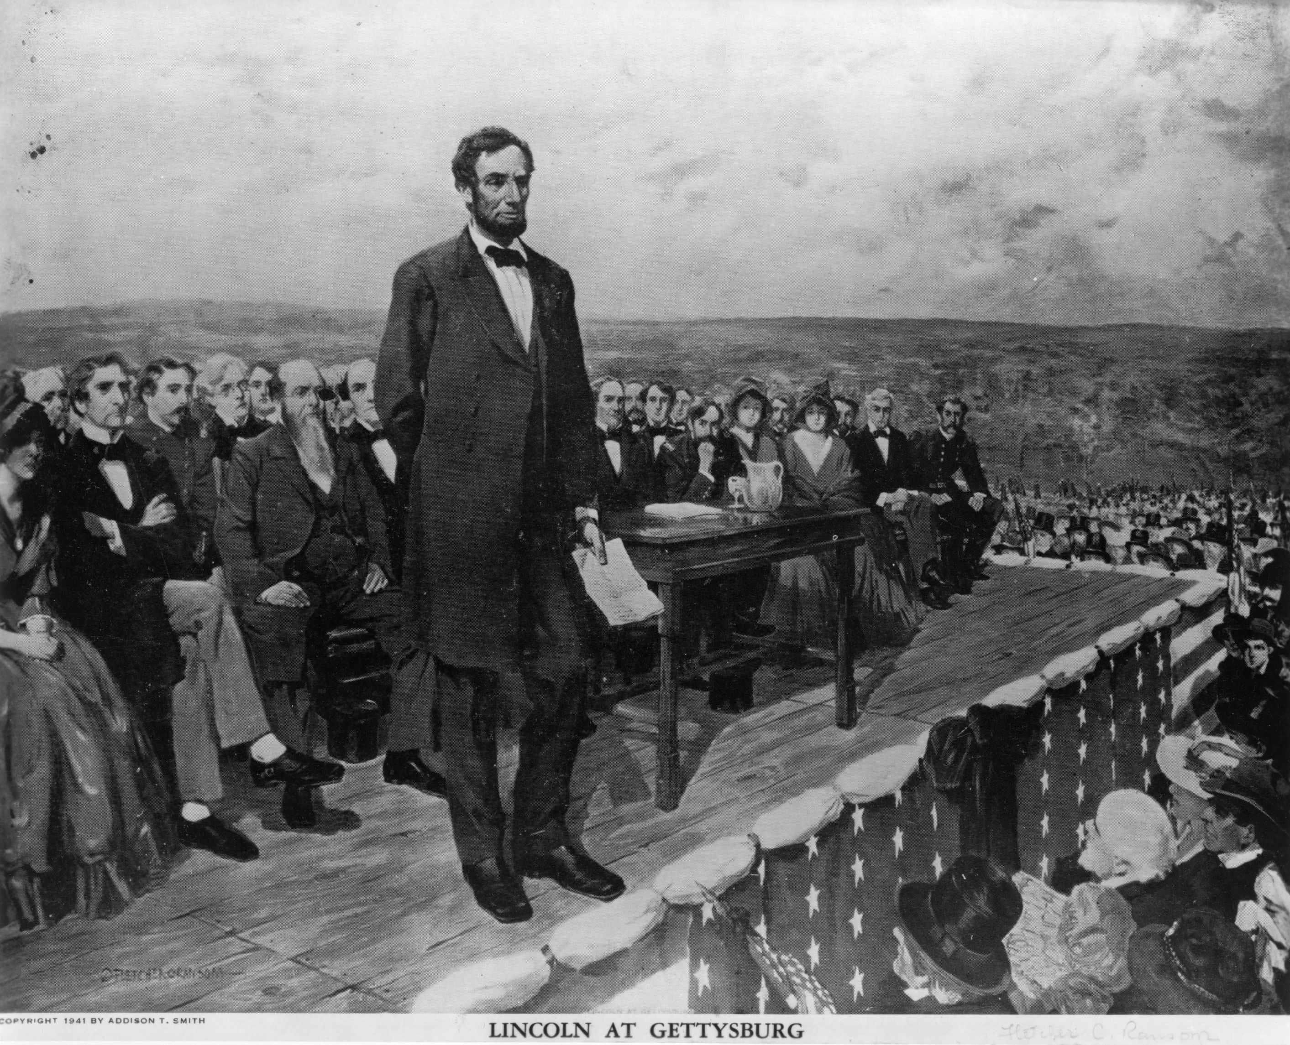
Gettysburg Address
In November 1863, Lincoln’s Gettysburg Address was another event by which he shaped popular opinion in favor of preserving the Union. The occasion was the dedication of a military cemetery at the Gettysburg battlefield four months after 51,000 people were killed in the battle there.
Most of the ceremony was performed by famous orator Edward Everett, who spoke for two hours, as was the manner at that time for an important event.
Then Lincoln rose to speak, starting with his famous words “Four score and seven years ago.” He spoke for just two minutes in what is now considered one of the greatest speeches in the English language.
His address helped raise the spirits of Northerners who had grown weary of the war and dismayed by southern victories over the larger Union armies. He convinced the people that the United States was one indivisible nation.

Slide 5
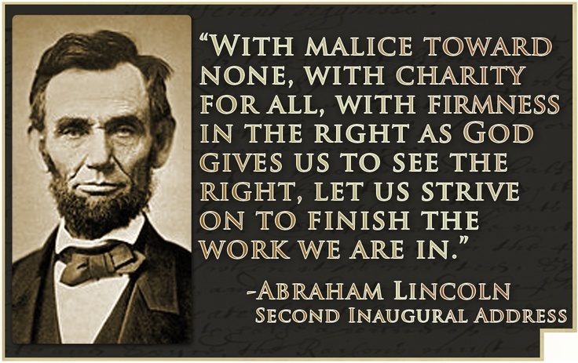
Lincoln’s Second Inaugural Address
Lincoln was reelected president in 1864. When he delivered his second inaugural address, Union victory over the Confederacy was certain, and Americans foresaw an end to slavery. Instead of boasting about that victory, Lincoln expressed sorrow that the states had not been able to resolve their differences peacefully.
However, he clearly stated that slavery was such an evil that the North was right to have gone to war over the issue. But he urged Americans not to seek revenge on slaveholders and their supporters and military.
Instead, he urged reconstruction of the South “with malice toward none; with charity for all.” Now at the end of the Civil War, Lincoln formed what would become the popular memory of why the war was necessary.
He said it had been fought to preserve the Union as an indivisible nation of citizens who would no longer profit from “wringing their bread from the sweat of other men’s faces”––from taking their earnings from the labor of unpaid slaves.

Slide 6
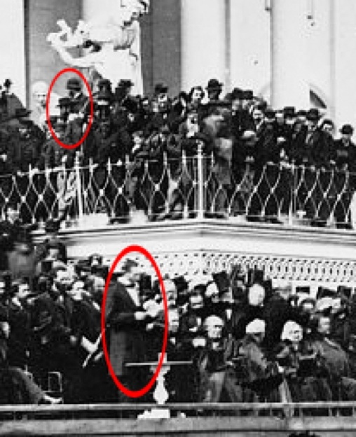

Slide 7
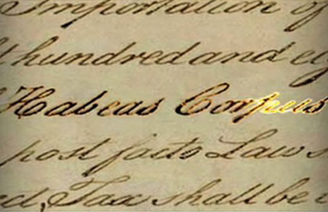
Habeas Corpus
Not all Northerners supported
President Lincoln’s efforts to preserve
the Union. Some were Confederate
sympathizers (just as some
Southerners were Union sympathizers).
Throughout the war, in some states Lincoln suspended the constitutional right of habeas corpus––the legal rule that anyone imprisoned must be taken before a judge to determine if the prisoner is being legally held in custody.
The Constitution allows a president to suspend habeas corpus during a national emergency. Lincoln used his emergency powers to legalize the holding of Confederate sympathizers without trial and without a judge to agree they were legally imprisoned. Over 13,000 Confederate sympathizers were arrested in the North.

Slide 8
Assignment
In pairs, closely read the Gettysburg Address and Lincoln’s Second Inaugural Address. Highlighters are located on the supply shelf. Then, fully answer the questions on the back.
If you do not finish in class, it is HOMEWORK so use your time wisely. You should be able to finish in class.
If you finish early, work on your Performance Task

Slide 9
3rd Block
Students in small groups will create a newspaper advertisement for or against the War of 1812.
Each group will defend the group’s position along with rationalization for that position.
The advertisement will include a visual.

