Slide 1
Which event during the late 1700s highlighted the weaknesses of the Articles of Confederation? A) the Nullification Crisis B) the Battle of Yorktown C) Daniel Shays's Rebellion D) Nathaniel Bacon's Rebellion
The emerging idea in the mid-1800's that the United States should control the land between the Atlantic Ocean and the Pacific Ocean is called what?
A) Manifest Destiny
B) Mutual obligation
C) American Destiny
D) Manifest Obligation
Both the Missouri Compromise of 1820 and the Compromise of 1850 were intended to settle disputes over
A) immigration from Europe
B) territorial conflicts with Mexico
C) the spread of slavery
D) tariffs on imports

Slide 2
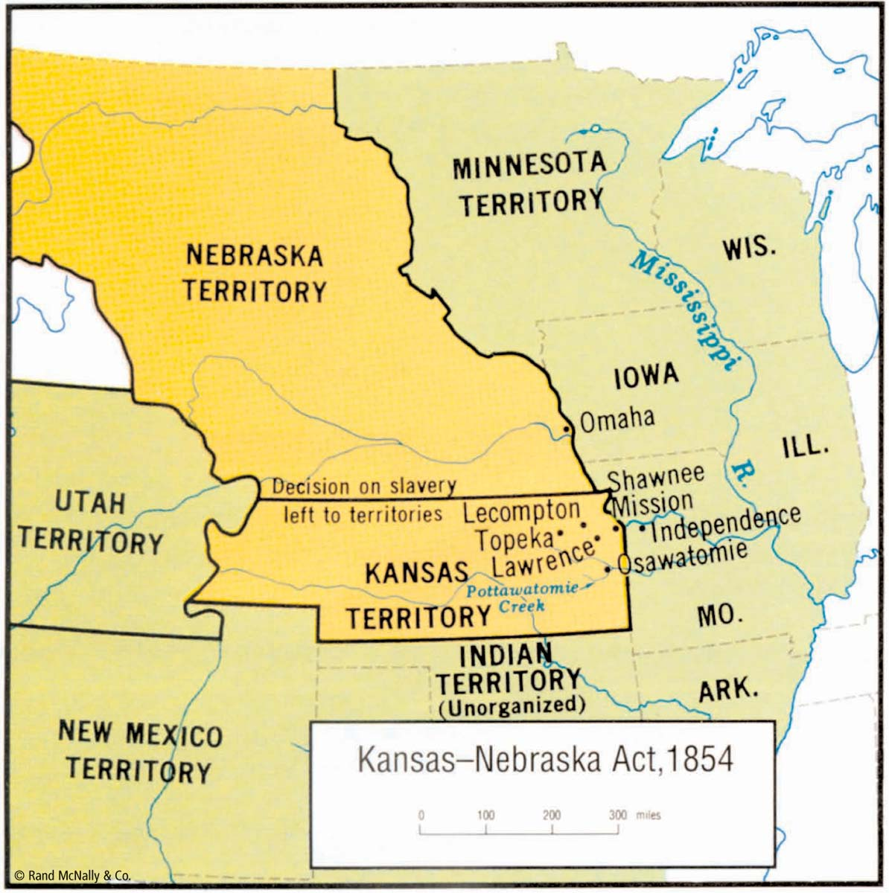
Kansas-Nebraska Act
In 1854, Congress again took up the issue of slavery in new U.S. states and territories.
This time, the territories were Kansas and Nebraska, and Congress approved the Kansas-Nebraska Act, which repealed the Missouri Compromise of 1820 and gave the settlers in all new territories the right to decide for themselves whether theirs would be a free or a slave state.
This made a proslavery doctrine, popular sovereignty (rule by the people), the law of the United States.

Slide 3
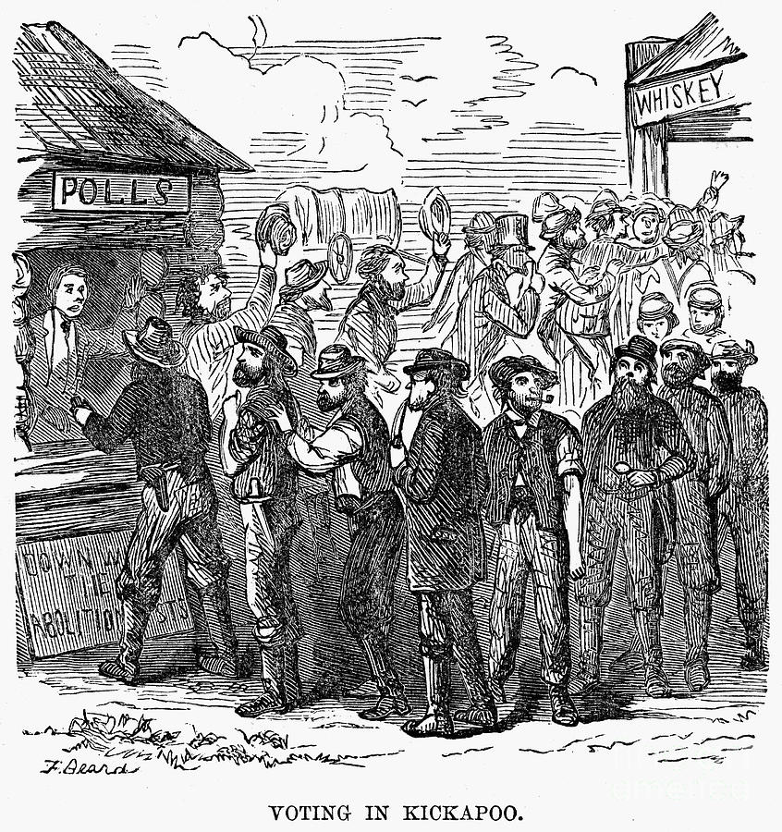
Kansas-Nebraska Act
Pro- and antislavery groups hurried into Kansas in attempts to create voting majorities there.
Antislavery abolitionists came from eastern states; proslavery settlers came mainly from neighboring Missouri.
Some of these Missourians settled in Kansas, but many more stayed there only long enough to vote for slavery and then returned to Missouri.

Slide 4
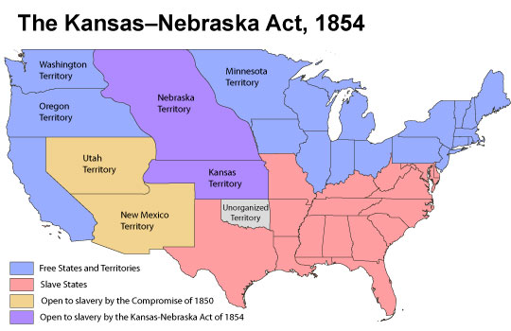
Kansas-Nebraska Act
Proslavery voters elected a legislature ready to make Kansas a slave state.
Abolitionists then elected a rival Kansas government with an antislavery constitution, established a different capital city, and raised an army.
Proslavery Kansans reacted by raising their own army.

Slide 5
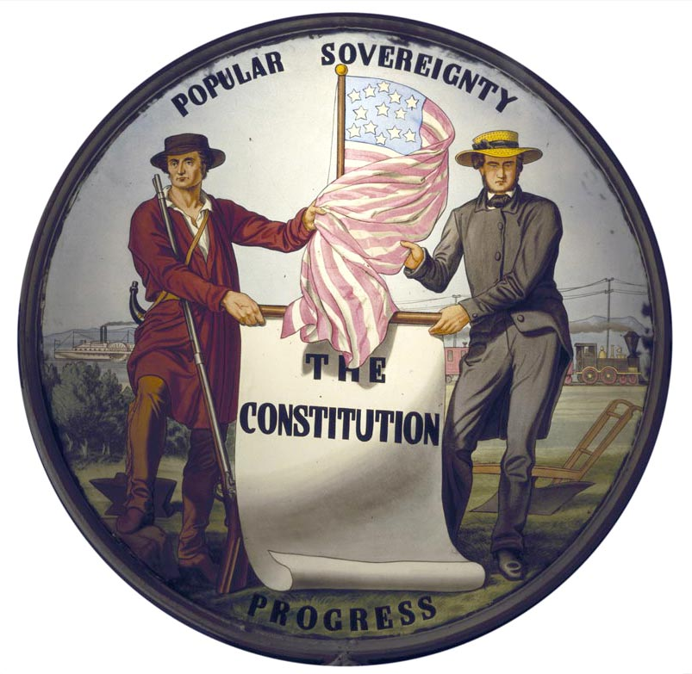
Kansas-Nebraska Act
The U.S. House of Representatives supported the abolitionist Kansans; the U.S. Senate and President Franklin Pierce supported the proslavery Kansans.
Violence between the two sides created warlike conditions. Popular sovereignty had failed.

Slide 6
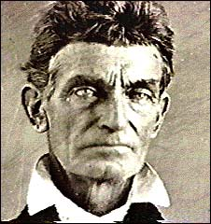
John Brown’s Raid
One famous abolitionist, John Brown, decided to fight slavery with violence and killing. In 1856, believing he was chosen by God to end slavery, Brown commanded family members and other abolitionists to attack proslavery settlers in Kansas, killing five men.

Slide 7
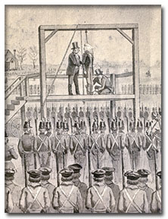
John Brown’s Raid
In 1859, he led a group of white and black men in a raid on the federal armory at Harpers Ferry, Virginia (in modern-day West Virginia). They seized federal weapons and ammunition, killing seven people. Brown’s plan was to deliver the weapons and ammunition to slaves, who would then use them in an uprising against slaveholders and proslavery government officials.
But the raid failed, and Brown was captured by U.S. Marines led by U.S. Army Colonel Robert E. Lee. Eventually, Brown was convicted of treason against the state of Virginia and executed by hanging. Many Americans thought Brown was a terrorist killer. Others thought he was an abolitionist martyr

Slide 8
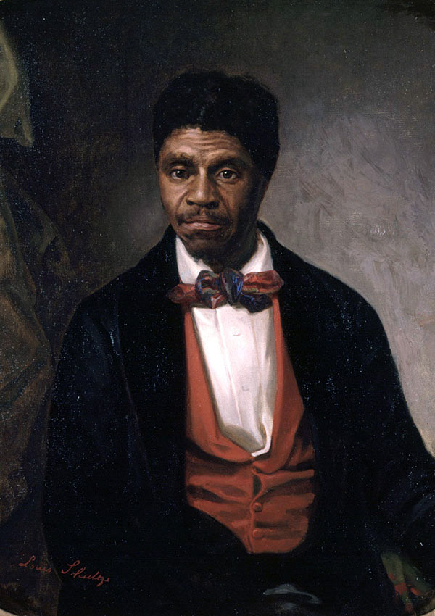
Dred Scott
In 1857, the U.S. Supreme Court issued the Dred Scott decision, settling a lawsuit in which an African American slave named Dred Scott claimed he should be a free man because he had lived with his master in slave states and in free states.
The Court rejected Scott’s claim, ruling that no African American––even if free––could ever be a U.S. citizen.
Further, the Court said Congress could not prohibit slavery in federal territories. Thus, the Court found that popular sovereignty and the Missouri Compromise of 1820 were unconstitutional.

Slide 9
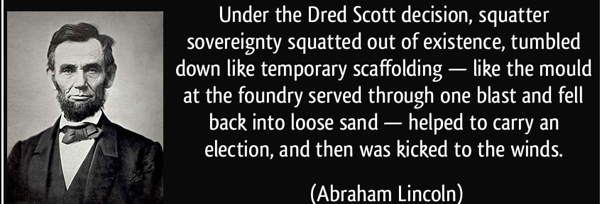
Dred Scott Case
The Dred Scott decision gave slavery the protection of the U.S. Constitution.
Proslavery Americans welcomed the Court’s ruling as proof they had been right during the previous few decades’ struggles against abolitionists. In contrast, abolitionists convinced many state legislatures to declare the Dred Scott decision not binding within their state borders.
The new Republican Party said that if its candidate were elected president in 1860, he would appoint a new Supreme Court that would reverse Dred Scott.

Slide 10
Group work
Each group will have a document pertaining to the Dred Scott case. They will create a note sheet/ poster with a visual component for their document explaining that document.
Then, they will present their document to the class. Students will be asked to take notes on each others' presentations.
Group 1& 5: Pages 1- 4 (end at “A Bad Decision”
Group 2& 6: Pages 6-10 (end at “Who Was Dred Scott)
Group 3: Pages 20-25 (end at “The Case in the Federal District Court)
Group 4: 31 (The Compromise not Taken) -35

