Slide 1
Warm up: Missouri Compromise close reading.
Answer the questions on the back. This will be graded!

Slide 2
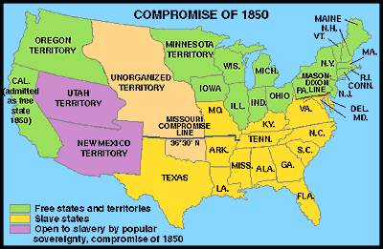
Divisions over slavery in territory gained in the Mexican-American (1846-48) War were resolved in the Compromise of 1850.

Slide 3
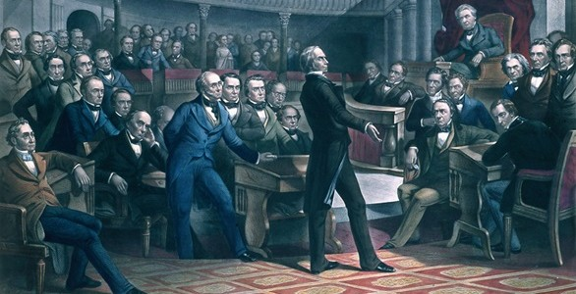
Compromise of 1850- What it Did
It consisted of laws admitting California as a free state, creating Utah and New Mexico territories with the question of slavery in each to be determined by popular sovereignty, settling a Texas-New Mexico boundary dispute in the former’s favor, ending the slave trade in Washington, D.C., and making it easier for southerners to recover fugitive slaves.

Slide 4
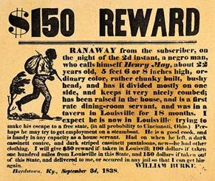
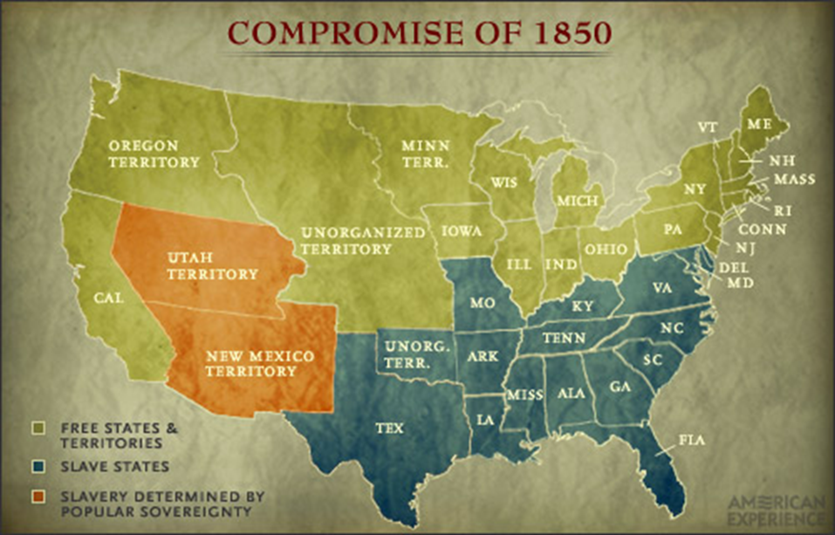
Compromise of 1850
California was admitted to the Union as the 16th free state. In exchange, the south was guaranteed that no federal restrictions on slavery would be placed on Utah or New Mexico.
Texas lost its boundary claims in New Mexico, but the Congress compensated Texas with $10 million. Slavery was maintained in the nation's capital, but the slave trade was prohibited. Finally, and most controversially, a FUGITIVE SLAVE LAW was passed, requiring northerners to return runaway slaves to their owners under penalty of law.

Slide 5
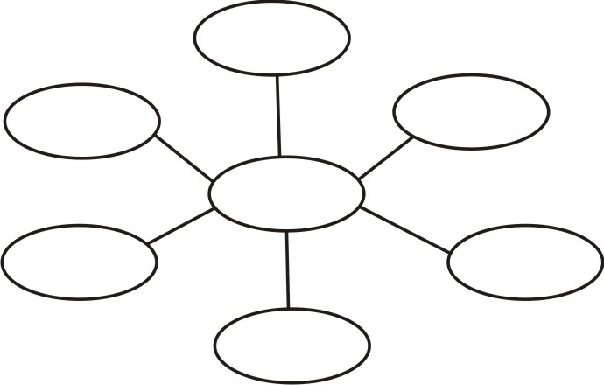
In Pairs
Create a graphic organizer of the five major conclusions of the Compromise of 1850

Slide 6
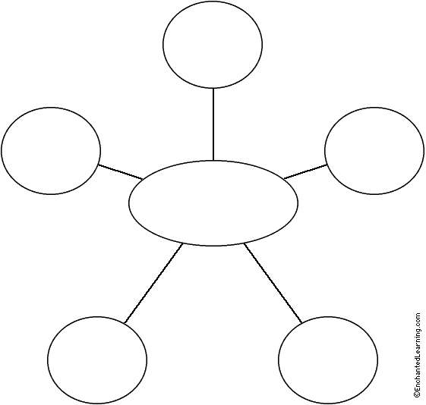

Slide 7
Close Reading
Read the popular sovereignty sheet. Use highlighters if needed.
Answer the questions on a separate sheet of paper and staple together. Turn in before you leave.

