Slide 1
Journal: Pretend you are either a citizen of New York City or Savannah, Georgia. Describe your political beliefs.
New York City | Savannah, Georgia

Slide 2
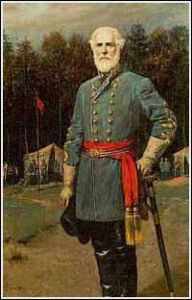
Intro to Mexican American War
The Mexican-American War (1846-1848) marked the first U.S. armed conflict chiefly fought on foreign soil.
It pitted a politically divided and militarily unprepared Mexico against the expansionist-minded administration of U.S. President James K. Polk, who believed the US had a “manifest destiny” to spread across the continent to the Pacific Ocean.
A border skirmish along the Rio Grande started off the fighting & was followed by a series of U.S. victories. When the dust cleared, Mexico had lost about one-third of its territory, including nearly all of present-day California, Utah, Nevada, Arizona and New Mexico.

Slide 3
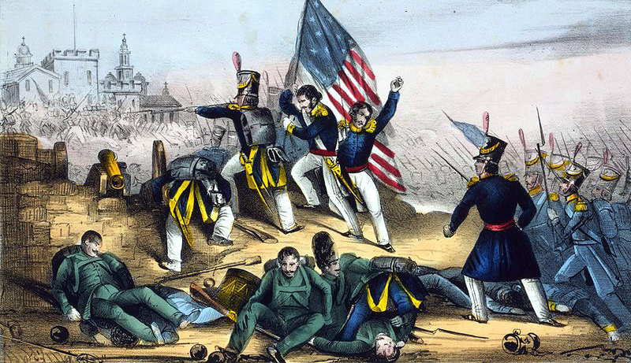
Mexican American War
In 1845, the US took Texas into the Union and set its sights on the Mexican territories of New Mexico and California.
U.S. annexation of Texas and other factors led to war in 1846.
During the conflict, the US occupied much of northern Mexico. When the US eventually won the war, this region was ceded to the US as a part of the Treaty of Guadalupe Hidalgo.

Slide 4
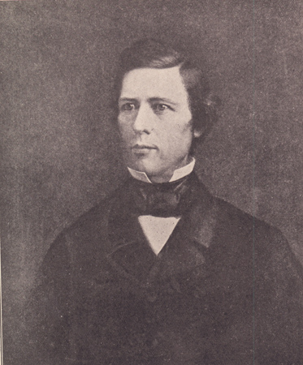
Wilmot Proviso
During the Mexican-American War, Congress debated whether slavery would be allowed in New Mexico and California if these territories were acquired from Mexico.
would have banned slavery in any territory to be acquired from Mexico in the Mexican War or in the future
The antislavery position was outlined in a proposal called the Wilmot Proviso, but the House of Representatives failed to approve it, and the issue of whether to allow or prohibit slavery in new states remained unresolved.

Slide 5
Partner Work
Students will research the Mexican American War on the iPads.
They will create an informational sheet that includes the causes, major events and key people of the war.

