Slide 1
Journal: Who do you think should have the most power: the state or federal governments? Why?

Slide 2
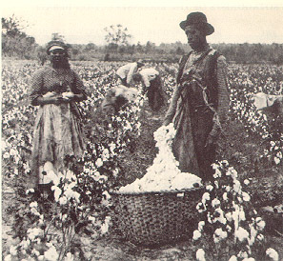
Slavery and politics
Most white Southerners opposed abolition. White writers and public speakers argued slavery was a necessary part of life in the South. The southern economy, they said, was based on large-scale agriculture that would be impossible to maintain without slave labor.
They also boasted that southern white culture was highly sophisticated and said it was made possible by the plantation economy.
Another proslavery argument claimed slaves were treated well and lived better lives than factory workers in the North. In fact, some whites said they provided better lives for slaves than free blacks were able to provide themselves. When settlers in the slaveholding Missouri Territory sought statehood, proslavery and antislavery politicians made slavery a central issue in national politics.

Slide 3
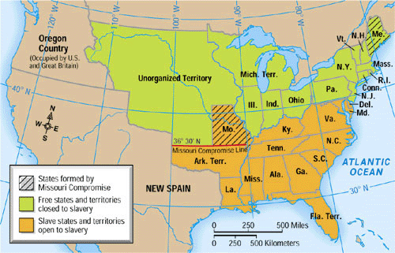
The Missouri Compromise
The state constitution proposed by Missouri allowed slavery. Because half the states in the union allowed slavery while the other half did not, statehood for Missouri would upset the U.S. Senate’s equal balance between proslavery and antislavery senators.
This issue was resolved when Congress passed the Missouri Compromise. Under the compromise, Maine would be admitted to the Union as a free state, Missouri would be admitted as a slave state, and slavery would be prohibited in the northern part of the Louisiana territory, except for Missouri.
Once again, half the states would allow slavery while the other half would not, and the Senate would retain its equal balance between proslavery and antislavery senators––until the next state asked to enter the Union.

Slide 4
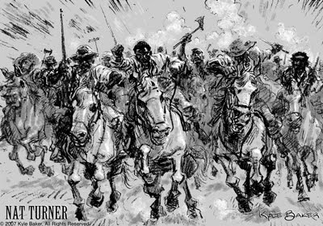
Nat Turner
African American preacher Nat Turner believed his mission on Earth was to free his people from slavery.
Seeing an 1831 solar eclipse as a message from above, he led a slave rebellion on four Virginia plantations.
About 60 whites were killed, and Turner was captured, tried, and executed. To stop such uprisings, white leaders passed new laws to limit the activities of slaves and to strengthen the institution of slavery.

Slide 5
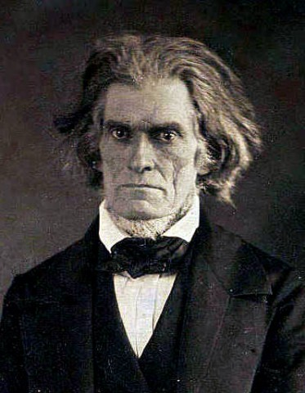
Nullification Crisis
Vice President John C. Calhoun argued with President Andrew Jackson about the rights of states to nullify (cancel) federal laws they opposed.
Trouble, known as the Nullification Crisis, resulted when southern states sought to nullify a high tariff (tax) Congress had passed on manufactured goods imported from Europe. This tariff helped northern manufacturers but hurt southern plantation owners, so legislators nullified the tariff in South Carolina.

Slide 6
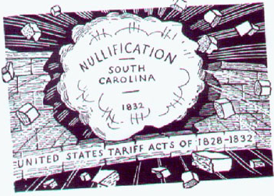
Results of Nullification
Calhoun, a South Carolinian, resigned from the vice presidency to lead the efforts of the southern states in this crisis. His loyalty to the interests of the southern region, or section, of the United States, not to the United States as a whole, contributed to the rise of sectionalism.

Slide 7
Nullification Crisis
Calhoun & the advocates of sectionalism argued in favor of states’ rights––the idea that states have certain rights & political powers separate from those held by the federal government and that the federal government may not violate these rights.
The supporters of sectionalism were mostly Southerners. Their opponents were afraid that if each state could decide for itself which federal laws to obey, the United States would dissolve into sectional discord or even warfare

Slide 8
Work on your Performance Task

Slide 9
Group Work
Students will be divided into groups of 3 and be assigned either a pro-states rights stance or a pro-federal rights stance.
They will research arguments for their stance and create a notes sheet, pamphlet, flier or poster to explain their stance and convince others to agree with them.
This is due at the end of class. Provide plenty of detail.

