Slide 1
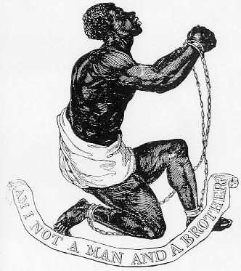
What do you think the artist’s political beliefs were?

Slide 2
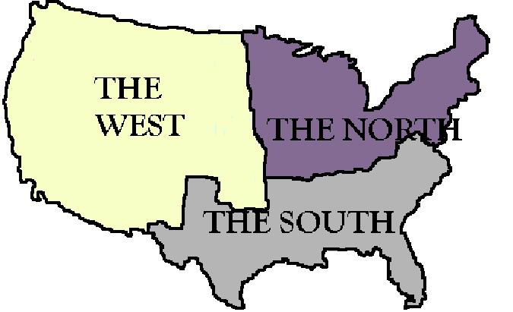
Vocabulary of the Standard:
Abolition: the movement in favor of officially ending or stopping slavery
Sectionalism: a tendency to be more concerned with the interests of your particular group or region than with the problems and interests of the larger group, country, etc.

Slide 3
Abolition
By 1820, although racial discrimination against African Americans remained, slavery had largely ended in the North.
Many Northerners and some Southerners took up the cause of abolition, a campaign to abolish slavery immediately & grant no financial compensation to slave owners.
As most slaves were held in southern states, abolition was a significant issue that led to growing hostility between Northerners and Southerners

Slide 4
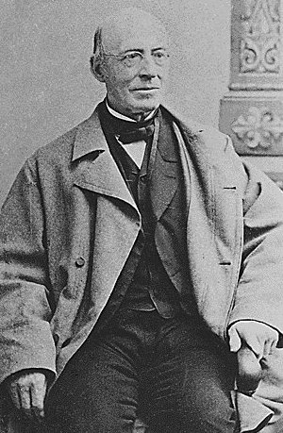
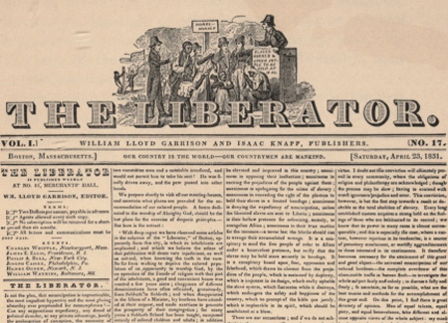
William Lloyd Garrison
a writer and editor, was an important white abolitionist.
He founded regional and national abolitionist societies and published an antislavery newspaper that printed graphic stories of the bad treatment received by slaves

Slide 5
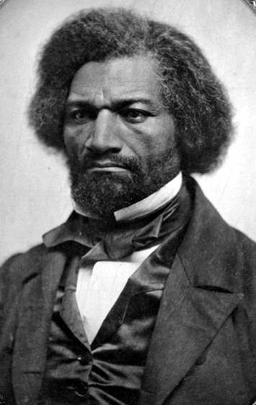
Frederick Douglass
a former slave, worked for Garrison and traveled widely, giving eloquent speeches on behalf of equality for African Americans, women, Native Americans, and immigrants.
He later published autobiographies and his own antislavery newspaper

Slide 6
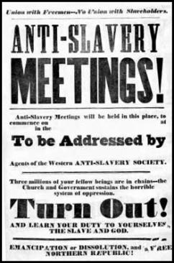
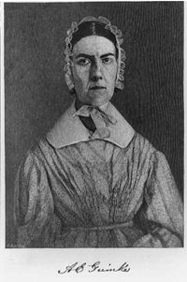
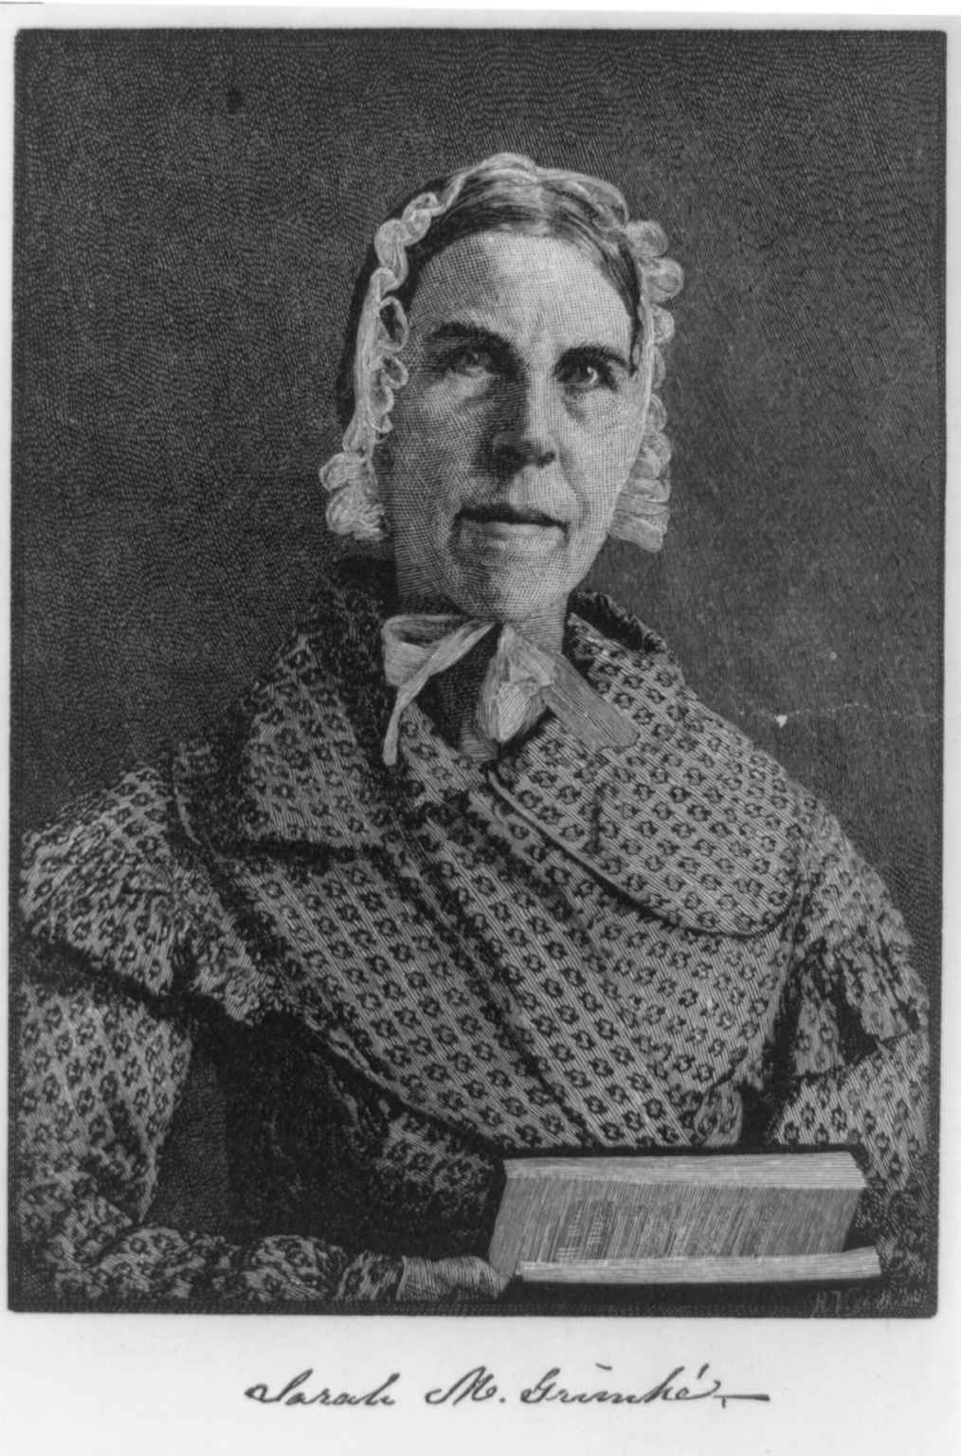
The Grimke Sisters
The Grimke sisters, Sarah and Angelina, were southern women who lectured publicly throughout the northern states about the evils of slavery they had seen growing up on a plantation.
Their public careers began when Garrison published a letter from Angelina in his newspaper.

Slide 7
Group Work
Each person will choose an abolitionist to research (William Lloyd Garrison, Frederick Douglas, the Grimke Sisters)
Each person will make a flier for their abolitionist, describing their lives, beliefs and activism
Students will analyze and note on their flier how their abolitionist’s life influenced their beliefs

