Slide 1
You have 15 minutes to finish your poster from yesterday. You will present these today. Get your poster and supplies and get started!

Slide 2
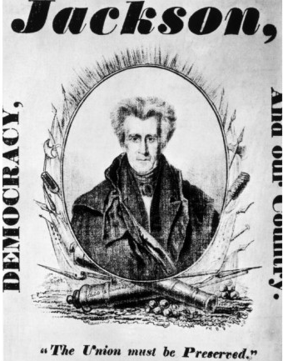
Popular Political Culture
Jackson’s presidential campaigns caused an increase in public participation in politics
Jackson’s side accused his opponent of flattering European royalty and of misusing public funds.
The opponent accused Jackson of unfaithfulness in his marriage, of massacring Native Americans, of illegally executing convicted soldiers, and of dueling.
These accusations were publicized in songs, pamphlets, posters, and lapel buttons. A voter could find all these at the first-ever campaign rallies and barbecues.

Slide 3
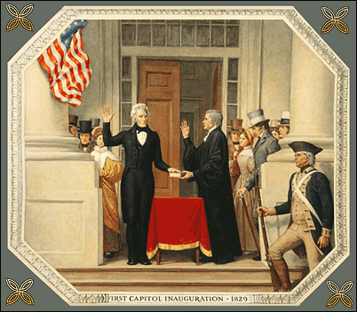
Jacksonian Democracy
President Andrew Jackson and his supporters shared a political philosophy later referred to as “Jacksonian Democracy.”
It sought a stronger presidency and executive branch, and a weaker Congress.
Out of respect for the common man, it also sought to broaden public participation in government, so it expanded voting rights to include all adult white males, not just landowners.
Another principle of Jacksonian democracy was that politicians should be allowed to appoint their followers to government jobs as a way of limiting the power of elite groups. Jacksonians also favored Manifest Destiny and greater westward expansion of the United States.

Slide 5
Nationalism
As a people, Americans in Jackson’s day believed in Manifest Destiny. They believed their nation was different from, and superior to, other nations because most Americans of that time shared the Protestant religion and English language, ancestry, and culture.
They believed it was their duty to expand the hold of their religion, language, ancestry, and culture all the way to the Pacific Ocean to remake all of North America as the Founding Fathers had remade its Atlantic coast. Altogether, these beliefs comprise American nationalism.

Slide 6
Performance Task
Part 1: Each group will be given an issue in Jackson’s presidency and a packet with sources on that issue. Students will make a poster about that issue and explain whether Jackson was a “Saint” or a “Tyrant”
Part 2: Students will take notes on the provided chart. After all presentations, students will use all the evidence to come to a conclusion. Students will write a paragraph explaining whether Jackson was a “Saint” or a “Tyrant” based on all evidence.

Slide 7
Close Reading and RACE
Close Reading: Read the “Great Society” speech, list of programs, and the pro and con arguments.
Then, students will use the RACE strategy to write about which letter they agree with most and why. Letter should be at least half a page.

Slide 8
Take out your notes and study for your quiz
#4: B. should say “Expansion of voting rights”

