Slide 1
What is Manifest Destiny?
A law for colonists
An attitude that it was the fate of the us to grow to the Pacific
The name of the largest railroad company in the US
The name of the first settlement in California
The Great Compromise and the Three-Fifths Compromise both dealt with
A. the admission of new western states.
B. the territorial expansion of slavery.
C. the regulation of interstate commerce.
D. the representation of states in Congress.
The Articles of Confederation were important MAINLY because they
A) named the country "The United States of America."
B) protected the rights and liberties of American citizens.
C) forbade states to enter into treaties without approval from Congress.
D) held the country together prior to the implementation of the Constitution.

Slide 2
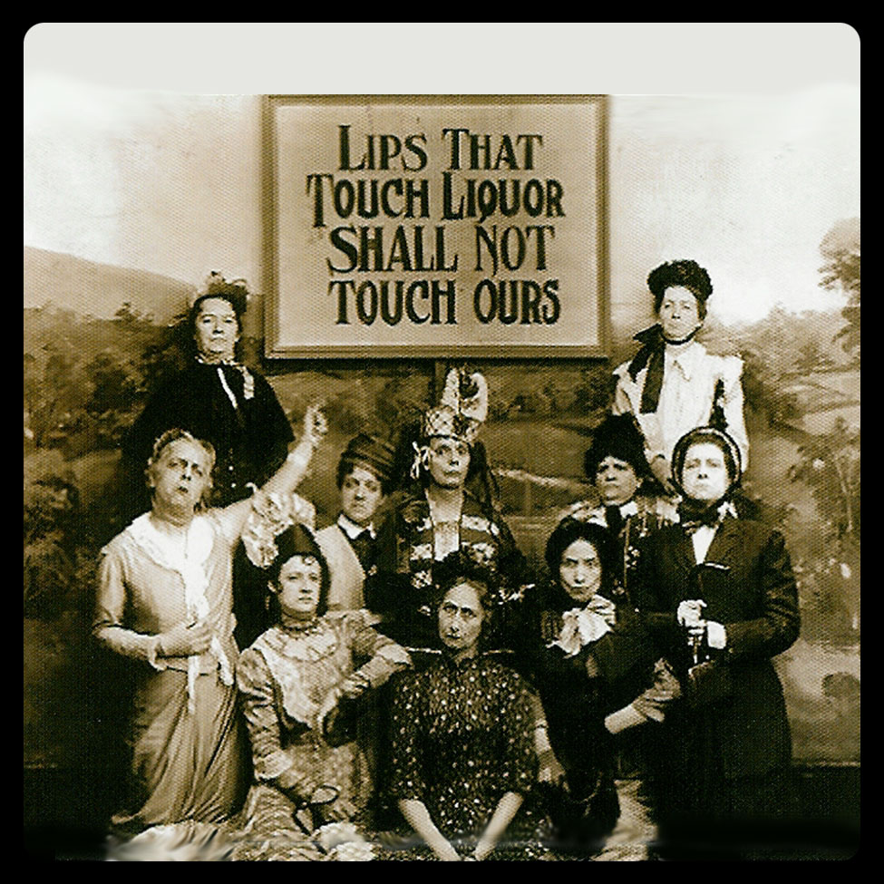
Temperance
People should drink less alcohol, or alcohol should be outlawed altogether.
This movement increased the size of Protestant religious organizations and their influence in western and rural sections of the country.
Women played an important role, which laid the foundation for the women’s movement.

Slide 3
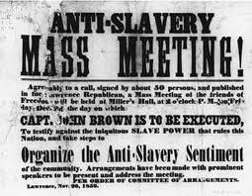
Abolition
Slavery should be abolished and it should not be allowed in new states.
This movement made slavery and its expansion an important political issue.
Women played an important role, which laid the foundation for the women’s movement.

Slide 4
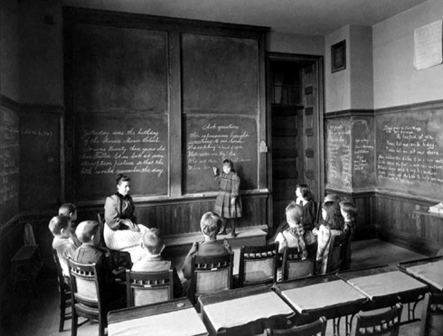
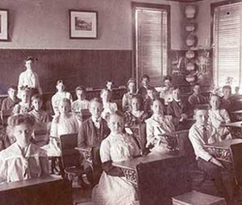
Public School
All children should be required to attend free schools supported by taxpayers and staffed by trained teachers.
This movement established education as a right for all children and as a state and local issue it improved the quality of schools by requiring trained teachers

Slide 5
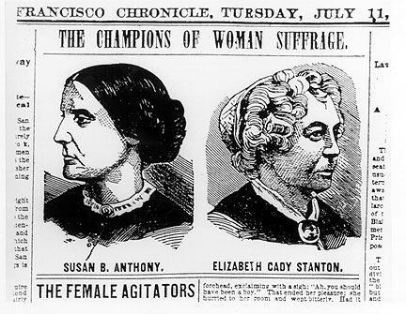
Women’s Suffrage
Women’s rights were few in the early 1800s. Women did not have the right to vote (suffrage) and often lacked legal custody of their own children. Most men––and most women, too––believed this was fitting and proper.

Slide 6
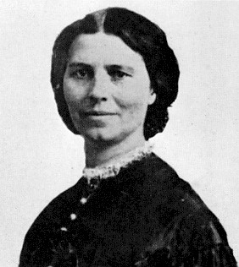
Elizabeth Cady Stanton
She was an outspoken advocate for women’s full rights of citizenship, including voting rights and parental and custody rights.
In 1848, she organized the Seneca Falls Conference, America’s first women’s rights convention, in New York.
Delegates adopted a declaration of women’s independence, including women’s suffrage.
Historians often cite the Seneca Falls Conference as the event that marked the beginning of organized efforts by women in the United States to gain civil rights equal to those of men.

Slide 7
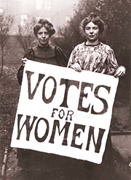
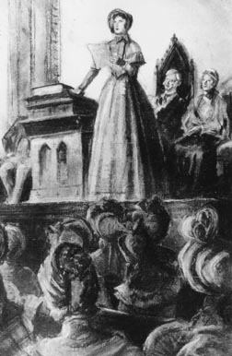

Slide 8
Assignment
Each group will be assigned a different reform movement. Students will use the iPads to access the class website which will have links to resources on each reform movement.
Students will have 30 minutes to create a poster with details of each movement that they will present to the class.
Things to include:
Major people involved with the movement
Major events
Major ideas
Brief history
A picture

