Slide 1
Manifest Destiny
Journal: Imagine you were a child in the mid 19th century who was part of the labor force in New York City. What do you think your life would be like? Be specific. How would your work day go? What would your home be like?

Slide 2
Vocabulary of the Standard
Manifest Destiny- for the attitude prevalent during the 19th century period of American expansion that the United States not only could, but was destined to, stretch from coast to coast.
The word manifest means “obvious,” and the word destiny means “fate

Slide 3
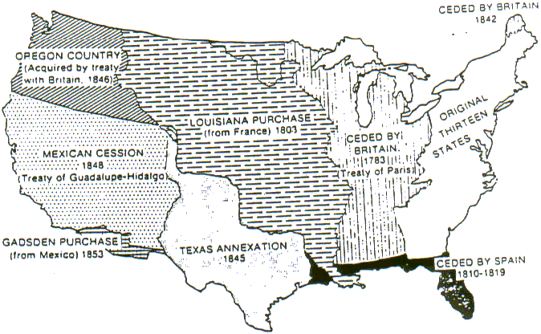
Westward migration
Between 1800 and 1860, the United States more than doubled in size and the number of states expanded from 16 to 33.
There were three primary motivations for America’s westward growth: 1. the desire of most Americans to own their own land 2. the discovery of gold and other valuable resources 3. the belief that the United States was destined to stretch across North America (Manifest Destiny).

Slide 4
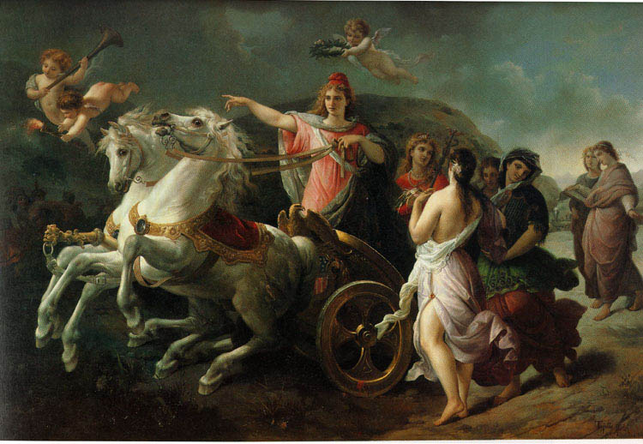
Why?
Manifest Destiny was the name given to the idea that the United States would naturally occupy the territory between the Atlantic and Pacific oceans
According to Manifest Destiny, the obvious fate of the United States was to expand “from sea to shining sea.”
There were strong economic motivations behind this belief, as well as racism regarding Native Americans and Mexican people. It became a popular political belief in the United States during the early 19th century

Slide 5
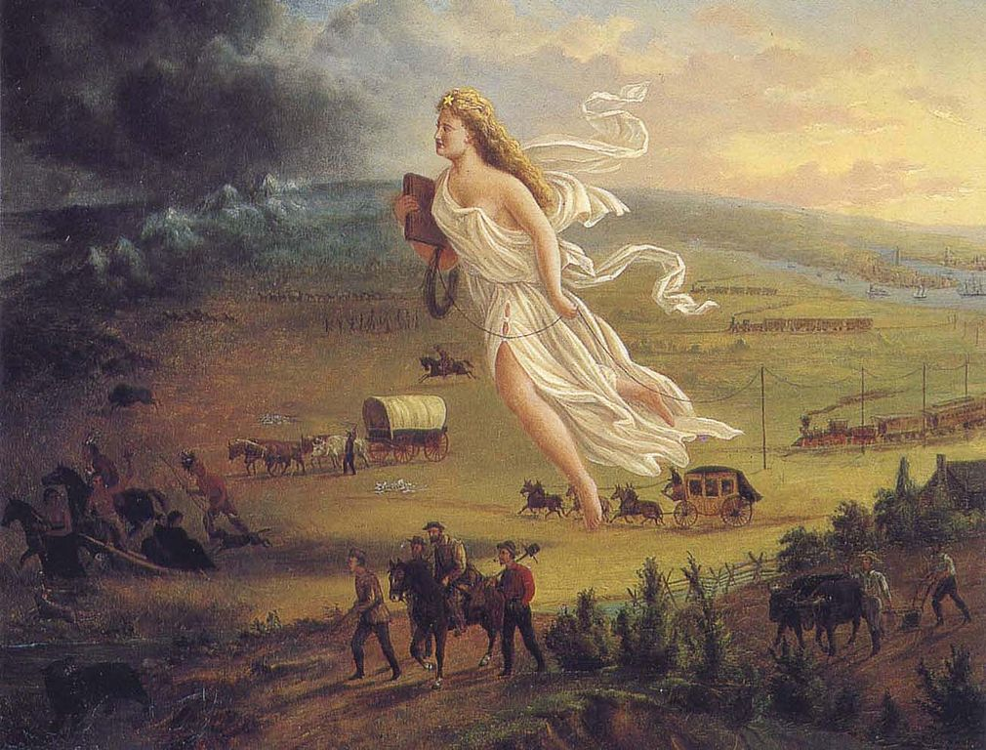

Slide 6
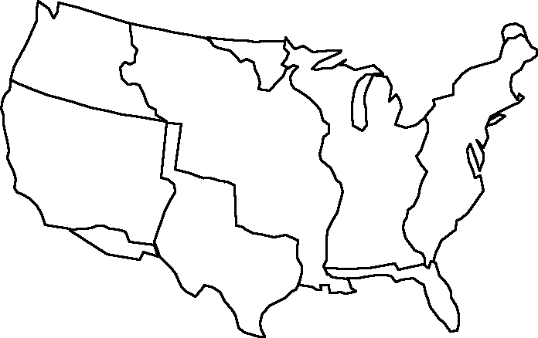
Your Turn: Color & label all the territories the US gained until Manifest Destiny was complete

Slide 7
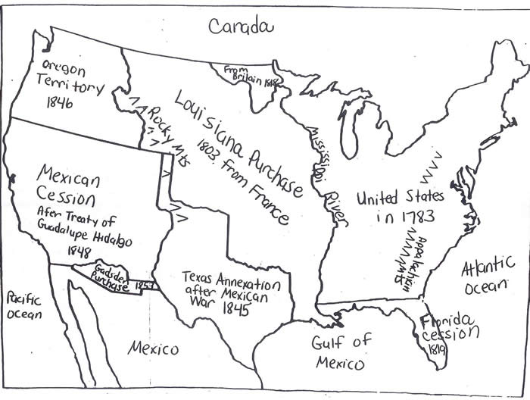

Slide 8
3rd block
Students will create a diary in which they assume the first-person historical character of an American heading west. Students should imagine that they are participating in the Lewis and Clark expedition.
The diary entries should demonstrate:
1) an awareness of the conditions of travel, the geography traveled through, and the risks of travel
2) an understanding of the reasons why a 19th-century American would have undertaken this trip
3) an understanding of why Thomas Jefferson wanted this land

