Slide 1
Industrial Revolution
Journal: What would life be like if we had no machinery?

Slide 2
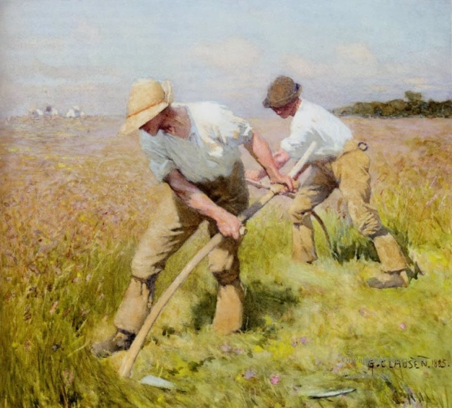
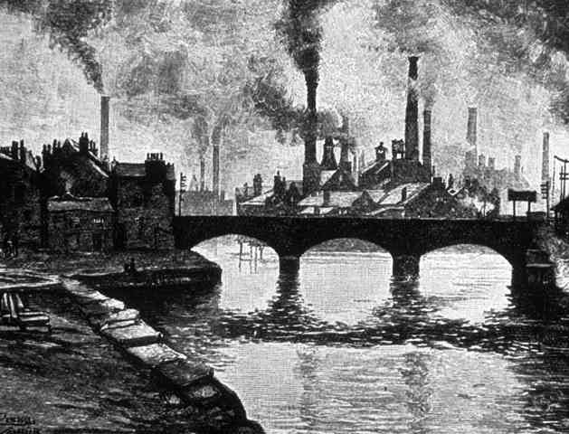
Vocabulary of the Standard
The Industrial Revolution- which took place from the 18th to 19th centuries, was a period during which predominantly agrarian, rural societies in Europe and America became industrial and urban.
  Agrarian- farming
  rural- the countryside
  Industrial- business
  Urban- cities

Slide 3
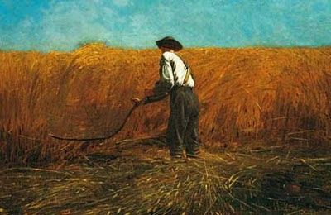
Life before the IR
Prior to the Industrial Revolution, which began in Britain in the late 1700s, manufacturing was often done in people’s homes, using hand tools or basic machines.

Slide 4
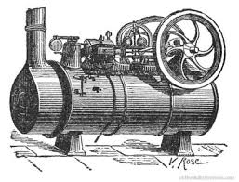
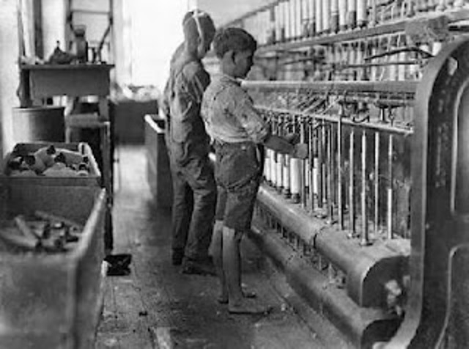
How did it happen?
power driven machines operated by semiskilled or unskilled workers replaced hand tools operated by skilled laborers, altering the quality of work for many people
Eli Whitney best illustrates the rise of industrialization with his invention of the cotton gin and interchangeable parts for muskets
Industrialization marked a shift to powered, special-purpose machinery, factories and mass production. The iron and textile industries, and the development of the steam engine, played major roles
also saw improved systems of transportation, communication and banking.

Slide 5
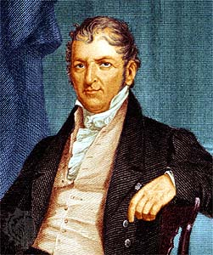
Eli Whitney and the Cotton Gin
American inventor Eli Whitney invented the cotton gin in 1793.
It is a machine that rapidly removes cotton plant seeds from the valuable cotton fiber used to make thread and fabric.
By producing more cotton in a day than any person could working by hand, the gin reduced the cost of processing cotton and greatly raised the profit from growing it.
To further cut costs and raise profits, unskilled slaves were often put to work running the cotton gins in the southern states

Slide 6
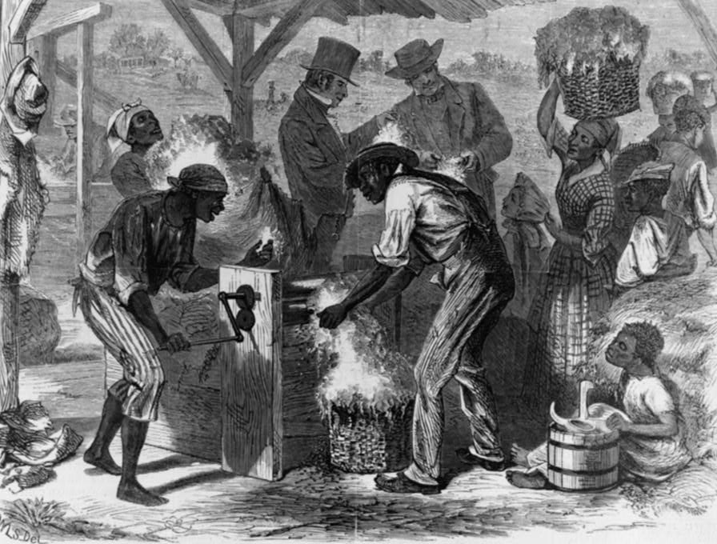

Slide 7
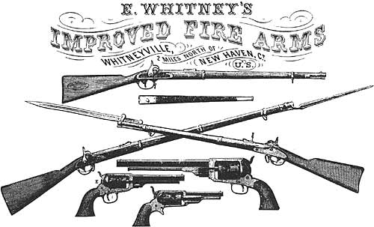
Interchangeable parts
Another industrial improvement
Whitney developed was interchangeable parts.
Before industrialization, a broken mechanism had to be discarded and replaced because all its parts had been handmade by skilled workers to fit only that mechanism.
Whitney introduced the practice of manufacturing identical parts so only the broken part would need to be replaced to repair the whole machine. He applied this process to making muskets.
If one piece of the musket’s mechanism broke, the owner could continue to use the musket after that piece was replaced with a matching piece.
Interchangeable parts made it possible for semiskilled workers to mass-produce mechanical products.

Slide 8
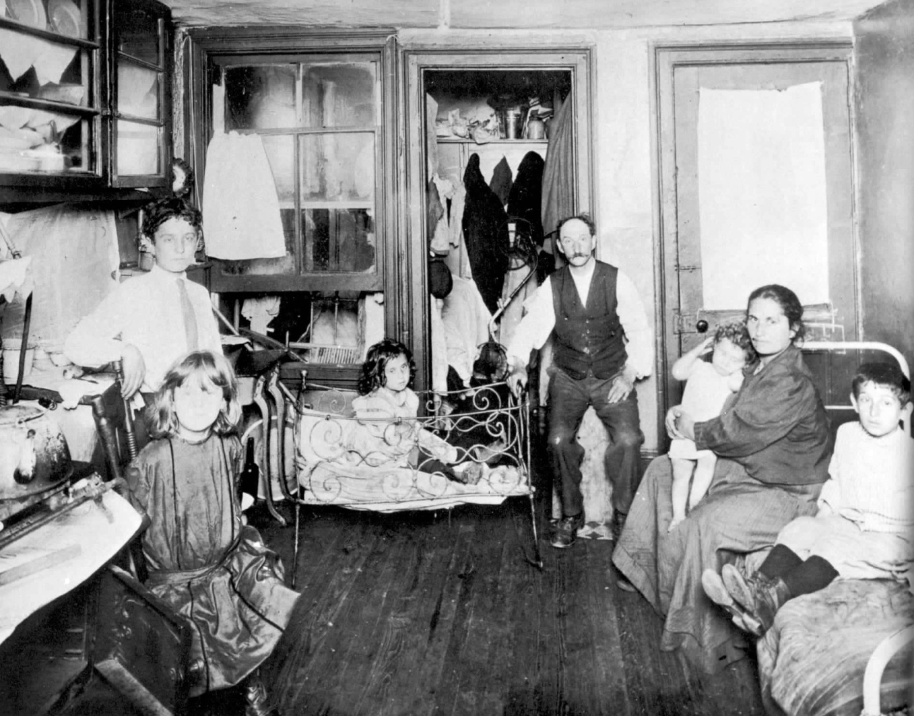
The downside
resulted in often grim employment and living conditions for the poor and working classes.
Wages for those who labored in factories were low and working conditions could be dangerous and monotonous.
Unskilled workers had little job security and were easily replaceable.

Slide 9
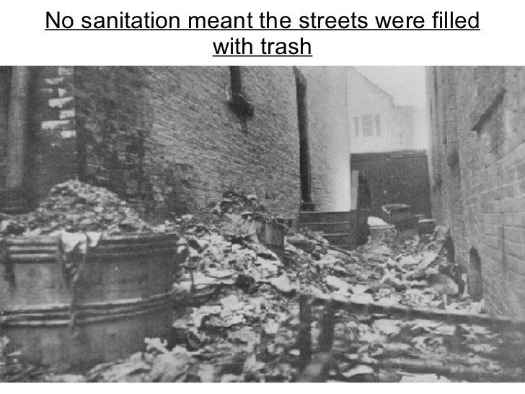

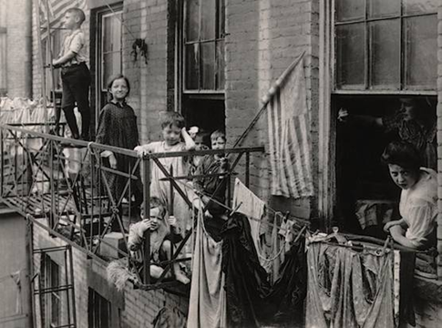
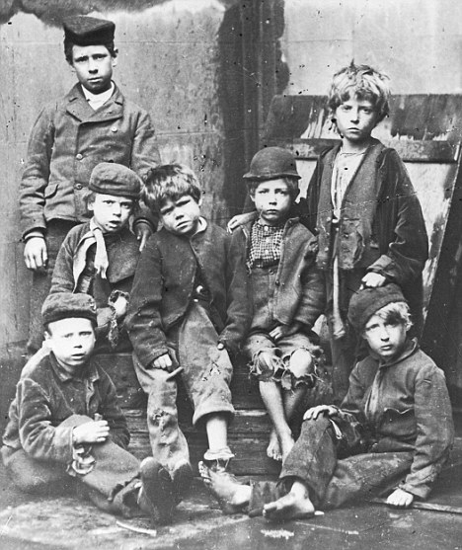

Slide 10
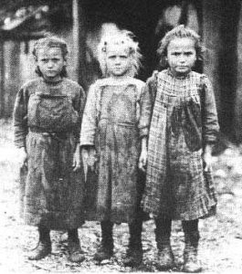
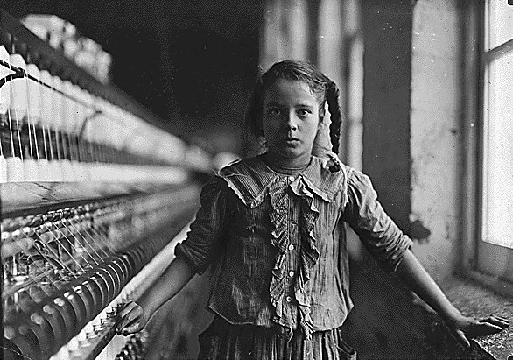
Child Labor
Children were part of the labor force and often worked long hours and were used for such highly hazardous tasks as cleaning the machinery.
In the early 1860s, an estimated one-fifth of the workers in Britain’s textile industry were younger than 15.
Urban, industrialized areas were unable to keep pace with the flow of arriving workers from the countryside, resulting in inadequate, overcrowded housing and polluted, unsanitary living conditions in which disease was rampant

Slide 11
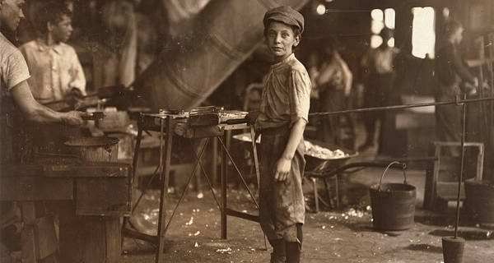
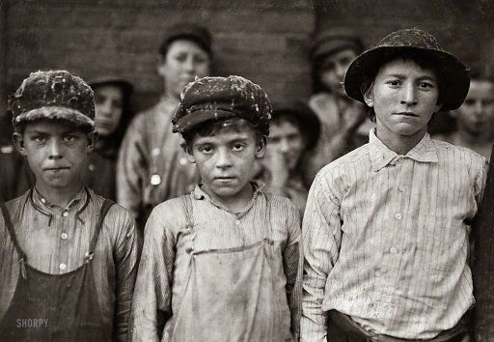
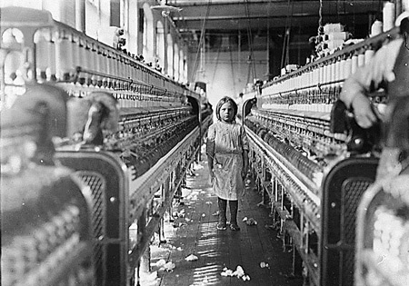
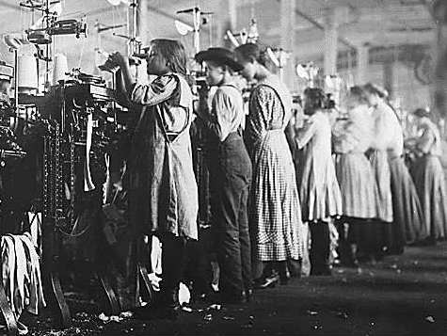

Slide 12
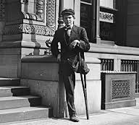
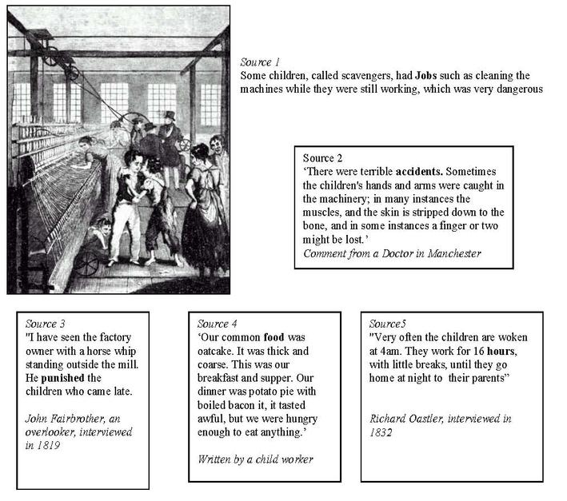
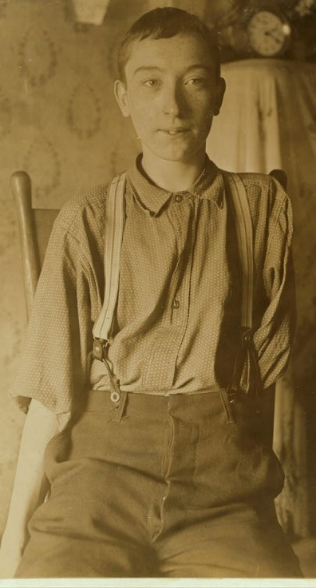
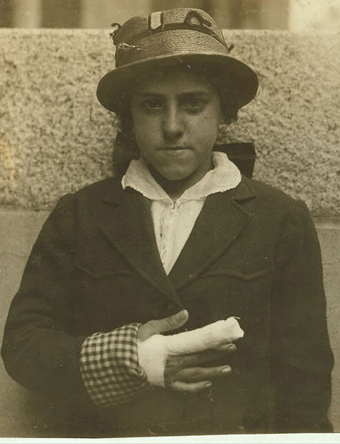

Slide 13


Slide 14
At the bottom of your pro-con list answer this question:
Was the industrial revolution worth it? Why do you think that?

Slide 15
3rd Block
Students will label a map delineating the major territorial acquisitions from 1803-1860 including the
  Louisiana Purchase (1803)
  the purchase of Florida (1819)
  the Annexation of Texas (1845)
  the acquisition of the Oregon Territory (1846)
  land acquired in the Treaty of Guadalupe Hidalgo that ended the Mexican-American War (1848)

