Slide 1
Journal: Pretend that a European country invaded South America. What do you think the US should do in that situation?

Slide 2
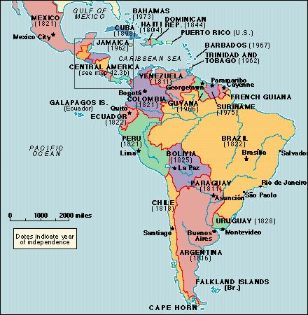
What was the Monroe Doctrine?
In 1823, President James Monroe warned the nations of Europe not to meddle in the politics of North and South America.
When a group of European countries planned to help one another recapture American colonies that had gained independence, Monroe announced that the United States would prevent European nations from interfering with independent American countries.

Slide 3
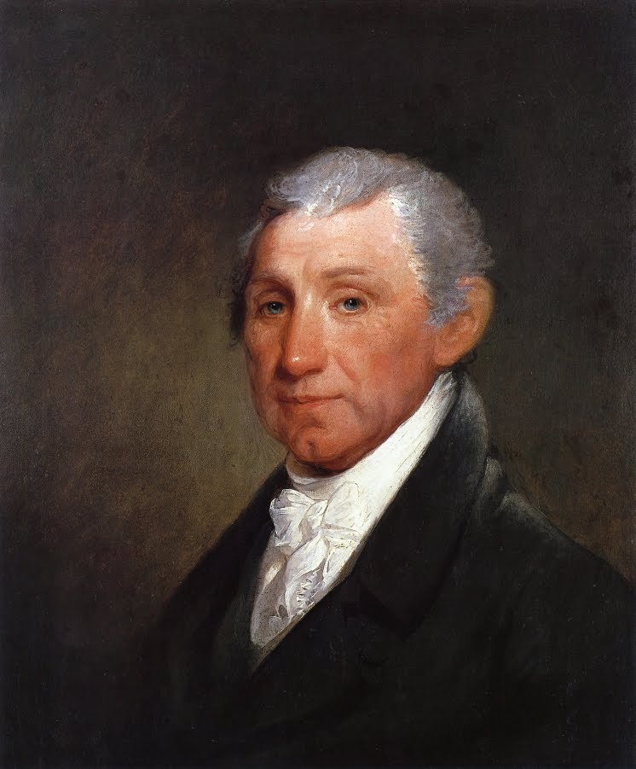
Monroe Doctrine Continued
Further, Monroe said the United States would remain neutral in wars between European nations and their American colonies, but, if battles took place in the New World, the United States would view such battles as hostile actions against the United States.
The Monroe Doctrine defined an aspect of U.S. foreign policy to which America still holds today.

Slide 4
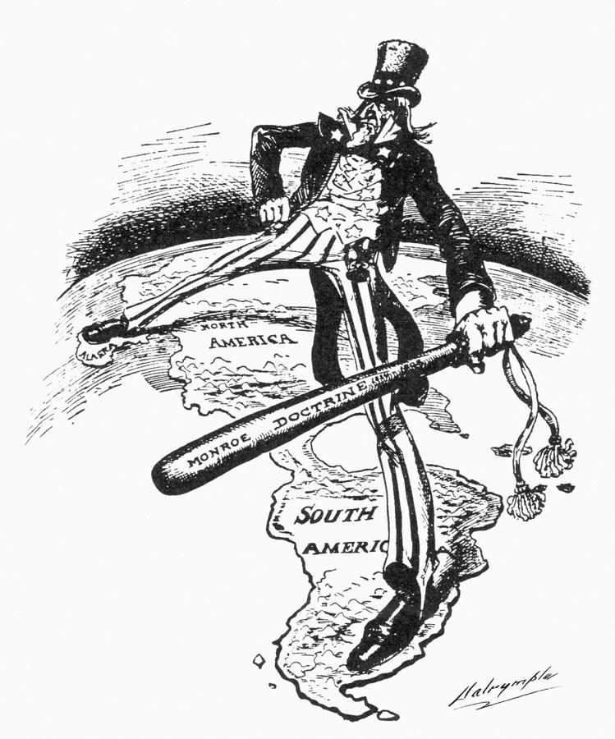
Group Practice

Slide 5
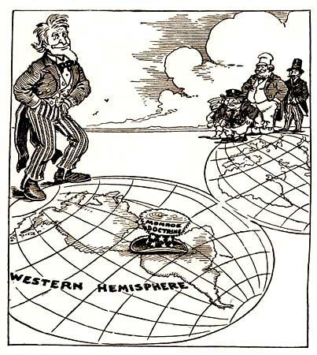

Slide 6
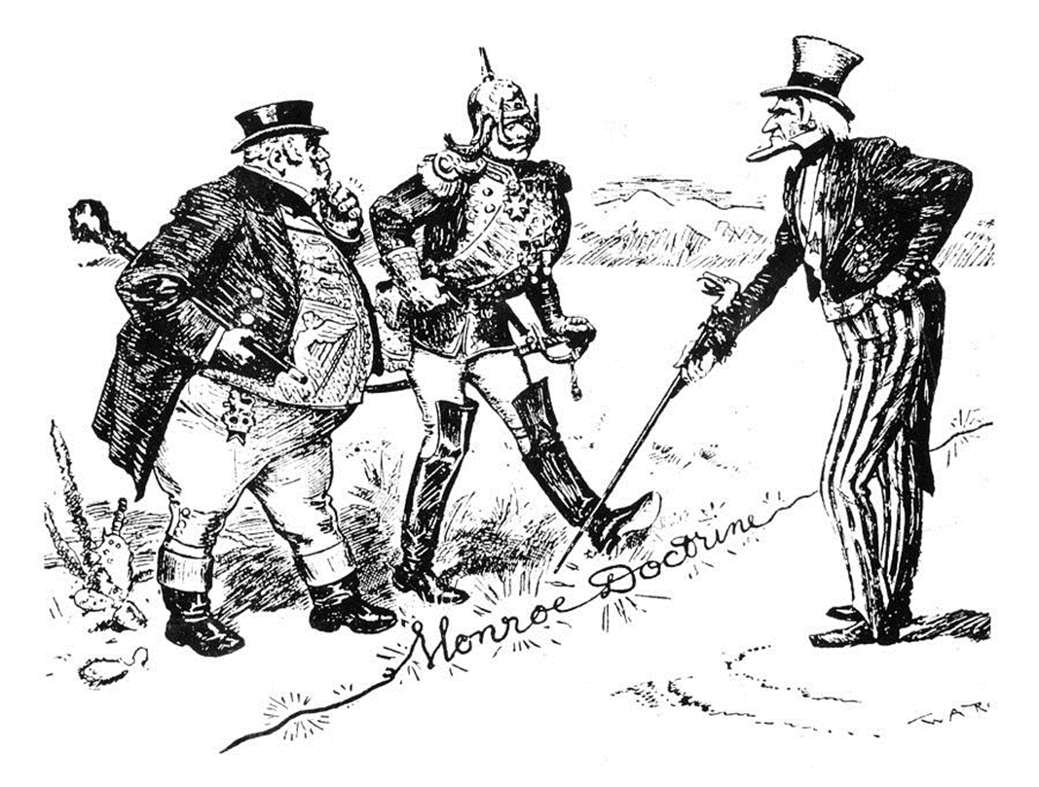

Slide 7
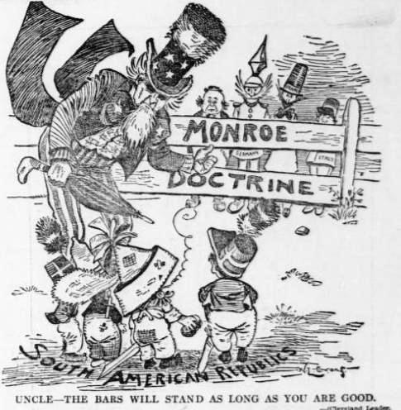

Slide 8
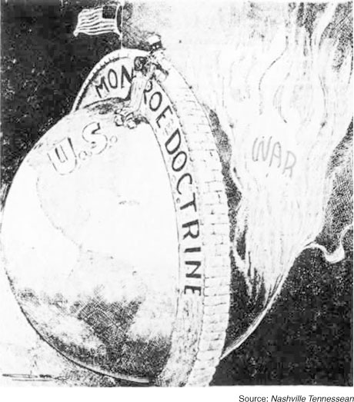

Slide 9
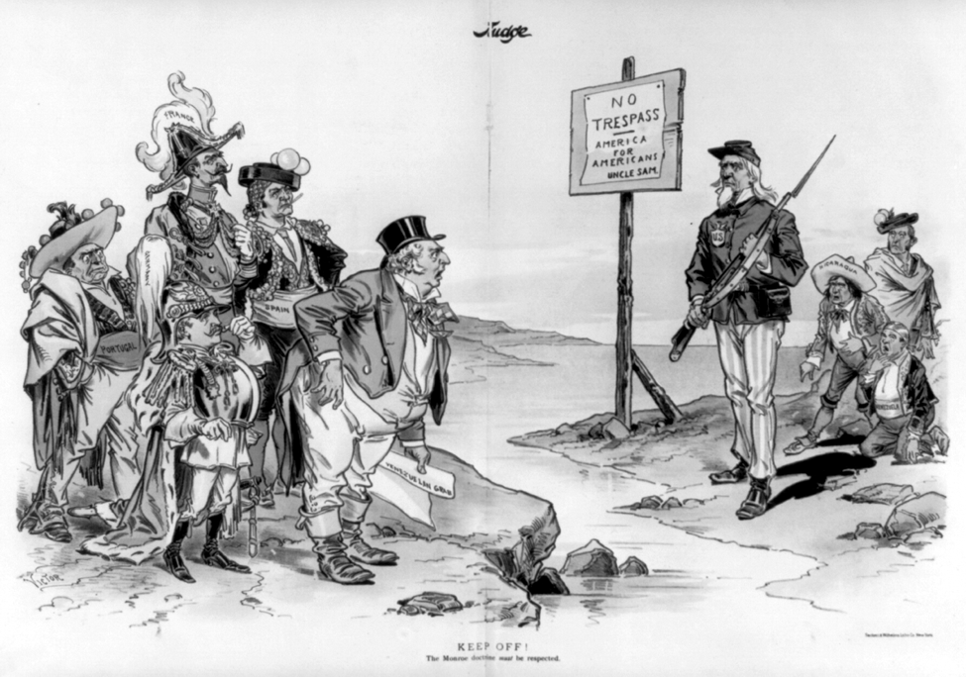

Slide 10
Textbook Profile Writing Assignment:
Students are to pretend they are a famous historical figure and write what they would want future textbooks to say about them.
use the profile of Benjamin Franklin (in notes) as an example.
The essay must be three full paragraphs (5-7 sentences each).
Format Suggestion- break the paper up into the following 3 sections:
Paragraph 1- Introduce the time period and culture in which you lived
Paragraph 2- Introduce yourself and your background
Paragraph 3- explain your future accomplishments and how you might contribute to history
This assignment is due by Thursday, September 11.

Slide 11
Monroe Doctrine Virginia Plan Nationalism
George Washington New Jersey Plan
Great Compromise Montesquiue
3/5 Compromise Erie Canal
Articles of Confederation New York City
Whiskey Rebellion Infrastructure
Shays Rebellion Political factions
Anti-Federalist Non-intervention
Federalist Immigrants LA Purchase
Bill of Rights Ratify
James Madison Veto War of 1812
John Adams Thomas Jefferson
Federalist Papers Impressment Northwest Ordinance Lewis and Clark

