Slide 1
Erie Canal and New York City
What is significant about the war of 1812?
A. It was the only war fought in America
B. It was the only war fought between the Americans and the British
C. It was the first war fought with guns
D. It showed that America had a strong military and national identity

Slide 2
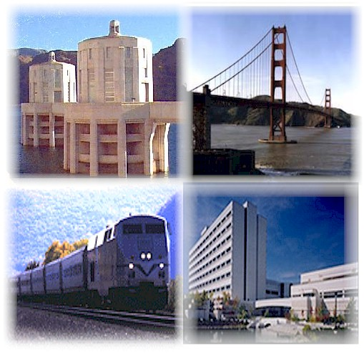
Vocab of the standard
Infrastructure- the basic equipment and structures (such as roads and bridges) that are needed for a country, region, or organization to function properly

Slide 3
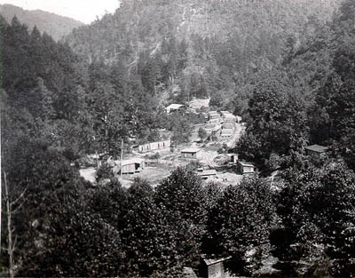
Why do we need it in 1820?
In this period, many families moved west of the Appalachian Mountains to claim land in the new American territories stretching to the Mississippi River. Their travel was difficult, taking a week to cross the distance a car might drive today in a few hours.

Slide 4
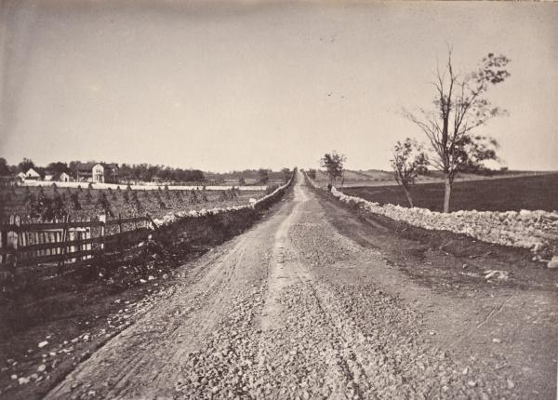
Building Infrastructure
In response, private companies built the young nation’s roads and waterways. These roads were often turnpikes, or toll roads, which travelers paid a fee to use. In turn, these fees were used to pay for upkeep of the new roads.
Where roads could not be built, barges were used on rivers to carry people and goods––as long as the rivers flowed in the same direction that the settlers and merchants wanted to travel.

Slide 5
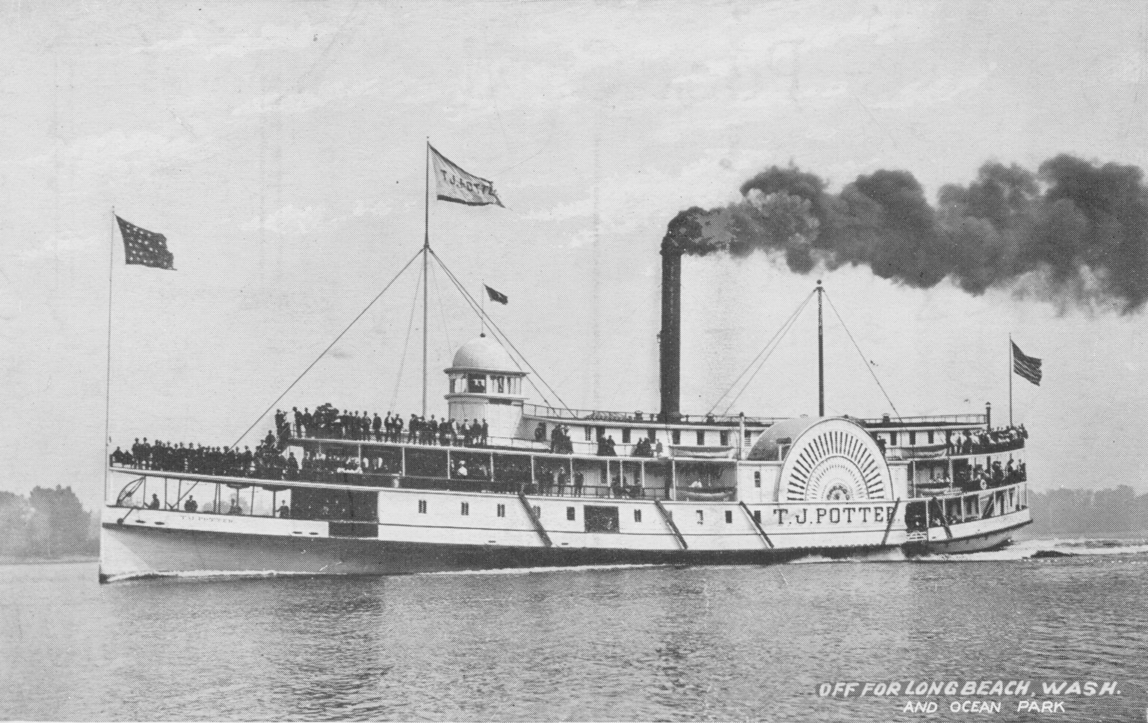
Steamboats and canals
Soon a new invention, the steamboat, enabled people to buy a ticket from private companies that operated the boats and to travel upstream as easily as downstream.
Lastly, in the wilderness where rivers did not run and roads could not be built, government leaders joined business people to build canals––artificial rivers. These shallow waterways were for barges, not steamboats, and had pathways alongside on which horses or mules pulled the barges.

Slide 6
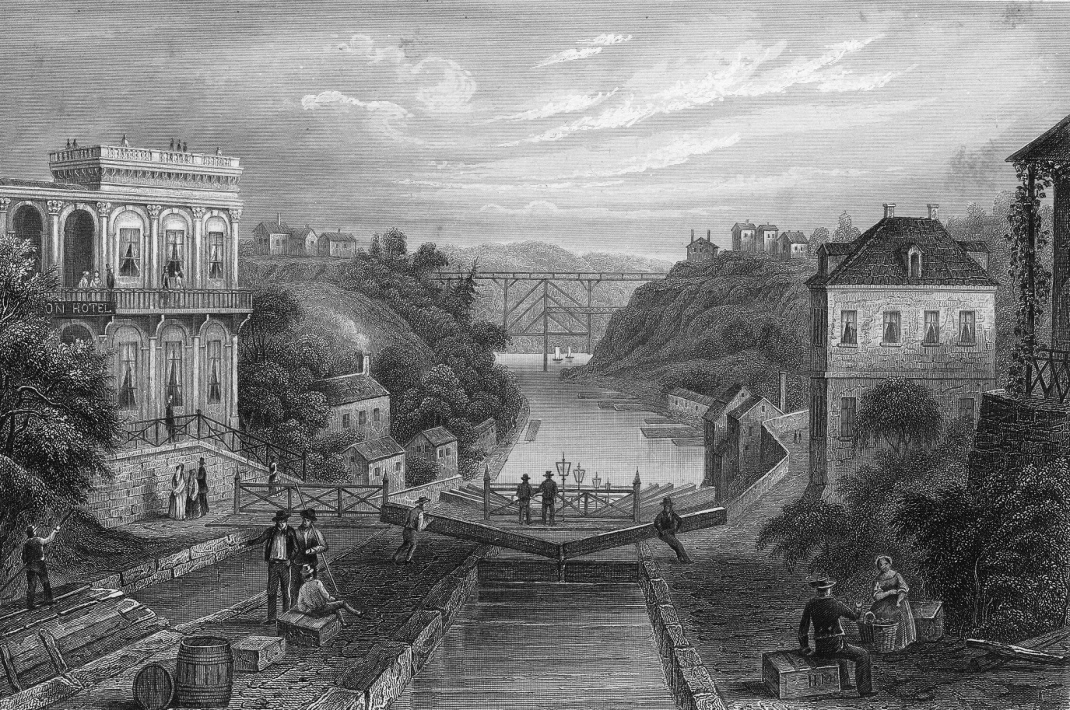
Erie Canal
The most famous canal built in this era was the Erie Canal, which connected the Great Lakes to the Atlantic Ocean.
It was opened in 1825 after eight years of digging by thousands of laborers, mostly immigrants. It stretches 363 miles from Lake Erie to the Hudson River, which flows into the Atlantic Ocean at New York City.
The Erie Canal served as a turnpike for barges where a road could not easily be built, and greatly lowered transportation costs. This not only opened up western New York and regions further west to increased settlement, but also helped unite new regions with the Atlantic states.

Slide 7
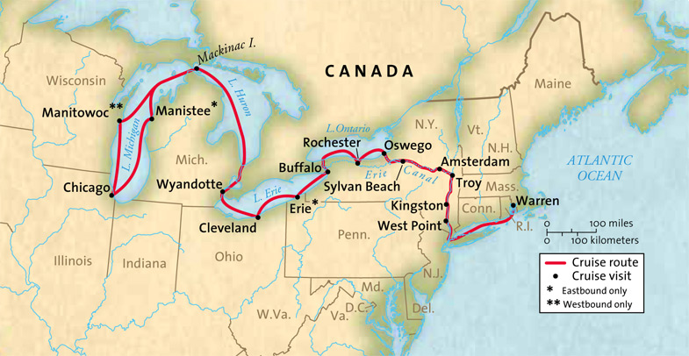

Slide 8
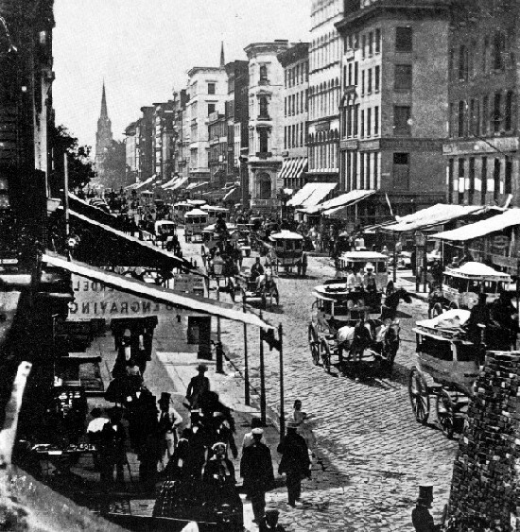
New York City
Until 1790, New York City was the capital of the United States.
In the early 1800s, civic development turned this colonial town into a great economic center established on a grid of city blocks. By 1835, the population had grown so large that New York City outpaced Philadelphia as the largest U.S. city.
Trade grew when the Erie Canal made the city’s harbors the link between European merchants and the great agricultural markets across the Appalachians from New York City. The city was home to the biggest gathering of artisans and crafts workers in the United States, and its banking and commercial activities would soon make it the leading city in all of North America.

Slide 9
Geographic | Social | Economic

