Slide 1
War of 1812
Unit 3

Slide 2
Journal: What do these Lyrics mean? What are they talking about? Where did they come from?
O say can you see by the dawn's early light,
What so proudly we hailed at the twilight's last gleaming, whose broad stripes & bright stars through the perilous fight, o'er the ramparts we watched, were so gallantly streaming?
And the rockets' red glare, the bombs bursting in air, gave proof through the night that our flag was still there; O say does that star-spangled banner yet wave, o'er the land of the free and the home of the brave?

Slide 3
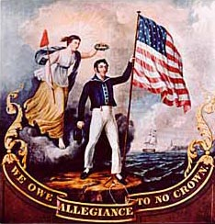
Background
In 1812, America declared war on Great Britain, which was already at war with France. Among the causes of this war, four stand out.
First, Americans objected to restrictions Britain was enforcing to prevent neutral American merchants from trading with the French.

Slide 4
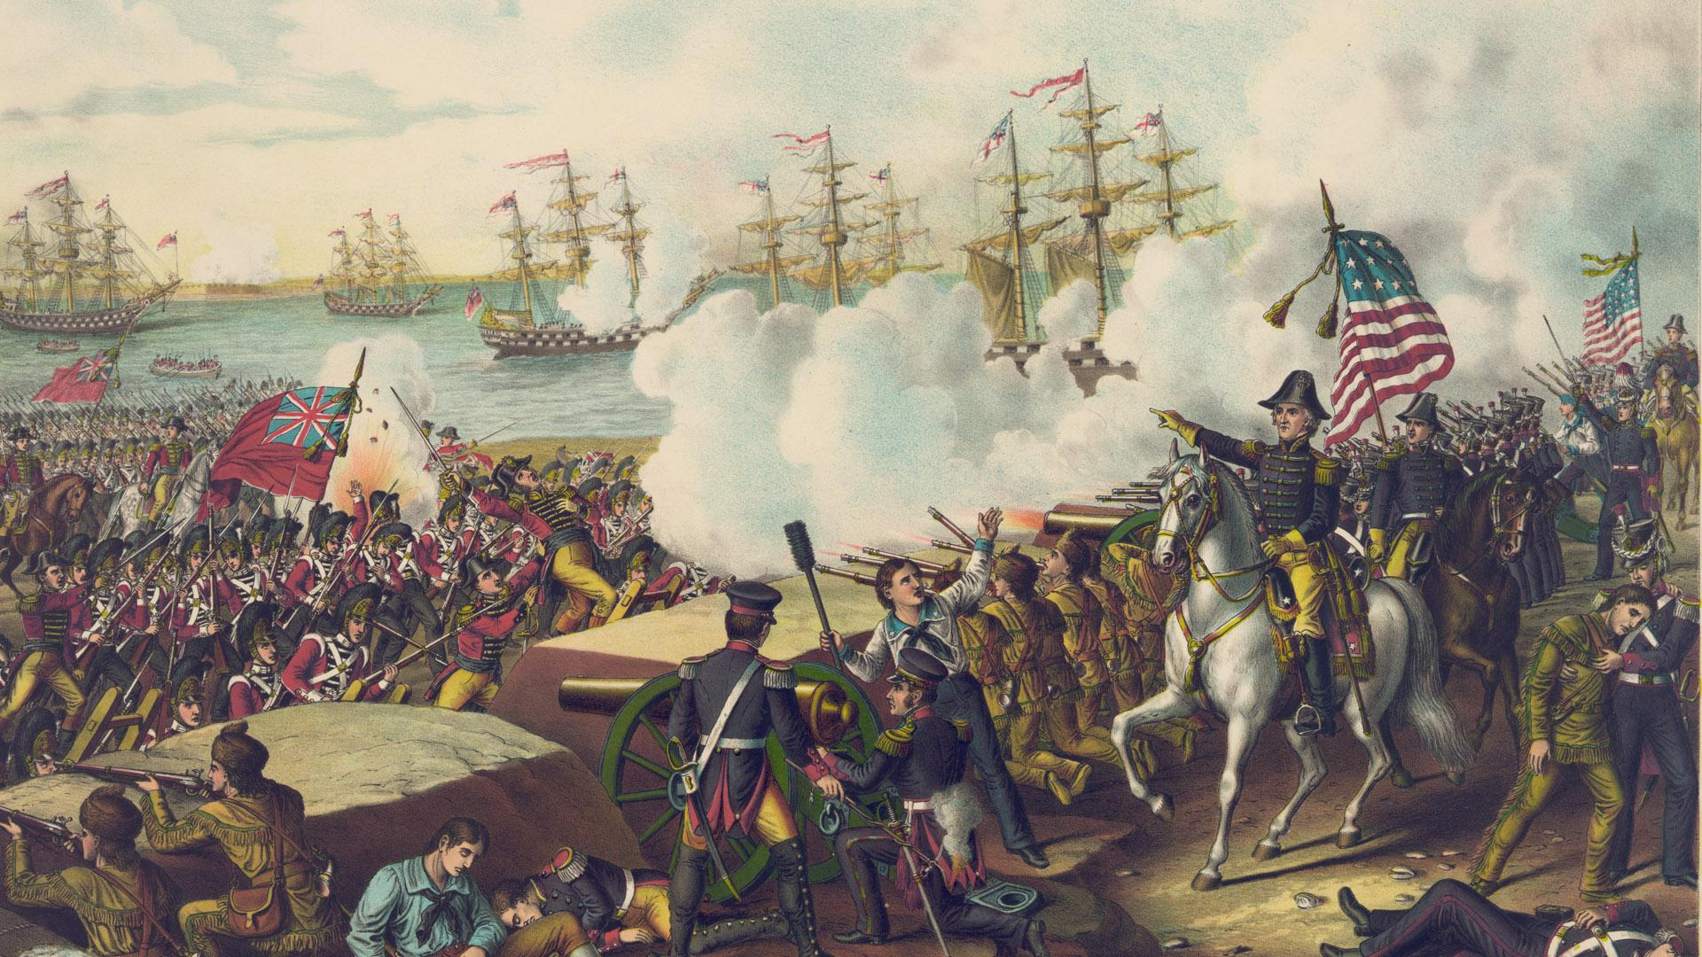
Causes
Second, Americans were outraged by the British policy of impressment. Under this policy, thousands of American sailors were forced against their will to serve in the British navy after their merchant ships were captured at sea.

Slide 5
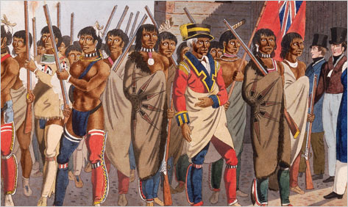
Causes
Third, Americans suspected the British were giving military support to Native Americans so they would fight to keep Americans from settling lands west of the Appalachian Mountains.

Slide 6
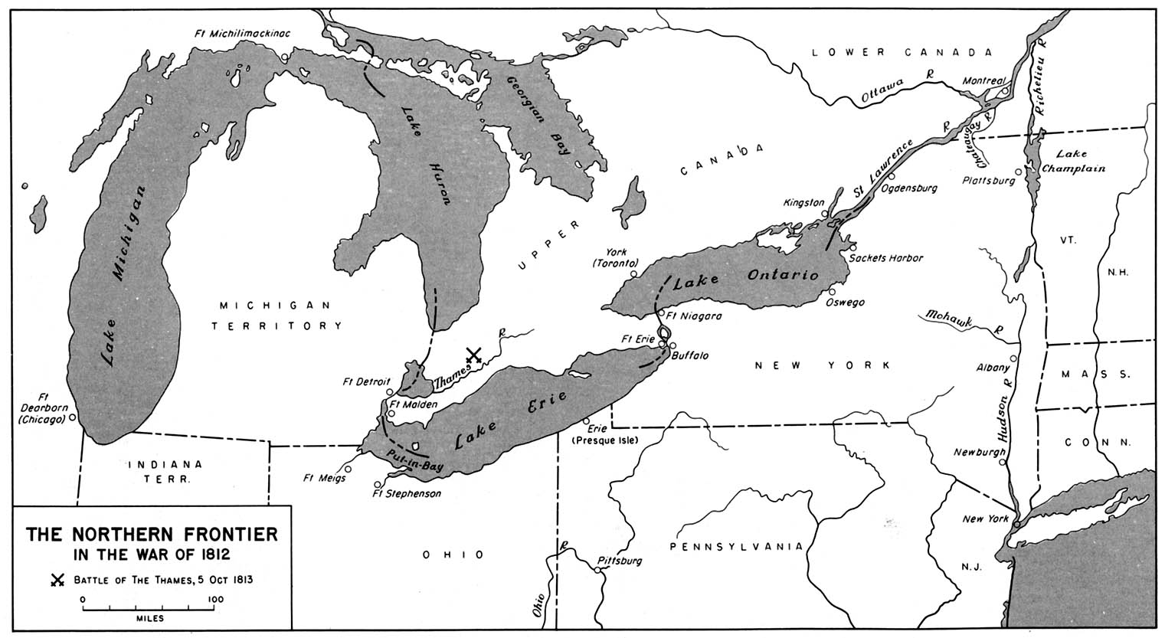
Causes
Fourth, Americans wished to drive the British out of North America altogether by conquering Canada while the British army was fighting the French in Europe.

Slide 7
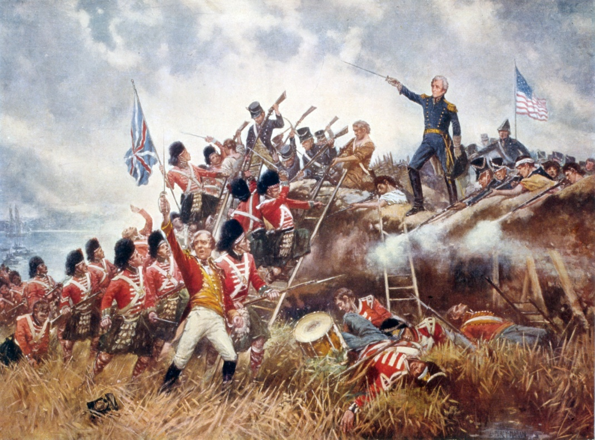
Battle of New Orleans
The Battle of New Orleans was the last major battle of the War of 1812.
The fight took place on January 8, 1815 when 7,500 British soldiers marched against 4,500 U.S. troops led by General Andrew Jackson. Jackson defeated the British just 30 minutes, halting their plans to attack New Orleans and establishing himself as a national military hero.
The Treaty of Ghent, which ended the war, had been signed two weeks before the battle but the news had not yet crossed the Atlantic.

Slide 8
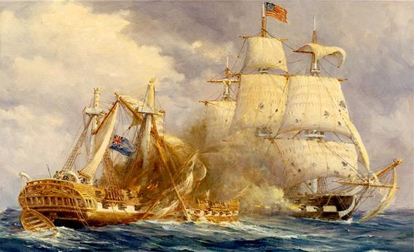
Results
A major result of the War of 1812 was the end of all U.S. military hostility with Great Britain. Never again would Britain and the United States wage war over diplomacy, trade, territory, or any other kind of dispute.
America’s army and navy were firmly established as worthy opponents of any European military force. The U.S. military’s achievements in the War of 1812 also served to heighten nationalist sentiments.

Slide 9
