Slide 1
What followed the Boston Tea Party? A. The free flow of trade between the colonies and other countries B. Harsh restrictions on colonial liberties and trade
C. Increased self-government in New England D. The removal of British troops from the colonies Which issue was highlighted by Daniel Shays Rebellion of 1786–1787? A. The dangers of executive authority over state’s rights B. The weaknesses of the Articles of Confederation C. The failure of the federal government to organize the territories D. The inability of the Monroe Doctrine to protect American interests The major cause of Cornwallis defeat at Yorktown was A. The British were short on men due to losses on the battlefield B. The British reinforcements did not arrive from New York C. Lord Cornwallis and his army were trapped by land and sea D. The British soldiers were exhausted from the southern campaign and weary of war

Slide 2
3rd block warm up
What do you know about John Adams?

Slide 3
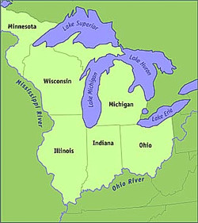
Northwest Ordinance
The first U.S. governmental territory outside the original states was the Northwest Territory, which was created by the Northwest Ordinance.
This law demonstrated to Americans that their national government intended to encourage westward expansion and that it would do so by organizing new states that would be equal members of the Union.

Slide 4
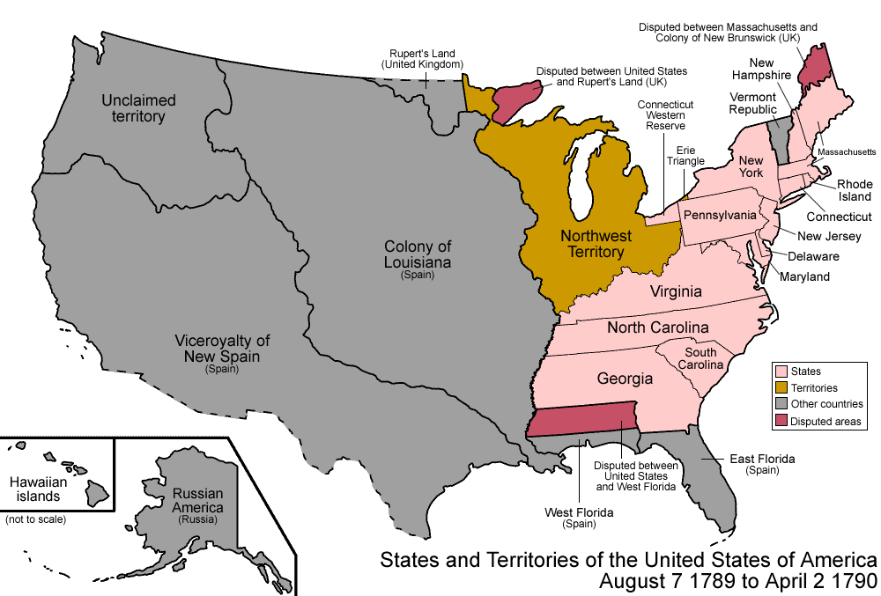

Slide 5
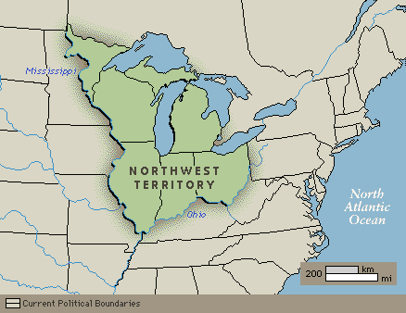
What did it do?
The ordinance banned slavery in the Northwest Territory. This law made the Ohio River the boundary between free and slave regions between the 13 states and the Mississippi River.
Additionally, the Northwest Ordinance mandated the establishment of public schools in the Northwest Territory

Slide 6
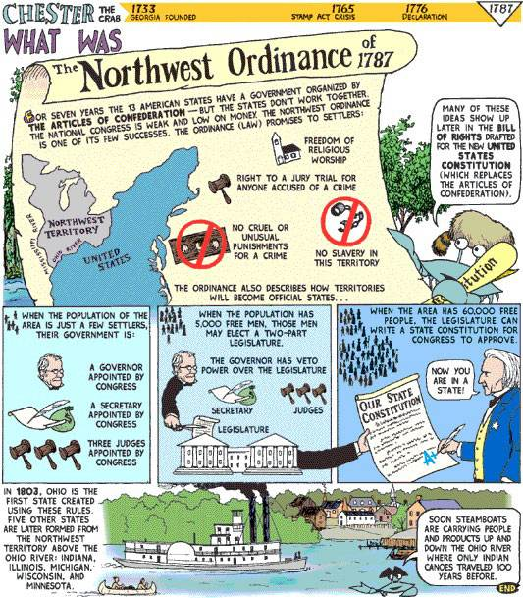
Why is it important?
created a policy for the addition of new states to the nation
Encouraged education of citizens by opening public schools
Encouraged westward migration

Slide 7
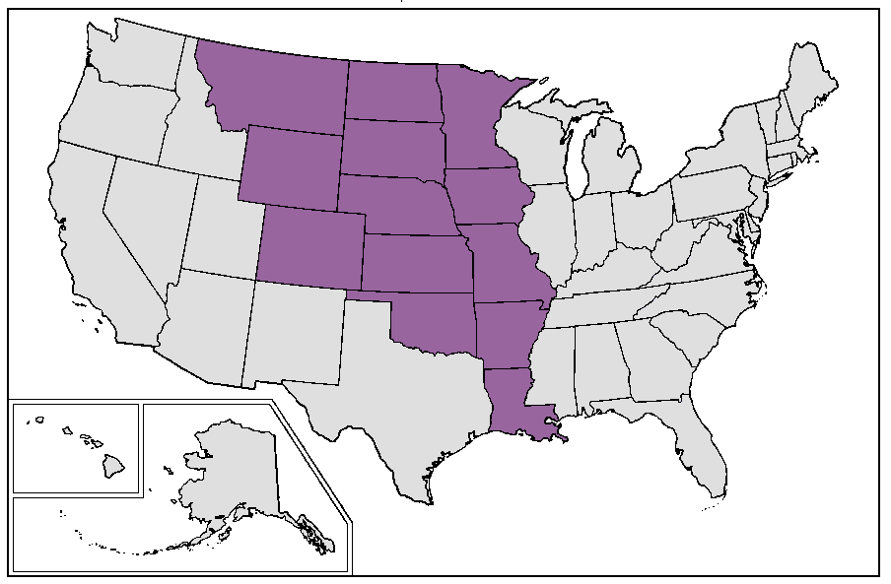
Louisiana Purchase
In the early 1800s, President Thomas Jefferson sent James Monroe to France to negotiate the purchase of the important port city of New Orleans.
At the time, the French ruler Napoleon controlled New Orleans and much of the land west of the Mississippi River.

Slide 8
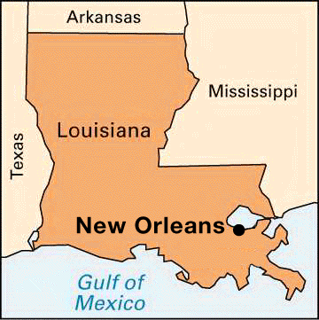
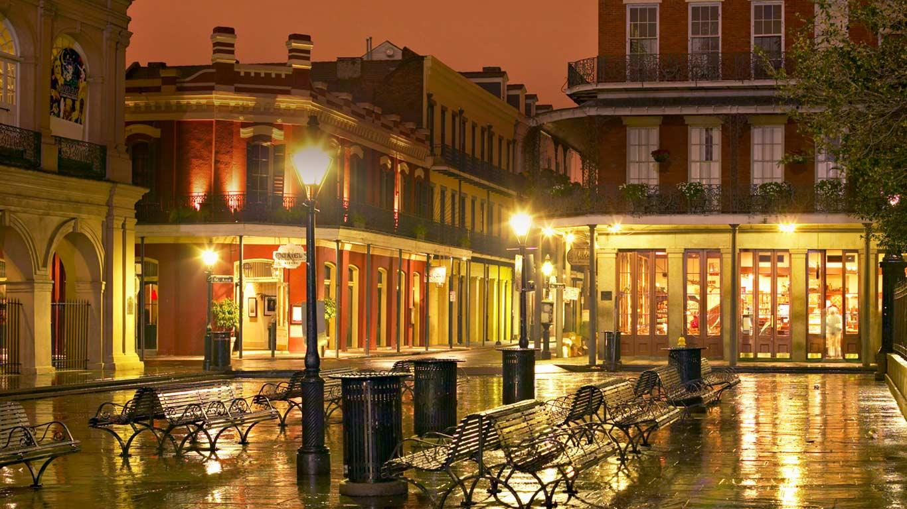
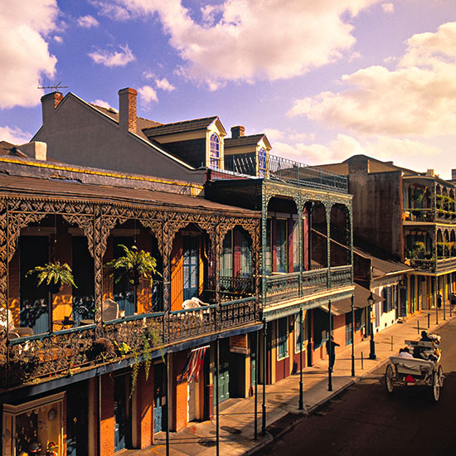
New Orleans- A port city

Slide 9
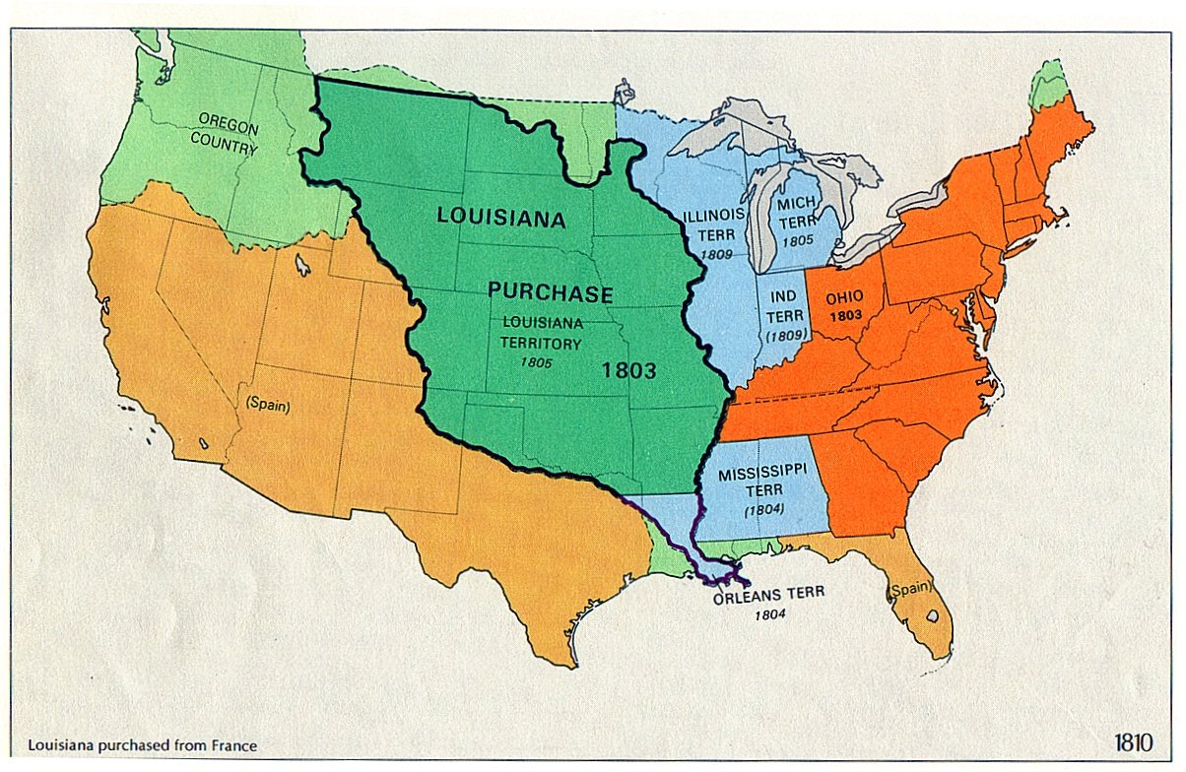
Louisiana purchase
In 1803, Napoleon agreed to sell to the United States not only New Orleans but also the entire Louisiana Territory for $15 million. As a result, the United States nearly doubled in geographic area.

Slide 10
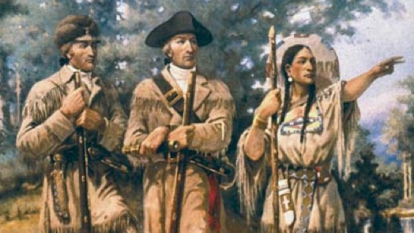
Lewis and Clark
Jefferson sent Meriwether Lewis and William Clark to explore Louisiana and the western lands all the way to the Pacific Ocean.
On their 16-month expedition, Lewis and Clark charted the trails west, mapped rivers and mountain ranges, wrote descriptions and collected samples of unfamiliar animals and plants, and recorded facts and figures about the various Native American tribes and customs west of the Mississippi River.

Slide 12
Time Line
As the students go through each day, they will create a timeline of events in their notes and include key information.
Summarize 10 days of the journey and explain why key stops on the journey influenced later westward migration and creation of more states.

Slide 13
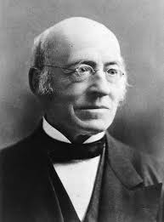
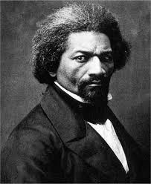
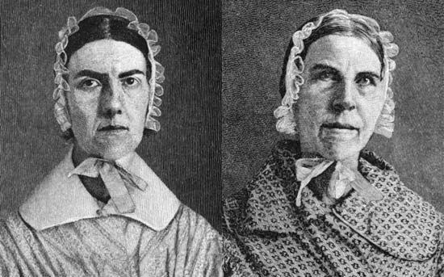
3rd block
Choose 2 of the following abolitionists: William Lloyd Garrison, Frederick Douglass, or the Grimke Sisters.
Create a poster comparing and contrasting your 2 chosen abolitionists
Information is expected to include: personal history, education, protest methods, notable activities, key works etc.

