Slide 1
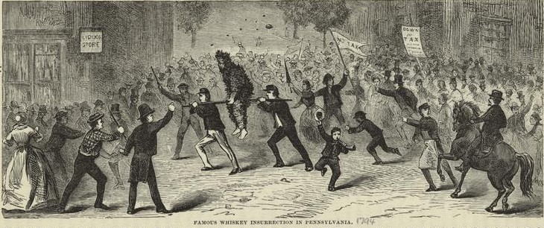
Unit 3
The Whiskey Rebellion

Slide 2
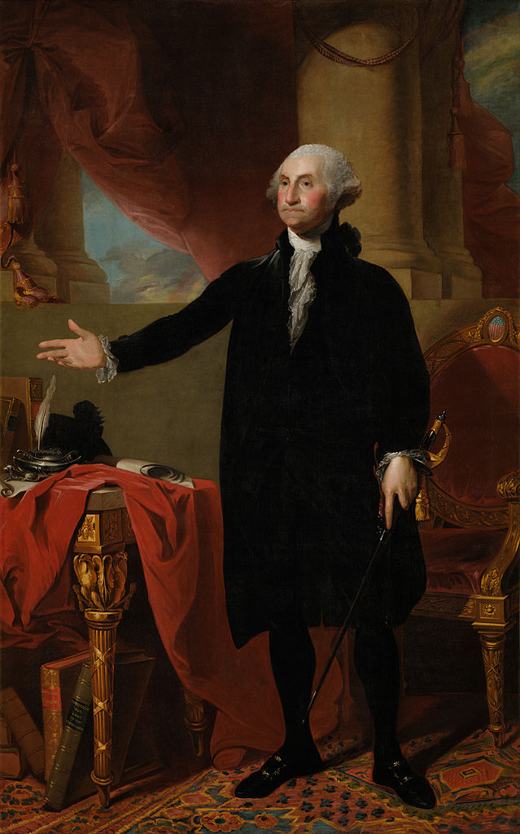
George Washington, President
George Washington was elected the first president of the United States. He established important patterns for future presidents to follow. Developments that altered the course of the history of the U.S. government took place during his administration. Washington favored nonintervention in Europe and avoided siding with France against Great Britain. Instead, the United States persuaded Britain to forgive many pre-Revolutionary debts and to drop certain restrictions on American trade with British colonies in the Americas. This ushered in an era of booming trade with Britain.

Slide 3
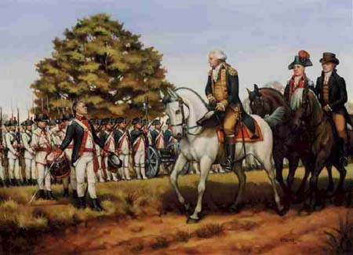
The Whiskey Rebellion
Washington’s new government persuaded Congress to pass taxes on liquor to help pay the states’ debt from the Revolutionary War. The tax hit the small whiskey-makers in western settlements particularly hard because they made liquor using excess crops of grain in order to make it easier to transport.
The Whiskey Rebellion resulted when, up and down areas west of the Appalachians, armed violence broke out as farmers frightened and attacked federal tax collectors.
George Washington led a large militia force into the western counties and put down the rebellion. Washington’s response showed his constitutional authority to enforce the law and that if Americans did not like a law, the way to change it was to petition Congress peacefully

Slide 4
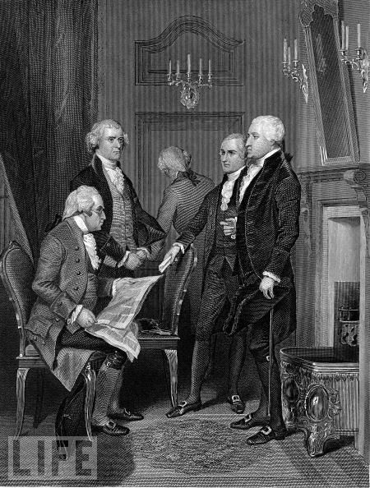
The Administration
Washington was the most influential and popular figure in the United States. He increased the prestige of his administration by making Thomas Jefferson his secretary of state and Alexander Hamilton his secretary of treasury.
Despite their talents and reputations, Jefferson and Hamilton had significant differences of opinion about the legitimate power of the United States government.
Jefferson believed that the national government must limit its power to those areas described by the Constitution, while Hamilton wanted to expand the power of the government to stabilize the nation and its economy.

Slide 5
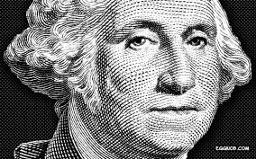
The end of an era
When Washington announced he would not seek a third term as president, the two men and their supporters attacked one another and competed to replace him. Things got so bad that, in his farewell address, Washington warned about the dangers of political parties (factions).

Slide 6
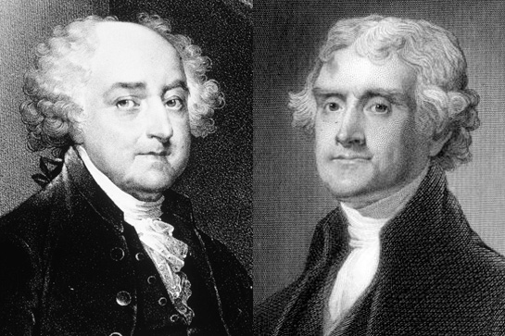
John Adams, 2nd President
The election of 1796 was a bitter contest between John Adams and Thomas Jefferson, with Adams winning by a small margin. Like Washington, Adams set examples that influenced future presidents as well as the course of American history.
His administration was plagued by conflicts with France and Great Britain that crippled the nation’s economy, and he received harsh political criticism from supporters of Vice President Jefferson.
To aid Adams, Congress passed laws that increased citizenship requirements so that Jefferson could not receive support from the immigrant community. Congress also tried to stop the criticism with attempts to limit the speech and press rights of Jefferson’s followers. Jefferson and Madison then argued that states could refuse to enforce federal laws they did not agree with. This was the beginning of the states’ rights concept.

