Slide 1
Unit 3
The Bill of Rights

Slide 2
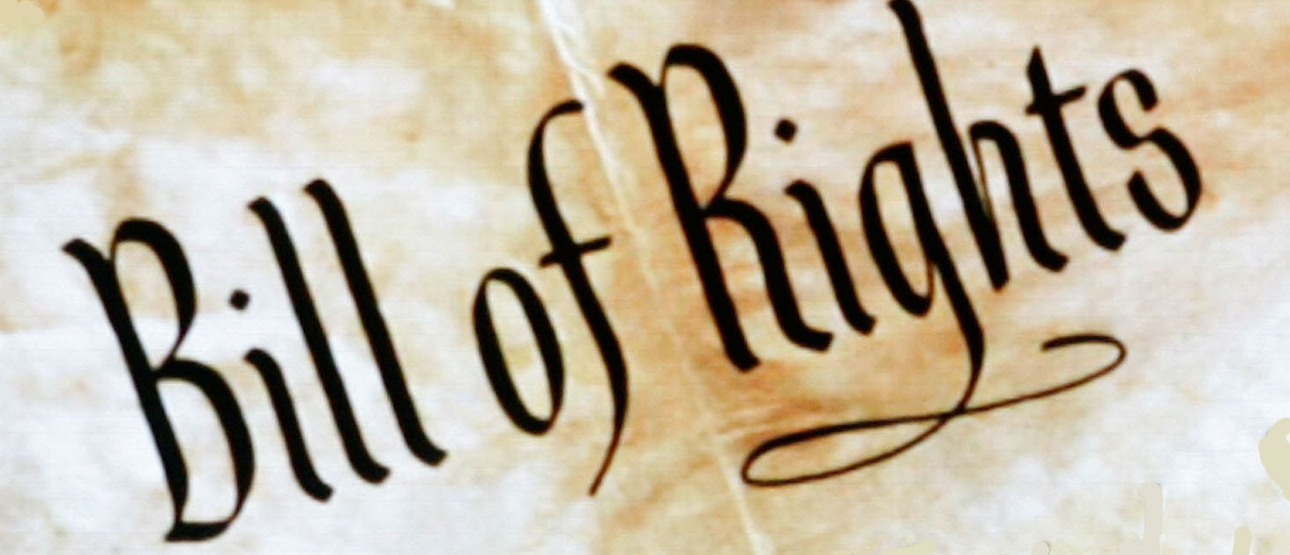
What is the Bill of Rights?
these amendments guarantee a number of personal freedoms, limit the government's power in judicial and other proceedings, and reserve some powers to

