Slide 1
5th block: Find your new seats on the task board. You MUST sit in those groups. No one behind my desk.
Which issue was highlighted by Daniel Shays Rebellion of 1786–1787?
A. The dangers of executive authority over state’s rights
B. The weaknesses of the Articles of Confederation
C. The failure of the federal government to organize the territories
D. The inability of the Monroe Doctrine to protect American interests
The major cause of Cornwallis defeat at Yorktown was
A. The British were short on men due to losses on the battlefield
B. The British reinforcements did not arrive from New York
C. Lord Cornwallis and his army were trapped by land and sea
D. The British soldiers were exhausted from the southern campaign and weary of war

Slide 2
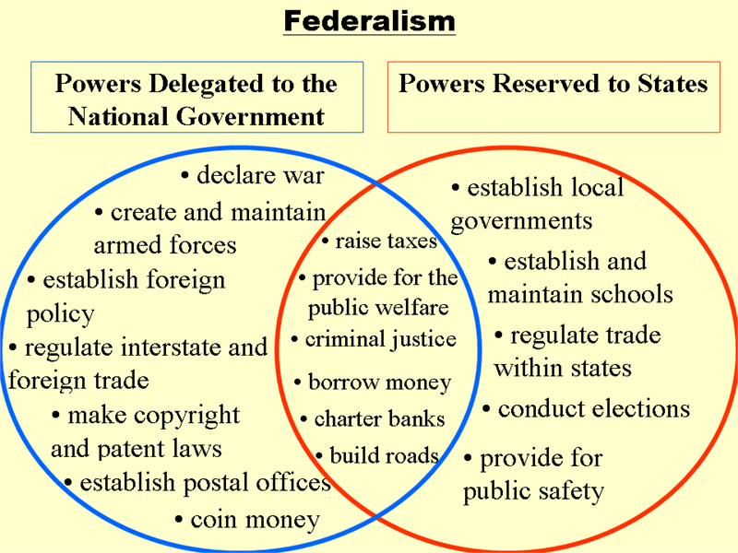

Slide 3
Writing the Constitution was just the first step in creating the new government.
Before the Constitution could take effect, the states had to accept, or ratify, it.

Slide 5
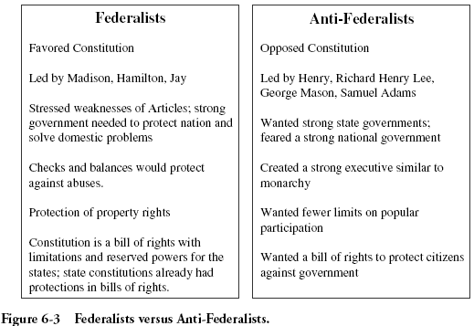
Different Opinions

Slide 7
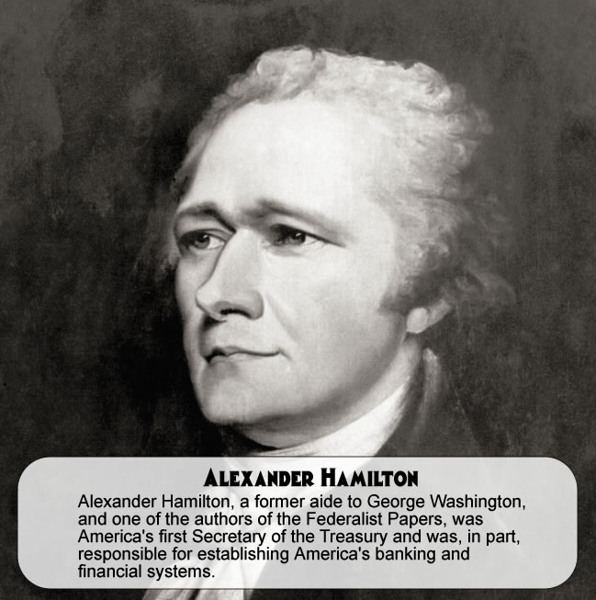
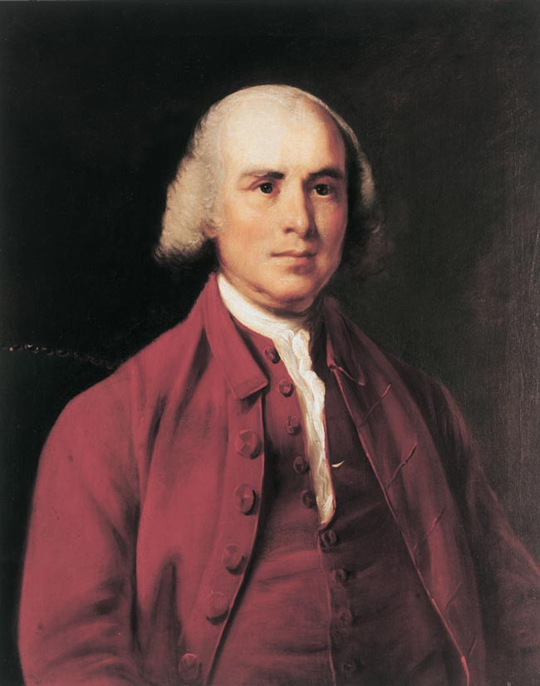
Federalists Papers
Promoted the Constitution
anti-Federalists believed the gov created by the Constitution would be too powerful and would eliminate the power of the states. They also argued that the Constitution did not describe the rights guaranteed to the states and to each citizen.
To counter these claims, James Madison, Alexander Hamilton, and others wrote the Papers and explained the intent behind its major provisions.

Slide 8
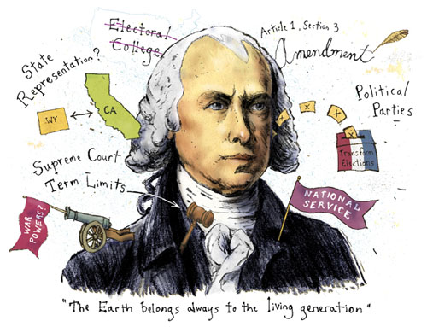
James Madison- Father of the Constitution

Slide 9
The Great Compromise
One great issue facing the delegates to the Constitutional Convention was how different sized states could have equal representation in the new government.
States with large populations supported a plan to create a legislative branch in which representatives were assigned based on each state’s population.
States with smaller populations supported a plan to create a legislative branch in which all states were equally represented.
Delegates to the Constitutional Convention settled the issue of representation in Congress by approving the Great Compromise.
This compromise helped “save” the Constitution by settling the dispute between states with large populations and states with small populations.
The compromise called for the creation of a legislature with two chambers: a House of Representatives, with representation based on population, and a Senate, with equal representation for all states.

Slide 10
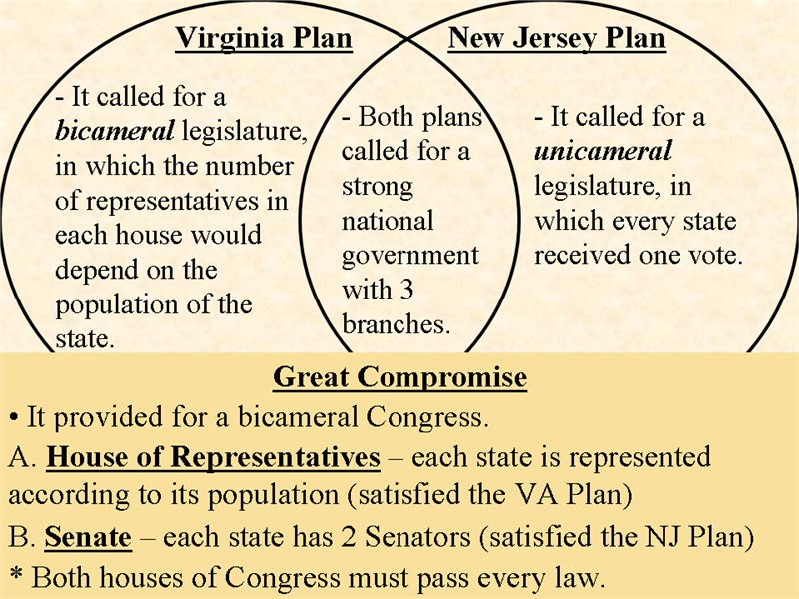
Compromises lead to our New Constitution

Slide 11
Do slaves count?
Another divisive and controversial issue that confronted delegates to the Constitutional Convention was slavery.
Though slavery existed in all the states, southern states depended on slave labor because their economies were based on producing cash crops.

Slide 12
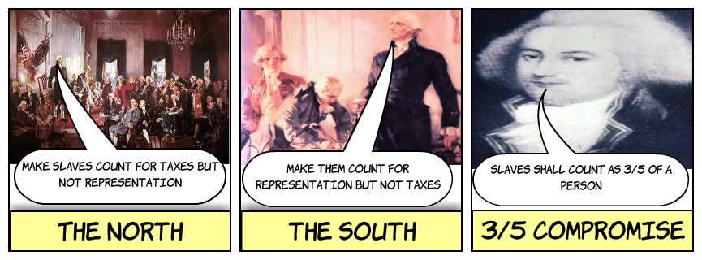
Slavery
States with large populations might have more representatives in the national government, states with large slave populations demanded to be allowed to count their slaves as a part of their population. Northern states resisted.
Both sides compromised by allowing the states to count three-fifths of their slaves when calculating their entire population.
To protect slavery, states with large numbers of slaves demanded that the new government allow for the continuation of the slave trade for 20 years and that northern states return runaway slaves to their owners.

Slide 13
Despite the fact that most delegates to the Constitutional Convention believed the government designed by the Articles of Confederation had to be replaced, many still feared strong central governments. To reassure people that the new government would not be too powerful, the framers of the Constitution created a limited government with divided powers.

Slide 14
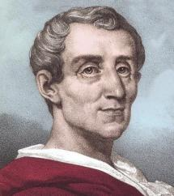
Montesquieu and Separation of Power
The framers were greatly influenced by the ideas of the famed French political thinker Charles de Montesquieu.
Powers were divided in two ways within the new government:
First, power was divided between national and state governments.
Second, the power of the executive branch was weakened because it was shared with the legislative and judicial branches.
For example, the legislature can override a presidential veto of a bill, and the Supreme Court can rule that a bill signed by the president is unconstitutional
An example of these checks and balances would be the president’s power to veto laws passed by Congress.

Slide 15
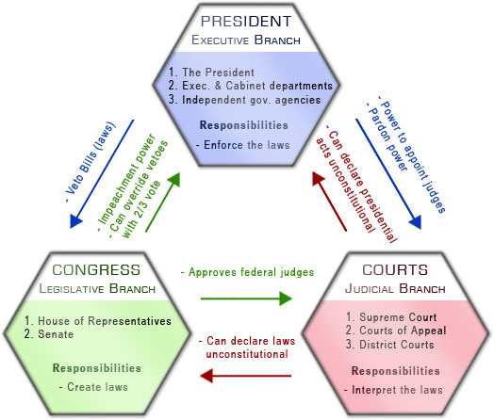

Slide 17
1.
2.
3.
4.
5.
6.
7.
8.
9.
10.

Slide 18
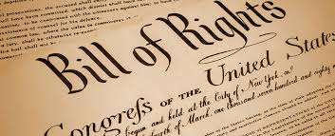
First Amendment: Guarantees freedom of religion, of speech, and of the press, and the right to petition the government
Second Amendment: Guarantees the right to possess firearms
Third Amendment: Declares that the government may not require people to house soldiers during peacetime
Fourth Amendment: Protects people from unreasonable searches and seizures
Fifth Amendment: Guarantees that no one may be deprived of life, liberty, or property without due process of law
Sixth Amendment: Guarantees the right to a trial by jury in criminal cases
Seventh Amendment: Guarantees the right to trial by jury in most civil cases
Eighth Amendment: Prohibits excessive bails, fines, and punishments
Ninth Amendment: Declares that rights not mentioned in the Constitution belong to the people
Tenth Amendment: Declares that powers not given to the national government belong to the states or to the people

Slide 19
Federalists vs Anti-Federalists

Slide 20
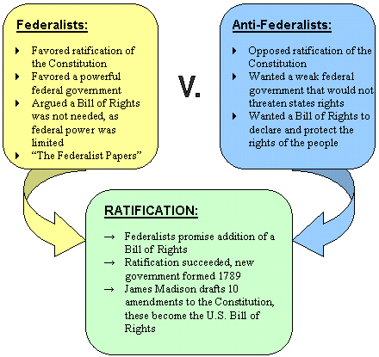
Compromise

