Slide 1
George Washington was an effective military commander because he
a Won more battles than he lost using well-trained troops
b Preserved the army through his leadership skills
c Negotiated alliances with the leaders of other nations
d Prevented attacks against major population centers
“I have to inform your excellency that I have been forced…to surrender the troops under my command to the combined forces of the Americans and French….Source: Letter from Lord Cornwallis.
Which event resulted from the development described in the quotation?
a The Treaty of Paris of 1783 was signed
b The Articles of Confederation were adopted in 1777
c Hessian mercenaries entered the war to support the British army
d Some pledged military aid to the Americans

Slide 2
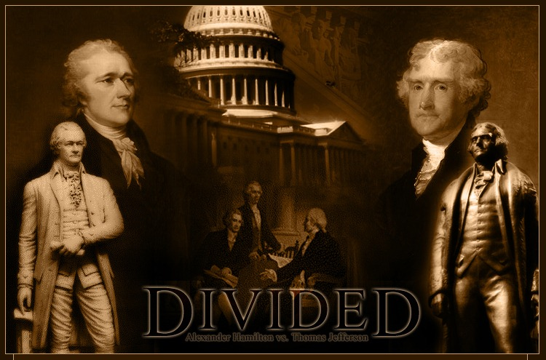
Anti-Federalists
As soon as the contents of the Constitution were published, a group of influential people spoke out against it.
These people came to be known as the anti-Federalists. They believed the government created by the Constitution would be too powerful and would eliminate the power of the states.
They also argued that the Constitution did not describe the rights guaranteed to the states and to each citizen.

Slide 3
Now what?
The anti- Federalists had a valid argument but was it worth not ratifying the Constitution over?
How can we compromise?

Slide 4
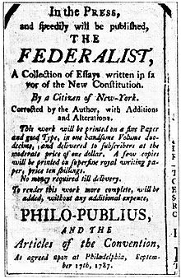
The Federalist Papers
To counter these claims, James Madison, Alexander Hamilton, and others wrote a series of articles that supported ratification of the Constitution and explained the intent behind its major provisions, called the Federalist Papers.
Supporters of the Constitution were known as Federalists.

Slide 5
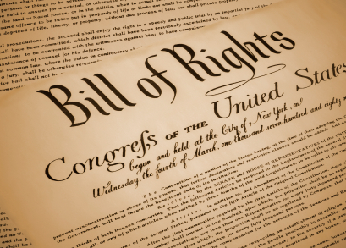
The Bill of Rights
To overcome the anti-Federalist argument that the Constitution failed to include a statement of states’ rights and individuals’ rights, Madison created the Bill of Rights, which would be added to the Constitution after the Constitution was ratified.

Slide 7
Assignment
Students will create pictures for each of the 10 amendments that make up the Bill of Rights. These pictures must convey the meaning and importance of each amendment and must incorporate the number of the amendment into the picture.
For instance, students might draw a flagpole in the shape of a “1”with students gathered peaceably around it to convey the 1st amendment freedom of assembly.
First Amendment: Guarantees freedom of religion, of speech, and of the press, and the right to petition the government
Second Amendment: Guarantees the right to possess firearms
Third Amendment: Declares that the government may not require people to house soldiers during peacetime
Fourth Amendment: Protects people from unreasonable searches and seizures
Fifth Amendment: Guarantees that no one may be deprived of life, liberty, or property without due process of law
Sixth Amendment: Guarantees the right to a trial by jury in criminal cases
Seventh Amendment: Guarantees the right to trial by jury in most civil cases
Eighth Amendment: Prohibits excessive bails, fines, and punishments
Ninth Amendment: Declares that rights not mentioned in the Constitution belong to the people
Tenth Amendment: Declares that powers not given to the national government belong to the states or to the people

Slide 8
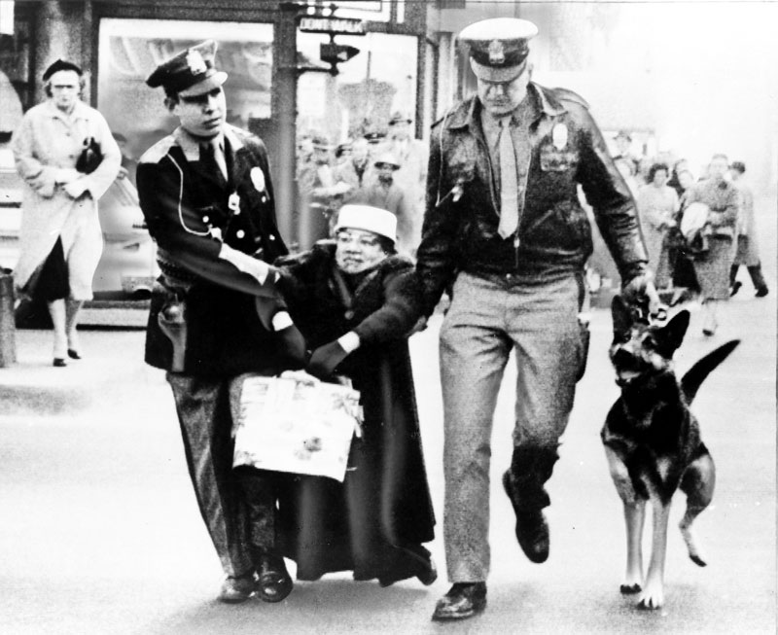
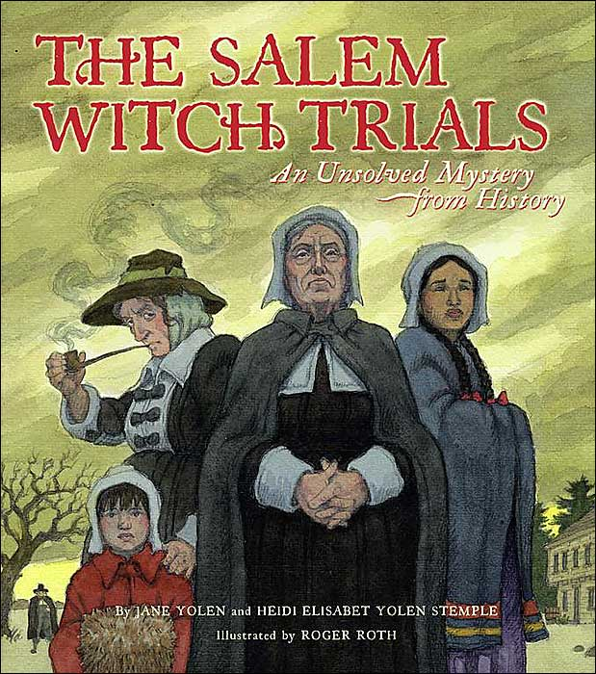
Violation of Which Amendment?
US Federal Gov

Slide 9
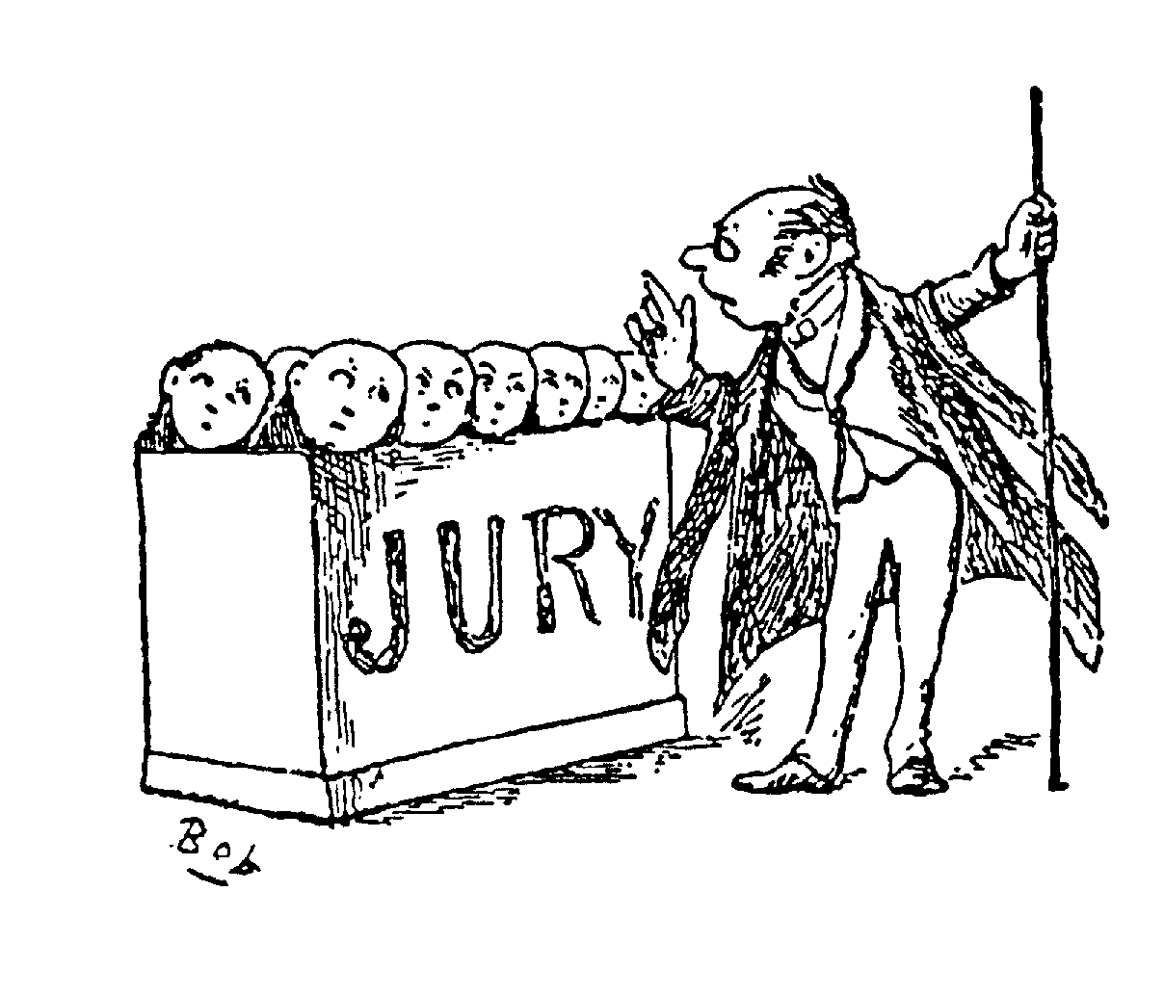
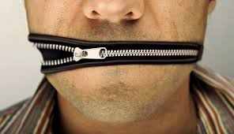
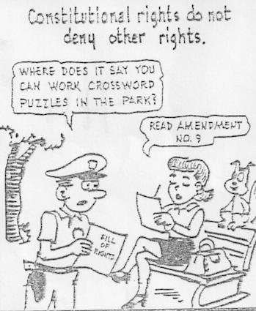
Which Amendment?

