Slide 1
The New United States
Journal: What would you want your new government to look like if you were in America after the revolution?

Slide 2
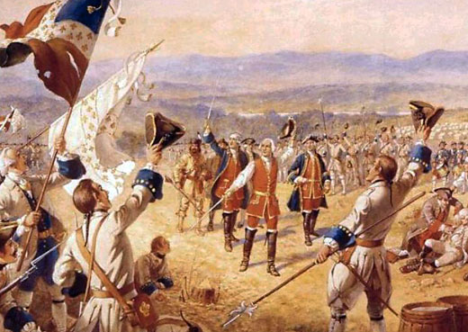
We won the Revolution!! Now what?
Need a formal law
Who gets to decide what the law is?
What rights will citizens have?
Who is in charge?

Slide 3
The Articles of Confederation were written during the American Revolution. They reflected Americans’ fear of a powerful national government. As a result, the Articles created a government that had no executive branch and that lacked the power to tax, regulate commerce, or establish a national currency. The Articles gave individual states more power than the national government had. As a result, conflicts among the states threatened the existence of the nation.

Slide 4
What were the Articles of Confederation?
They were a precursor to the Constitution
A good place to start but not quite enough

Slide 5
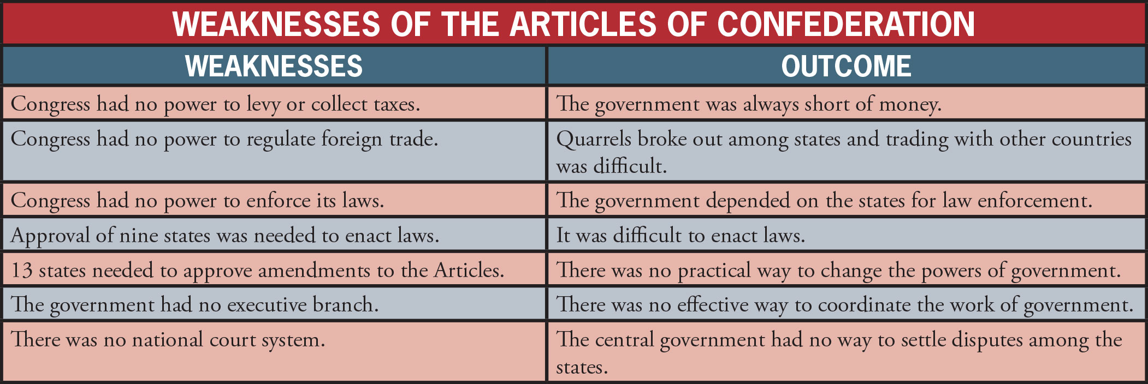
Weaknesses of the Articles of Confederation

Slide 6
The political weakness of the United States and its potential for collapse left it vulnerableto attack by foreign countries and convinced many influential Americans to support a Constitutional Convention. Political leaders were further motivated by Shays’s Rebellion, which they felt set a precedent for mob rule.

Slide 7
Daniel Shays led more than a thousand farmers who, like him, were burdened with personal debts caused by economic problems stemming from the states’ RevolutionaryWar debts. Shays and his men tried to seize a federal arsenal in Massachusetts. This was just one of many protests that debt-ridden farmers made during this period. Without the power to tax, America’s weak government could not repair the national economy.
Responding to Shays’s Rebellion, George Washington supported the establishment of a stronger central government. In May 1787, he was elected president of the Constitutional Convention in Philadelphia, where he and the Founding Fathers created a federalist form of government for the United States.

Slide 8
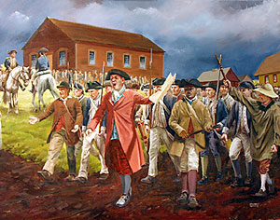
Shays’ Rebellion overview
a series of protests in 1786 and 1787 by American farmers against state and local enforcement of tax collections and judgments for debt.
Although farmers took up arms in states from New Hampshire to South Carolina, the rebellion was most serious in Massachusetts, where bad harvests, economic depression, and high taxes threatened farmers with the loss of their farms.
Daniel Shays of Massachusetts, a former captain in the Continental army led the protest.

Slide 9
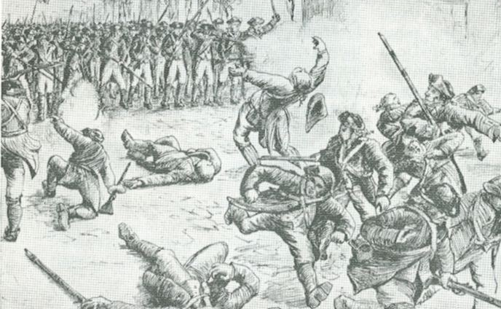
Shays’ Rebellion
Farmers were in debt because of the high cost of starting farms. If farmers were in debt, their farms could be seized and they could be imprisoned
Farmers asked state gov to print more money to help with the debt. When they denied this request, protests formed.

Slide 10
Why the Rebellion matters
Proponents of constitutional reform at the national level cited the rebellion as justification for revision or replacement of the Articles of Confederation, and Shays’ Rebellion figured prominently in the debates over the framing and ratification of the Constitution.
To farmers, the gov seemed unresponsive to the will of the people. To merchants and creditors, the gov seemed vulnerable to anarchy.
Shays' Rebellion came at the time when the states were choosing delegates to attend the convention that was to draft the Constitution of the United States.

Slide 11
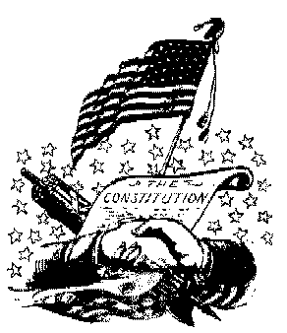
So now what?
We need a constitution!
What is a constitution?
Constitution- written laws of a country
But who gets the power??

Slide 12
Weaknesses of the Articles of Confederation

