Slide 1
Unit 2
Ben Franklin and the French Alliance

Slide 2
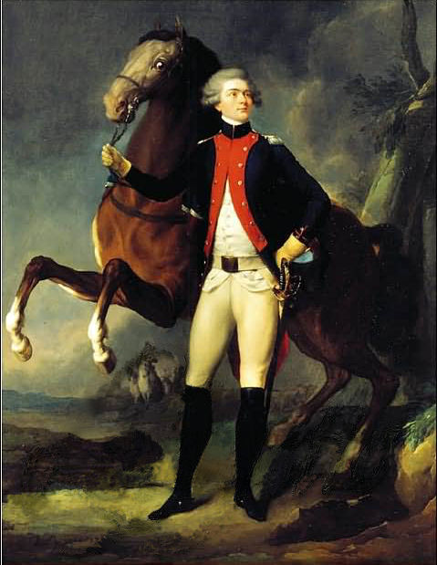
La Marquis de Lafayette
When Lafayette learned of the struggle of the Americans to secure their independence he decided to come to the colonies to help them as a volunteer. He also persuaded several French officers to come with him.
Eventually he landed near Charleston, South Carolina, June 13, 1777
He came to Philadelphia and the Congress welcomed him. He came to serve without pay and also as a volunteer. Since he represented the highest rank of French nobility and his motives were so patriotic in the American cause, the Congress commissioned him a Major General on the 31st of July.

Slide 3
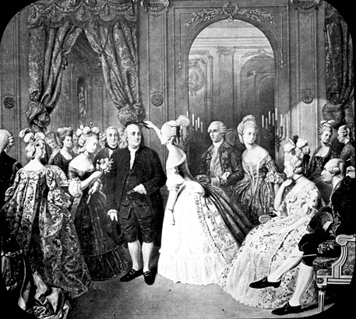
Ben Franklin in France
1776 -named an agent of a diplomatic commission by the Continental Congress & set sail from Philadelphia for France, to negotiate and secure a formal alliance and treaty
Socialized with the French upper class
Not until the American victory over the British at the Battle of Saratoga in October 1777 that France felt an American victory in the war was possible.
After the Battle of Saratoga, representatives of the US and France (including Benjamin Franklin) officially declared an alliance by signing the Treaty of Amity and Commerce and the Treaty of Alliance on February 6, 1778

Slide 4
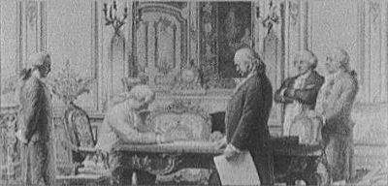
French Alliance
Treaty of Amity and Commerce- which bestowed most-favored nation trading privileges and also contained cooperative maritime provisions.
Conditional & Defensive Alliance- provided that in case war should break out between France and Great Britain as a result of the first treaty, France and America should fight the war together, and neither would make a peace or truce with the enemy without the formal consent of the other. Nor would they "lay down their arms until the Independence of the united states shall have been formally or tacitly assured by the Treaty or Treaties that shall terminate the War."

Slide 5
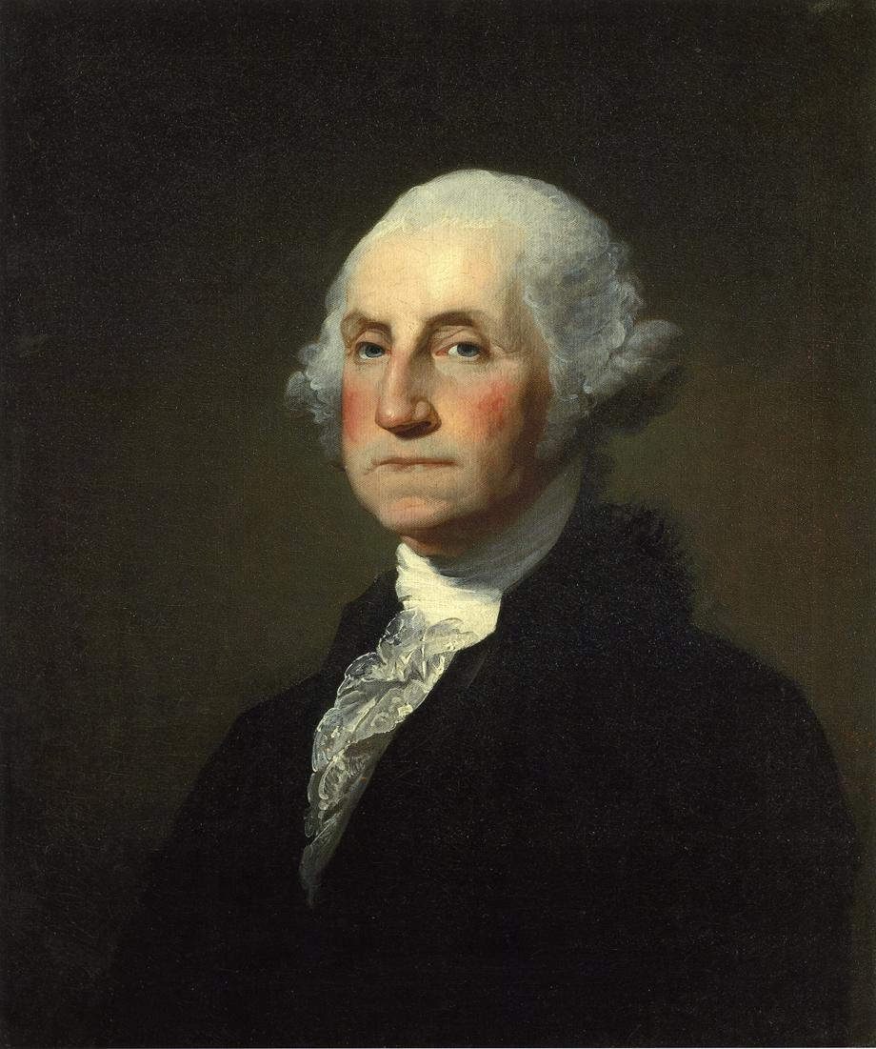
George Washington
Gained military experience in the French/Indian War
Chosen as commander in chief of Continental Army by 2nd Continental Congress

Slide 6
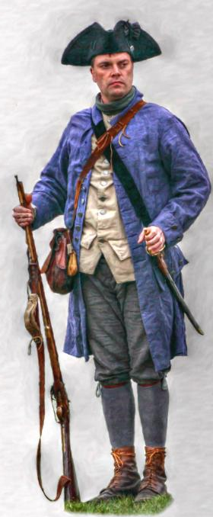
Life of common Revolutionary soldier
Life was extremely rough
Harsh winter conditions
Very few supplies and rations
Army was still in infancy- not much unity at this time

Slide 7
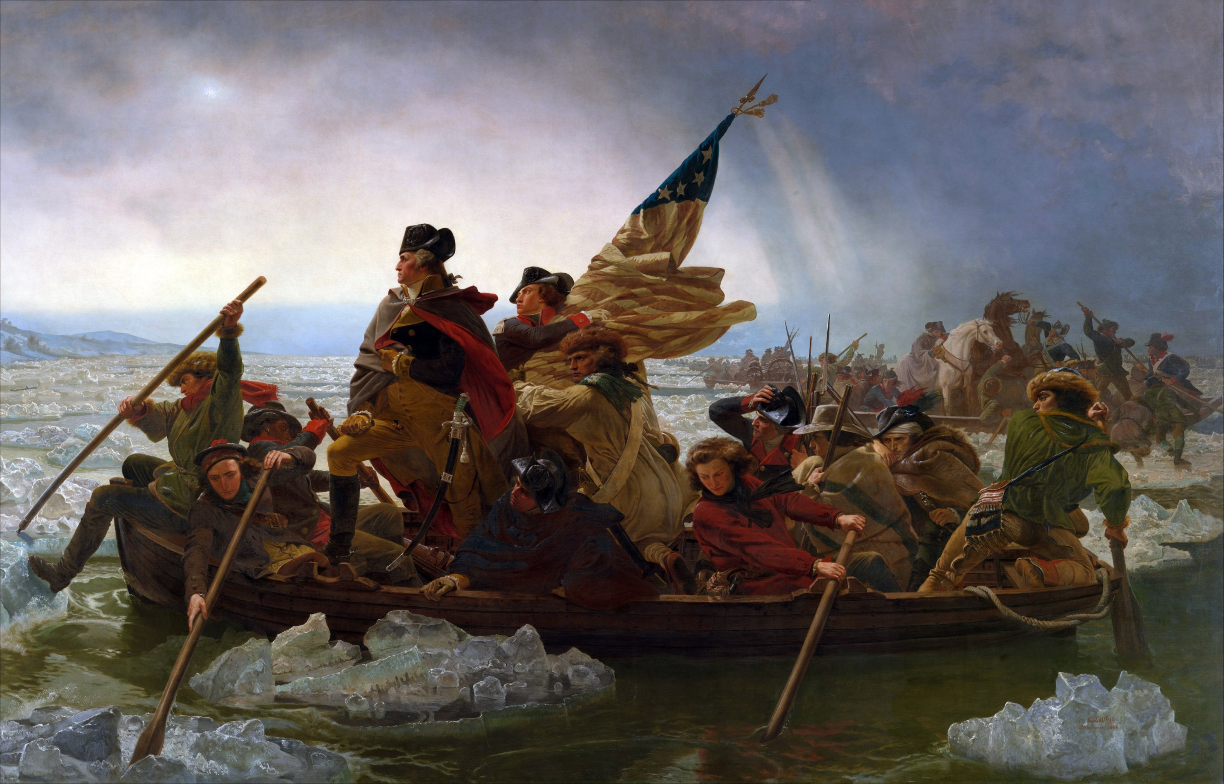
What do you see?

Slide 8
Crossing the Delware

Slide 9
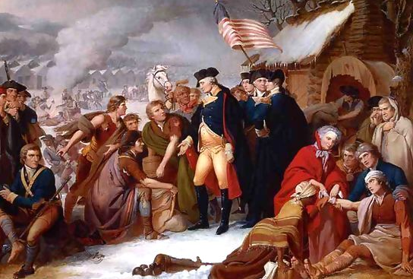
Valley Forge (winter 1777-78)
Name of George Washington’s troops’ camp
Three months of shortage and hardship
France entered the war on the side of the US. Valuable foreign soldiers came to Valley Forge.
Valley Forge was where a new, confident, professional American army was born. A vigorous, systematic training regime transformed ragged amateur troops into a confident 18th century military organization capable of beating the Red Coats in the open field of battle.
"An army of skeletons appeared before our eyes naked, starved, sick and discouraged," -New York's Gouvernor Morris of the Continental Congress.
Marquis de Lafayette- "The unfortunate soldiers were in want of everything; they had neither coats nor hats, nor shirts, nor shoes. Their feet and their legs froze until they were black, and it was often necessary to amputate them."
Notes:
Bloody footprints in the snow left by bootless men. Near naked soldiers wrapped in thin blankets huddled around a smoky fire of green wood. The plaintive chant from the starving: "We want meat! We want meat!“

Slide 10
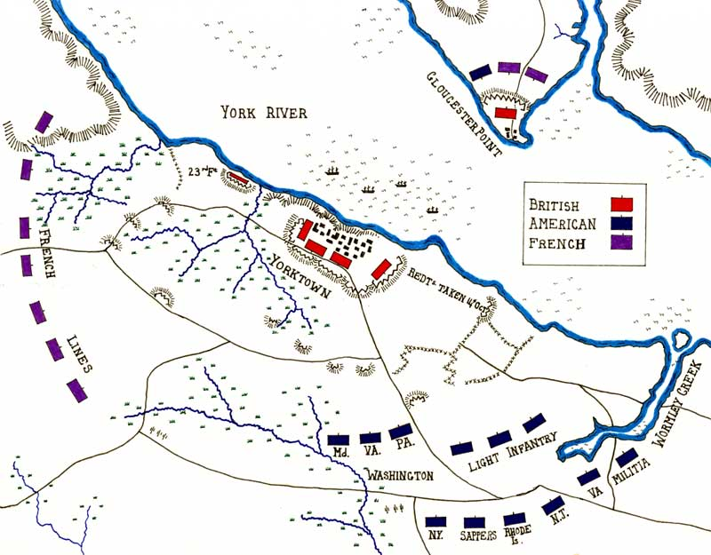
Yorktown and Cornwallis
Ambitious British general who led victories in the South.
His biggest mistake: Led 7,500 troops onto peninsula between James/York Rivers to camp at YORKTOWN.

Slide 11
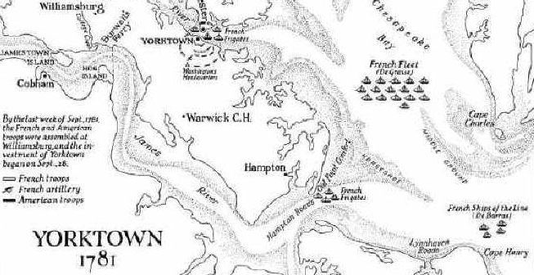
Yorktown
Troops under Cornwallis backed up against water
French Navy blockaded York River so British cannot re-supply or escape.
French and Colonial troops surrounded town
Cornwallis surrendered to French and American forces at Yorktown, VA October 1781.
Fighting ended but war not officially over until Treaty of Paris, Sept 1783

