Slide 1
Unit 2
Common Sense and the Declaration of Independence

Slide 2
Pick up a rubric in the blue chair in front
Then, look on the task board for your new seats. YOU MUST SIT IN YOUR NEW SEAT.
Please sit quietly and get out your notes packets
Reminders: No phones in class. No food in class. My room has been left a mess all week and that is going to come to an end.

Slide 3
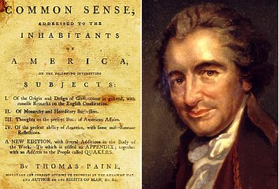
What is Common Sense?
inspired people in the 13 Colonies to declare and fight for independence from Great Britain in 1776
Explained advantages & need for immediate independence
in a style that common people understood- no quotes from ancient philosophers, used only Biblical references that common people would be familiar with

Slide 4
If the colonies continue increasing, it will become necessary to augment the number of representatives, and that the interest of every part of the colony may be attended to, it will be found best to divide the whole into convenient parts, each part sending its proper number
Small islands not capable of protecting themselves, are the proper objects for kingdoms to take under their care; but there is something very absurd, in supposing a continent to be perpetually governed by an island. In no instance hath nature made the satellite larger than its primary planet, and as England and America, with respect to each other, reverses the common order of nature, it is evident they belong to different systems: England to Europe, America to itself.

Slide 5
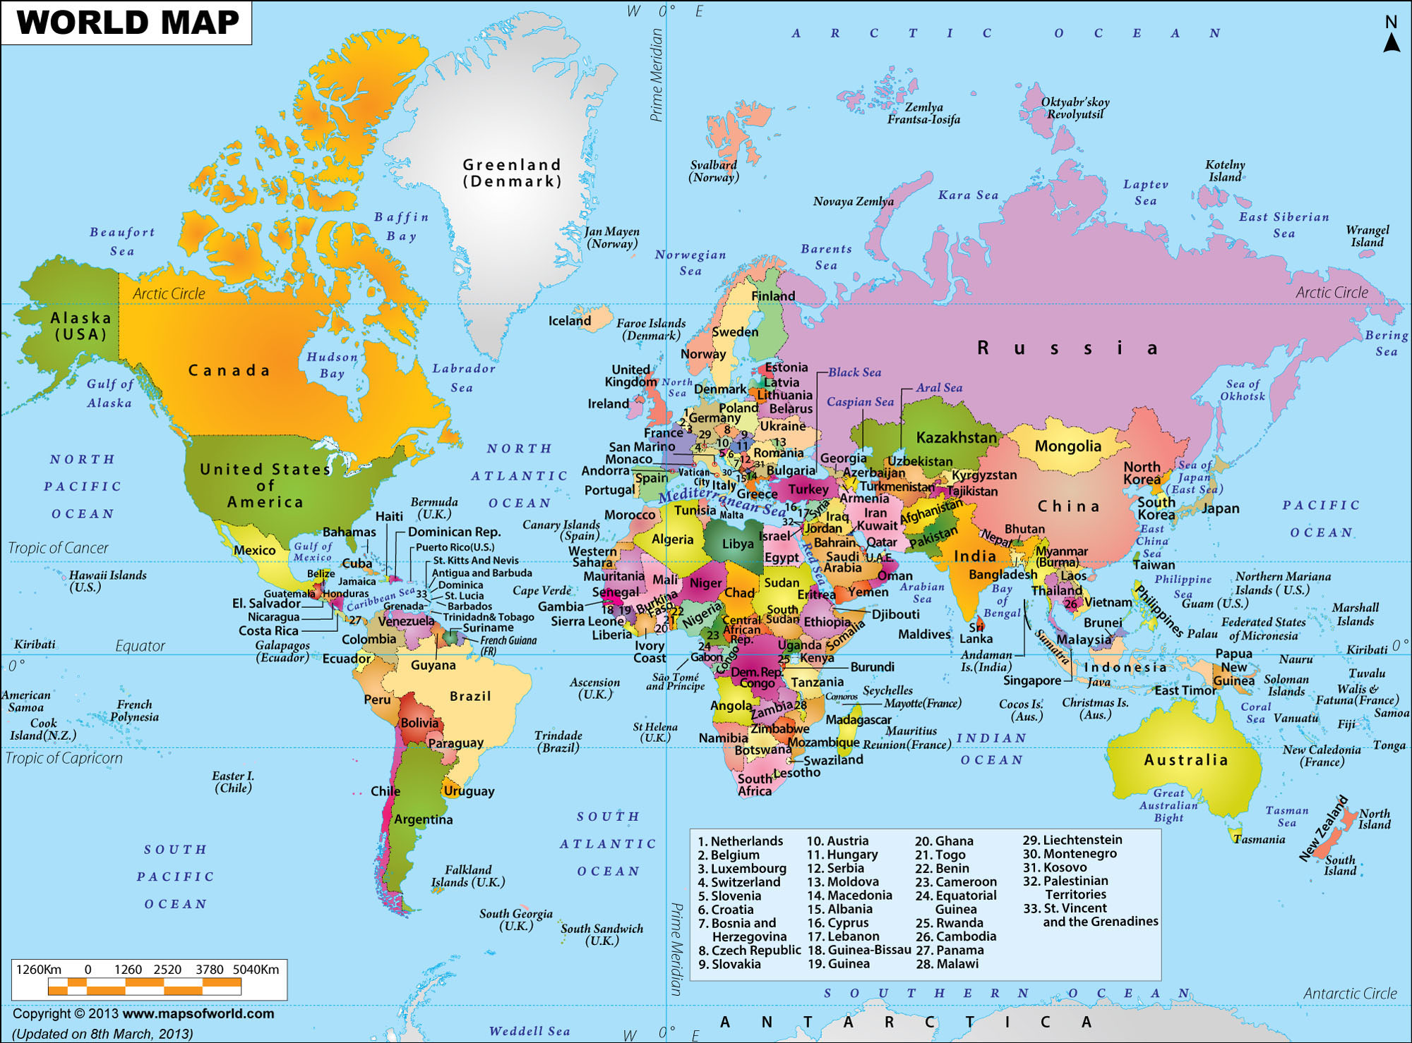

Slide 6
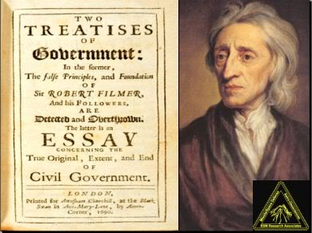
John Locke
Natural rights- (rights of all humans) rights are not contingent on the laws, customs, or beliefs of any particular culture or government, and are universal and inalienable (cannot be sold, transferred, or removed)
Contract theory- individuals have agreed to surrender some of their freedoms and submit to the authority of the government in exchange for protection of their remaining rights

Slide 7
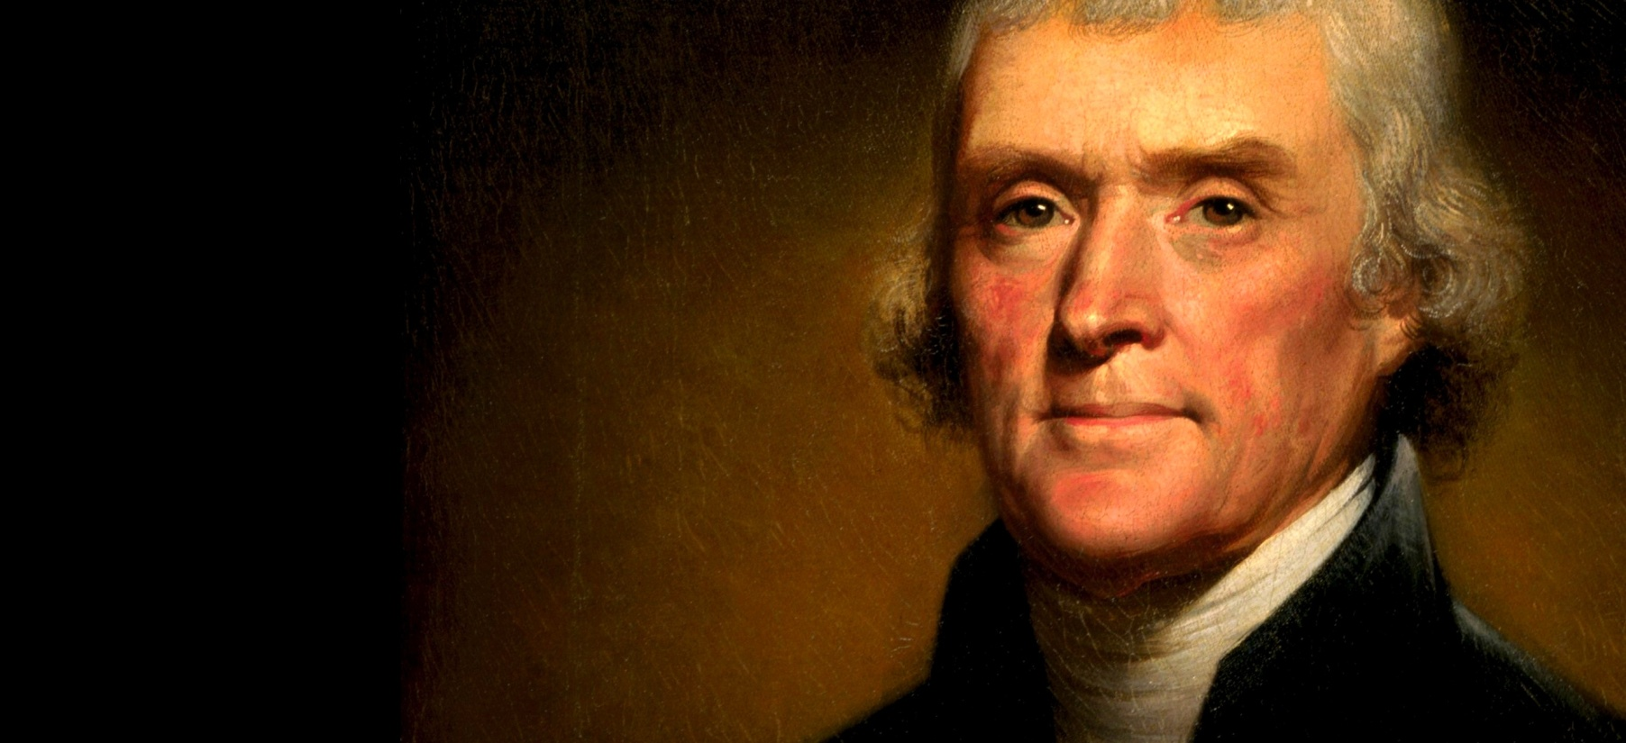
Thomas Jefferson
born in 1743 in Albemarle County, Virginia
In the Virginia House of Burgesses and the Continental Congress
Jefferson, at 33, drafted the Declaration of Independence.
He wrote a bill establishing religious freedom, enacted in 1786

Slide 8
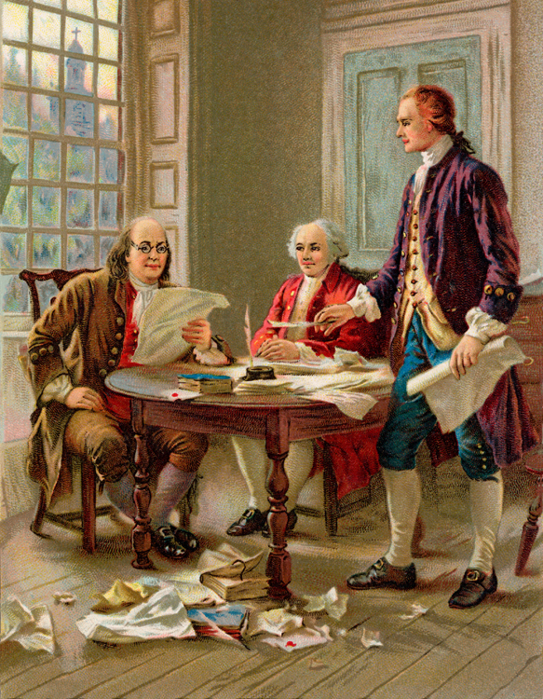
The Declaration of Independence
Drafted by Thomas Jefferson between June 11 and June 28, 1776
summarized "self-evident truths" and set forth a list of grievances against the King in order to justify before the world the breaking of ties between the colonies and the mother country

Slide 9
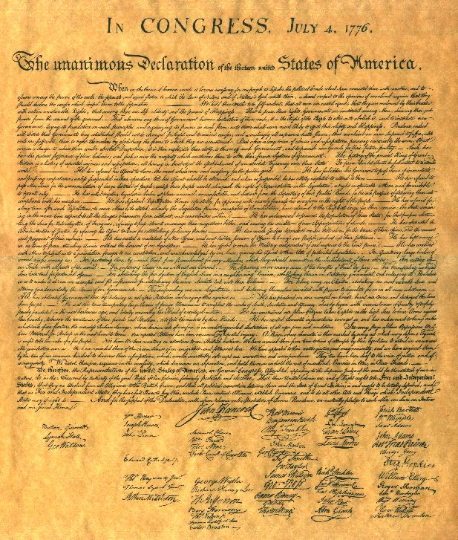
Signers of the Declaration
“There, I guess King George will be able to read that without his spectacles!” – John Hancock

Slide 10
3rd block
1st- move your desks into a large circle
2nd- You have 10 minutes to finish your Socratic discussion packets. I am taking them up right after our discussion.
3rd- Socratic discussion.

